Slide 1
Energy Options From Pacific Power
Blue Sky Blocks
$1.95/100kwh (typical home uses 500-1000kwh/mo)
Energy Source: 100% Wind.
Blue Sky Usage:
$0.0078/kwh (about 10%) above “regular” energy cost.
Energy Source: Wind 61%; Biomass 38%; Solar 1%
Habitat:
Rate the same as “Blue Sky Usage”
Energy Source: Wind 61%; Biomass 38%; Solar 1%
Additional ‘donation’ $2.50/month to The Nature Conservancy for restoration of native salmon habitat.

Slide 2
Get Help With Energy Consumption
Energy Trust of Oregon: Click here for Website
Help: Free home energy audit.
Cash rebates for solar water heating; Solar electric panels, more energy efficient heating
State of Oregon Help:
Tax credits to buy energy efficient appliances, solar electric panels and other things.
Click here for Energy Tax Credits
Local Electric Utility Help:
Electricity rebates and others for Energy Star purchases (and others—always check)

Slide 3
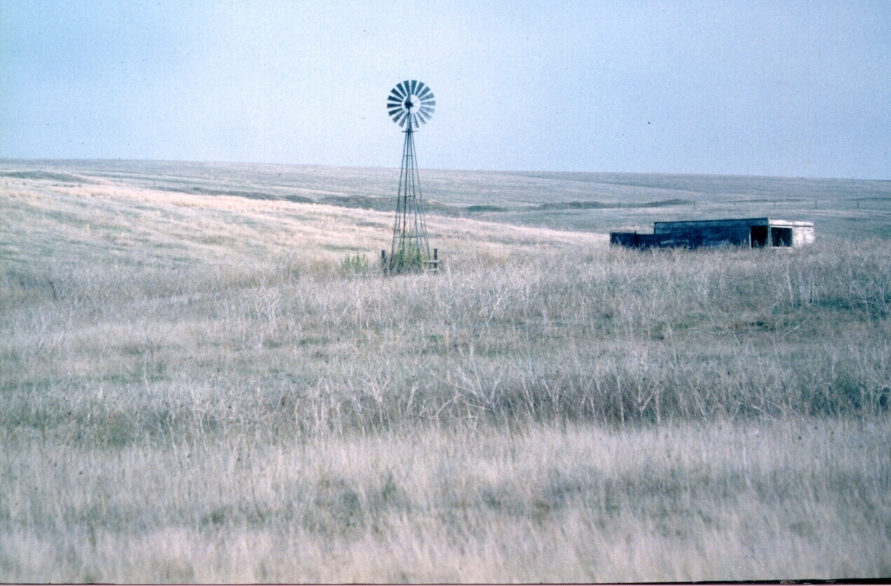
Wind Power

Slide 4
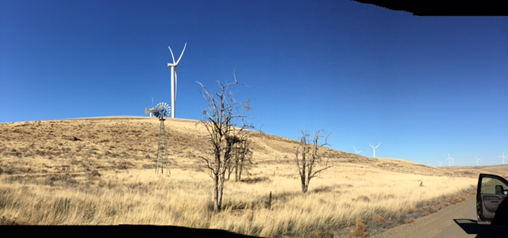
And out in our very own Morrow County*
Thanks to Morrow County student, Mary Rietmann for this photo

Slide 5
Why Wind Power?
Is Wind Power Competitive?
US Dept. of Energy “Levelized Costs of new generation facilities in 2022”
Hydropower 8.5 cents/kwh
New Wind 8.0 cents/kwh
New Coal 11 cents/kwh
New Natural Gas 6 cents/kwh
New Solar PV 2 cents/kwh
New Geothermal 4.8 cents/kwh
New Nuclear far above all others

Slide 6
Wind Power Advantages
It is perpetual
As long as the wind blows, you have energy inputs

Slide 7
Wind Power Advantages
It is perpetual
Wind speed increases during day as demand increases.

Slide 8
Wind Power Advantages
It is perpetual
Wind speed increases during day as demand increases
Turbines inexpensive and quick to install
2MW models cost about $2.5 million
Often less than a year from permit application to operating wind farm.

Slide 9
Wind Power Advantages
It is perpetual
Wind speed increases during day as demand increases
Turbines inexpensive and quick to install
Reduced Environmental Impacts
At least the operations. There are no free lunches—it takes resources to make these things and recycling at the end of their life.

Slide 10
Wind Power Advantages
It is perpetual
Wind speed increases during day as demand increases
Turbines inexpensive and quick to install
Reduced environmental impacts
Price stability
The wind is “free” it costs the same this year as the next, and the next, and the next.

Slide 11
Wind Power Advantages (con’t)
Reduced dependence on fossil fuel

Slide 12
Wind Power Advantages (con’t)
Reduced dependence on fossil fuel
More jobs per unit of energy

Slide 13
Wind Power Advantages (con’t)
Reduced dependence on fossil fuel
More jobs per unit of energy
Long-term income to ranchers and farmers

Slide 14
Wind Power Disadvantages
Wind must blow 2/3rds of the time

Slide 15
Wind Power Disadvantages
Wind must blow 2/3rds of the time
Need 15-18 mph constant wind

Slide 16
Wind Power Disadvantages
Wind must blow 2/3rds of the time
Need 15-18 mph constant wind
Often requires new infrastructure (powerlines)

Slide 17
Wind Power Disadvantages
Wind must blow 2/3rds of the time
Need 15-18 mph constant wind
Often requires new infrastructure (powerlines)
Chops birds and bats

Slide 18
Wind Power Disadvantages
Wind must blow 2/3rds of the time
Need 15-18 mph constant wind
Often requires new infrastructure (powerlines)
Chops birds
Noisy

Slide 19
Wind Power Disadvantages
Wind must blow 2/3rds of the time
Need 15-18 mph constant wind
Chops birds
Often requires new infrastructure (powerlines)
Noisy
Sight Pollution (all towers must have blinking lights)
Ugly?? Maybe more Surreal

Slide 20
Global Wind Installed Capacity-2015
The Big Five (in Gigawatts)

Slide 21
US vs World Wind Power (in Gigawatts) 2015

Slide 22
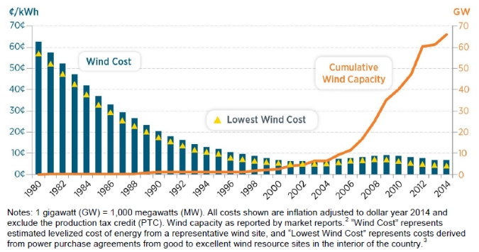
US Land Based Wind Installations 1980-2015

Slide 23
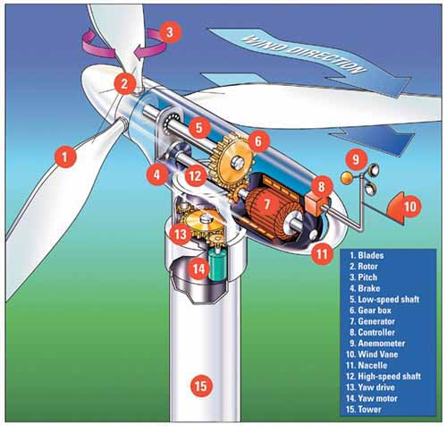
How a Wind Turbine Works

Slide 24
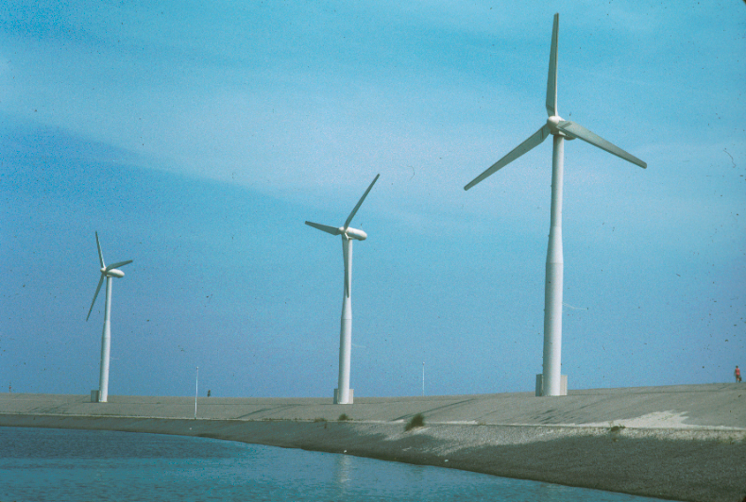
The Netherlands, 1992

Slide 25
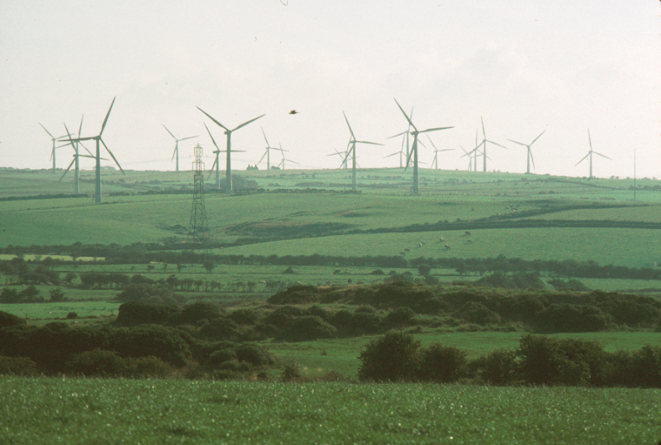
Anglesey, Wales, 2003

Slide 26
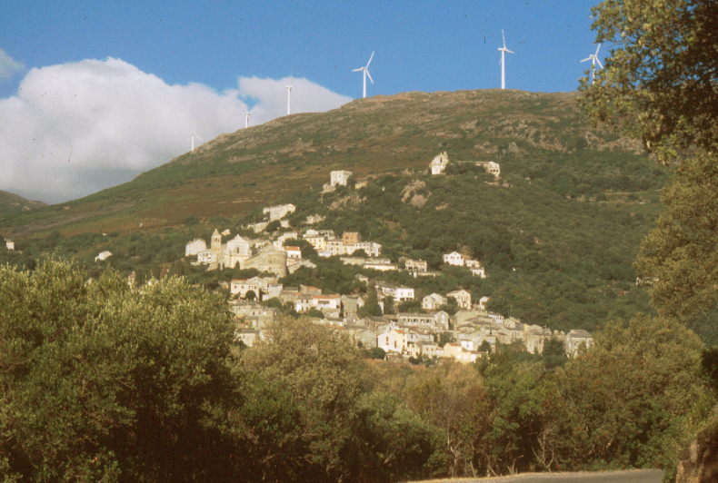
Corsica, 2005

Slide 27
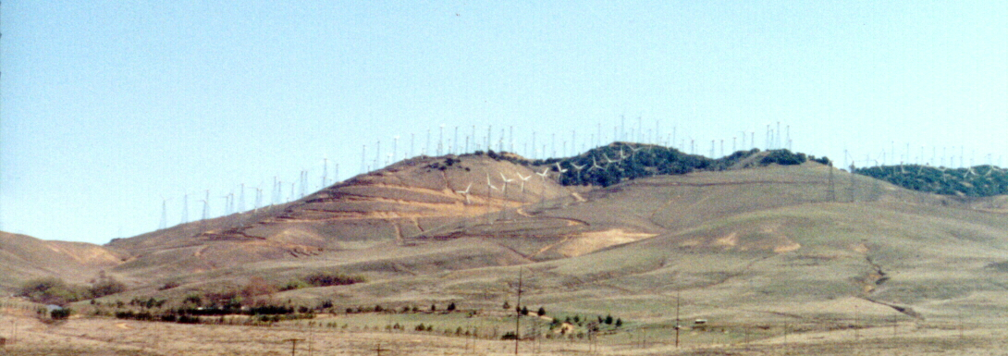
Tehachapi Pass, California, 2001
Bird Blender

Slide 28
????Megawatt????
A “Megawatt of “Installed Capacity” of Wind Generated Electricity is enough to power about 270 homes.
Currently in the US we are generating enough wind energy to power about 16.7
million homes.
This means that 82 million tons of CO₂ did not go into the atmosphere last year.

Slide 29
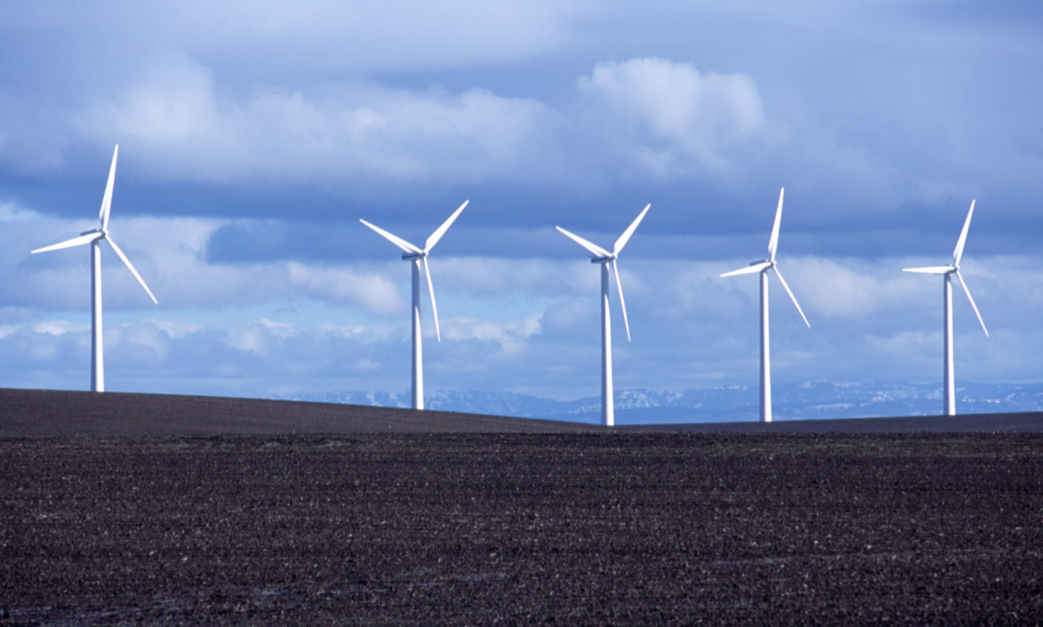
Installed and Potential Wind Capacity

Slide 30
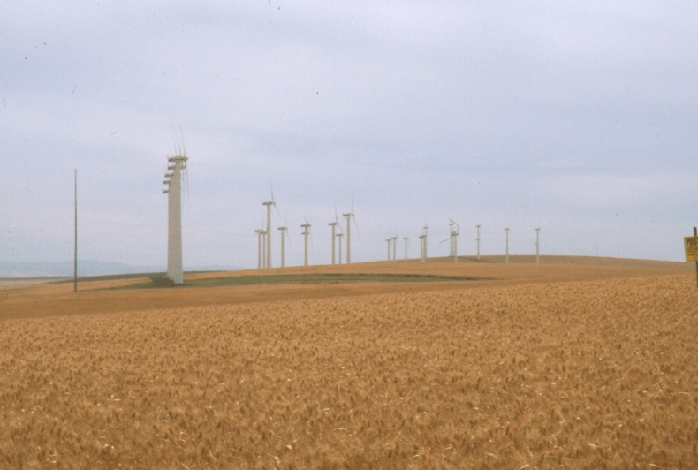
Vansycle Ridge Wind Farm; Northern Oregon

Slide 31
Current Wind Power
Currently meets almost 5% of US needs
Installed capacity increases:
50% in 2008
39% in 2009
5% in 2010
31% in 2011
60% in 2012
20% in 2013
9% in 2014
16% in 2015

Slide 32
Potential Wind E. in NW
--STATE--
Oregon
Washington
Idaho
Montana
--MEGAWATTS--
4,900
3,700
8,300
116,000

Slide 33
Oregon’s Power Future
2% of state suitable for Wind Generation (USDOE)
Could Oregon meet its needs with renewable energy—Hydro, Wind, Waves, Solar: both photovoltaic and concentrated solar? Perhaps if coupled with an increase in efficiency of existing buildings, etc.

Slide 34
Coal vs Wind
Coal:
* A 60 watt Incandescent light burning for non-stop for one year requires 427 pounds of coal.
* Converting that coal to energy produces:
3 lbs of sulfur dioxide (acid rain base)
3 lbs of nitrogen oxide (smog and acid rain base)
1112 pounds of carbon dioxide (greenhouse gas)
Wind:
* A single 2 MW wind turbine would only have to spin for 50 minutes to power that light bulb for a year.
Incandescent versus Compact Fluorescent Bulbs
* A single 2 MW wind turbine would have to spin for 12
minutes to power an equivalent size compact fluorescent bulb for a year and about 8 minutes for a LED bulb.

Slide 35
Wind Power “Battery”
Since wind doesn’t always blow at any given site it always requires a backup, often coal, hydro, gas.
Creative Solution: Underground sequestration of compressed air. Costs 6.5 cents/kWh to produce off peak; sell at 10 cents/kWh peak—

Slide 36
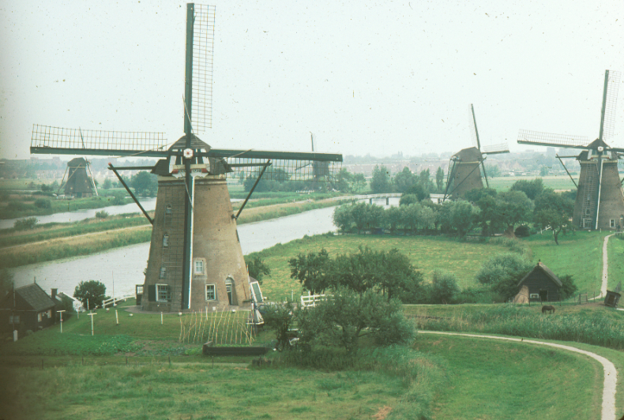

Slide 37
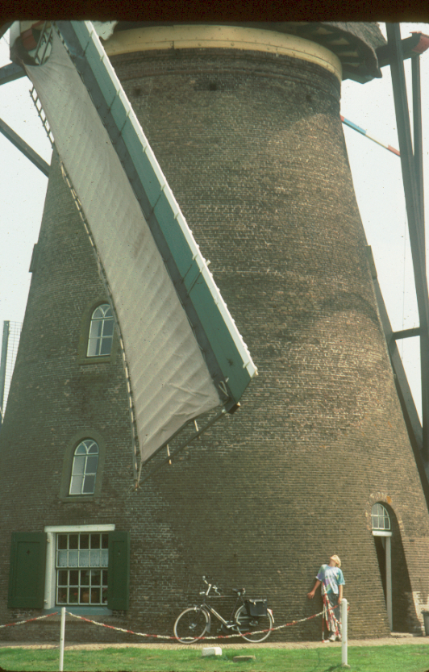

Slide 44
Global Wind Energy 2012* The big 5 *(In Gigawatts)

Slide 45
U.S. vs World Wind Power 2012* *(In Gigawatts)

Slide 46
Global Wind Energy (Gigawatts) 2013--The Big Five

