Slide 1
Geo 300: Sustainability for the Common Good
Winter 2015 OREGON STATE UNIVERSITY

Slide 2
About your Teaching Assistants
Yami Colon-Almodovar
colonaly@onid.oregonstate.edu
Office: Wilkinson 213
Office Hours: M 10-11, Tues 5-6
Mailbox: WILK 104
Major: MS-Geography
Sandra Huynh
huynhsa@onid.oregonstate.edu
Office: Weniger 332
Office Hours: M 3-4, F 11-12
Mailbox: WILK 104
Major: MS-Marine Resource Management

Slide 3
About your Teaching Assistants
Libby Morrison
morrisel@onid.oregonstate.edu
Office: Wilkinson 027
Office Hours: M 3-4, Tues 12-1
Mailbox: WILK 104
Major: MS- Geography and Water Policy
Melva Treviño
geo300melva@gmail.com
Office: Wilkinson 213
Office Hours: W 4-5, F 11-12
Mailbox: WILK 104
Major: PhD- Geography

Slide 4
Today
General expectations
Group projects
Energize Corvallis
Critical Thinking Papers

Slide 5
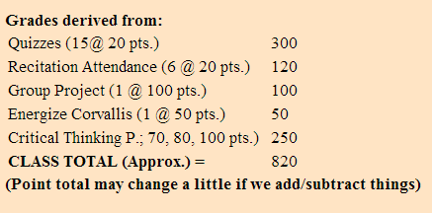
Why attend recitation?
All of this is done in recitation!
And go to lecture! Quiz points add up, too.

Slide 6
General Expectations
Check the syllabus or GEO 300 website for assignments that will be due in recitation
Participation (actively involved, no texting or rude chatter, etc.)
Email etiquette:
Include the TA name and recitation day and time

Slide 7
Recitation Schedule
Week 1
Introduction and Critical Thinking papers
Week 3
Critical Thinking paper workshop
Bring final draft of CT #1 for peer review (you need to have a draft for review or you won’t get recitation points)
Weeks 7, 8, 9, and 10
Group project workdays and presentations
All other weeks will be lectures.
Remember – your recitation attendance counts towards your overall grade.
Please let me know in advance (by email) if you will be unable to attend and a make-up assignment will be given to you.

Slide 8
Makeup Work/Absences
MAKEUP WORK/EXTRA CREDIT intended for those who miss a class or assignment, but open to anyone. Look at the "Extra Credit Opportunities" link.
Up to 40 points for participating in these activities/events.
One bonus point for each assignment printed double sided or on used paper.
Emergency Absences. For family or personal emergencies, please contact Professor as soon as possible to address missed assignments.
School Related Absences. Contact the Professor BEFORE THE ABSENCE to arrange credit for the missed assignment.
*All extra credit is turned in to your PROFESSOR, not the TA

Slide 9
Group Projects
You should have signed up for a project by now!
100 points
Time to meet your group members and choose a group leader
Group leaders:
must reach the contact person for your project within the next WEEK
Cc: YOUR TA when you email the contact person
Payoff: Group Leader not expected to participate in the paper or oral presentation

Slide 10
Group Projects
Presentations during last few weeks of recitation
More information on GEO 300 website
http://www.geo.oregonstate.edu/classes/geo300/gpw15.html

Slide 11
Energize Corvallis
50 points
1 month project
DUE: February 27, 2015
What does that mean? Begin early! Begin now!
See GEO 300 website for more instructions
http://www.geo.oregonstate.edu/classes/geo300/EnergizeCorvallis.html

Slide 12
Critical Thinking Papers
These papers are designed to help you become better researchers and writers in the process of investigating topics related to the course. They also have the added benefit of reducing stress as there are no exams in the course. These papers follow a rigid Critical Thinking format; concise writing and exact length; accurate and appropriate use of sources, cited properly, including a complete, properly formatted Reference/Works Cited section. Finally we require high quality writing.
They get progressively more valuable. CT # 1 = 70 points; CT # 2 = 80 points; CT # 3 = 100 points

Slide 13
Why Critical Thinking Papers?
Reflection of real-world writing and reports.
Lets you explore various topics in sustainability at a deep, intellectual level.
Teaches you how to make a concise, impactful point.
Exposes you to peer-reviewed literature.
Strict format of CT papers is relevant to real-world job experience.

Slide 14
Critical Thinking Papers
Three CT Papers, valued at 70pts, 80pts, and 100pts
Instructions and tips to help you succeed on GEO 300 website
Click on “Critical Thinking Papers” link (http://www.geo.oregonstate.edu/classes/geo300/ctw15.html)
Topics for CT Paper # 1
“Main” topic is dependent on last digit of your OSU ID number
“Final” topic: your choice from a few sub-topics

Slide 15
Example topic…
0-1. Human Population Increase is the biggest threat to long-term sustainability of the Earth? (Support or oppose this statement)
You have a small list of topics to choose from based on your ID number – find them on the GEO 300 website.
(http://www.geo.oregonstate.edu/classes/geo300/ctw15.html )

Slide 16
CT Paper Format
Heading
Title
Interpretation*
Analysis*
Evaluation*
Inference*
Explanation*
Self-regulation*
List of References/Works-cited/Bibliography
*These six sections MUST include word count sub-total
The entire paper must have between 500 and 550 words.
The analysis section must have between 400 and 450 words.
The other sections must have between 100 and 150 words combined.
Notes:
Each section heading must have the word count next to it.
Each section must appear in the paper in the order listed above and must be labeled as such.
If the above directions are not followed, you will get a zero.
Also must include a literature cited section (more on this later)
Literature cited does not factor into your word count

Slide 17
Heading
Include
Example
Name
Student ID #
GEO 300
Recitation day/time (W8, F10, F12, F3)
TA Name
CT# and due date
Question number (from the topics)
Word count total
Anne Chovy
000-000-000
GEO 300, W8
TA: Tom Ato
CT#1 due 10/17/14
Question number 0-1
Word Count: 550

Slide 18
Title
Instructions
Good Examples:
I should be able to tell your topic and your position from the title.
“The Earth’s sustainability is threatened by interactions between several different factors”
“Emerging Global Middle-Class Poses Greater Threat to Sustainability than World’s Elites”
Bad Examples:
“Population and sustainability”
“Society Classes and Sustainability”

Slide 19
Interpretation
Instructions
Example
This is your very short introduction paragraph.
Introduce why the topic is important, explain it very simply (if needed), and then conclude with your thesis statement.
Thesis statement: your argument/position on the topic and how you will support your position.** Include paragraph topics if necessary!
Interpretation (54 words*)
An ideal battery is able to control a high energy output based on demand, has an infinite capacity and is economically satisfactory. Pumped-storage plants are promoted as efficient batteries because they have the ability to utilize demand based on energy consumption rates, have large capacities and are an economically viable way to store energy.
*Interpretations can be shorter than this.
** It doesn’t matter what your opinion is, only that you support it with a well-written essay that follows the instructions.
Notes:
It doesn’t matter what your opinion is, only that you support it.

Slide 20
Analysis
Section MUST be between 400 and 450 words
Use peer-reviewed literature to form an argument and support your position *
Come up with 2 or 3 main points for your argument
Write a short paragraph for each one, citing your PR literature
Don’t just regurgitate info taken from sources – make an argument.
Examples:
1) The size of the emerging global middle-class (relative to the world’s elites) makes it a large threat to sustainability.
2) Middle-class citizens consume more products, leading to negative impacts on sustainability.
3) Middle-class citizens also eat more meat, which has a large ecological footprint.
* Each point supports the position that the emerging middle-class poses a greater threat to sustainability than the world’s elites.
Notes:
Ask yourself if each of your points supports your position.
If one doesn’t, get rid of it and replace it with a new one.

Slide 21
Example Analysis
Analysis (403 words)
The relationship between population, consumption, and technology can be modeled by the equation I=PAT where I is the human impact on the environment, P is population, A is affluence or consumption, and T is technology (Ehrlich and Goulder, 2007:page 1146). Population, affluence and consumption, and technology all interact to produce humanity’s environmental impact such that one alone cannot be identified as the primary threat.
Ecological footprint analysis reveals that the current human population is large enough and living in such a way that to maintain the current standards of living and current population would require approximately an additional half of an Earth’s worth of resources (Ehrlich and Ehrlich, 2013:paragraph 4). Additionally, many demographers agree that the world’s human population will increase to and level off at approximately 9-10 billion individuals by the end of this century (Lutz, Sanderson , and Scherbov, 2001:page 543). This population increase will necessarily increase the resources required to continue living sustainably on Earth – however, since the current population of roughly 7 billion people already cannot live sustainably with the resources at hand, the threat to sustainability comes primarily from a large population, not growth.
Identify your main points

Slide 22
Example Analysis (con’t)
GDP per capita is often used as a proxy to represent consumption, and in the previous century the world’s GDP has increased 1655% (Krausmann et al., 2013:page 10325). Krausmann et al. (2013:page 10328) also find that the world’s GDP is likely to continue to grow in the coming decades. There are numerous environmental impacts of increased consumption, including: the loss of vital ecosystem services, decreased biodiversity, and disruptions to biogeochemical cycles, among others (Krausmann et al., 2013:page 10325). Brown et al (2011:pages 19-26) find that the world’s GDP is also closely linked to energy usage and that developing nations’ energy needs increase dramatically as their GDP increases. The projected increase in energy use and consumption in the developing world will further decrease humanity’s ability to sustain the current average standard of living in the near future as energy reserves dwindle and ecosystem processes fail.
Unlike population and consumption, the technological impact of humanity on the environment has been decreasing or has remained over the past few decades (The World Bank 2003:page 148). However, to offset the projected increases in population and consumption, humanity’s technological impact on the environment would have to decrease drastically, far more than any predictions indicate (The World Bank 2003:page 122).
Cite your sources.

Slide 23
Example Analysis (con’t)
Don’t just regurgitate info taken from sources – make an argument.
Ecological footprint analysis reveals that the current human population is large enough and living in such a way that to maintain the current standards of living and current population would require approximately an additional half of an Earth’s worth of resources (Ehrlich and Ehrlich, 2013:paragraph 4). Additionally, many demographers agree that the world’s human population will increase to and level off at approximately 9-10 billion individuals by the end of this century (Lutz, Sanderson, and Scherbov, 2001:page 543). This population increase will necessarily increase the resources required to continue living sustainably on Earth – however, since the current population of roughly 7 billion people already cannot live sustainably with the resources at hand, the threat to sustainability comes primarily from a large population, not growth.

Slide 24
Evaluation
Instructions
Example
Write a sentence or two explaining the bias of authors of at least TWO of your sources.
OR explain why some of your sources may have other mistakes.
Tip: Look for authors’ bios. Where did they work? Who funded their research? (Be careful about this part! Please ask if you are unsure.)
When mentioning the bias, indicate how they might be biased.
Evaluation (26 words)
“Many of the sources use future population and consumption projections with large amounts of error but draw conclusions exclusively based on narrow bands of those projections.”
Evaluation (17 words)
“Some of the sources were statistical analyses from previous years, thus the values presented may have changed.”
Evaluation (20 words)
“Author1 and Author2 both work for such and such organization(s), so their research advocates the organization’s cause and is biased.”

Slide 25
Inference
Instructions
Example
If your topic is a global one: does it have local consequences that you haven’t addressed?
If your topic is a local one: does it have global consequences that you haven’t addressed?
Inference (22 words)
“Consumption and available technology vary significantly between different countries, so broadly drawn conclusions may be inaccurate for countries on either extreme end.”
or
“Since pumped-storage facilities are renewable systems, they are a viable option in reducing emissions globally by replacing non-renewable energy processes.”

Slide 26
Explanation
Instructions
Example
Concise conclusion
One sentence to one paragraph
Remind us of your thesis statement again.
Summarize the findings that support your point of view
What was the main point? And briefly, what were your analysis topics?
Explanation (31 words)
“The sustainability of the Earth is threatened by the large human population, their consumption, and various technologies that impact the environment. The primacy of one factor over another cannot be established.”
Explanation (28 words)
“In conclusion, pumped-storage is an efficient battery because it controls energy output based on demand, has large capacities and is an economically beneficial method of storing energy.”

Slide 27
Self-regulation
Instructions
Example
Think of your own bias.
Why did you take the position you did?
How did you feel/What did you know about the topic before your literature search?
Self-Regulation (31 words)
“My bias is that I approached this paper already believing in the changing Christian attitude.”
Self-Regulation (21 words)
“I grew up always recycling old clothing, so I am biased in that I had a personal history with the issue.”
Self-Regulation (18 words)
“My bias in favor of sustainable initiatives is a result of my education and familiarity with environmental issues.”

Slide 28
References/Works-cited
Your analysis must include at least 4 relevant references to peer-reviewed journal articles and/or books from the 21st century
21st century = 2000-2015!
Can have more that do not meet the above criteria
What does peer-reviewed mean?
The article is not published until it’s been reviewed by other scientists
What does it not mean?
Magazine articles
Newspaper articles
Your favorite website (including Wikipedia, obviously)
Do not distinguish between peer-reviewed and non peer-reviewed sources. If you list your references in a correct format, then your TA can tell the difference between the sources. Your TA looks very closely at these sources...AVOID A ZERO!

Slide 29
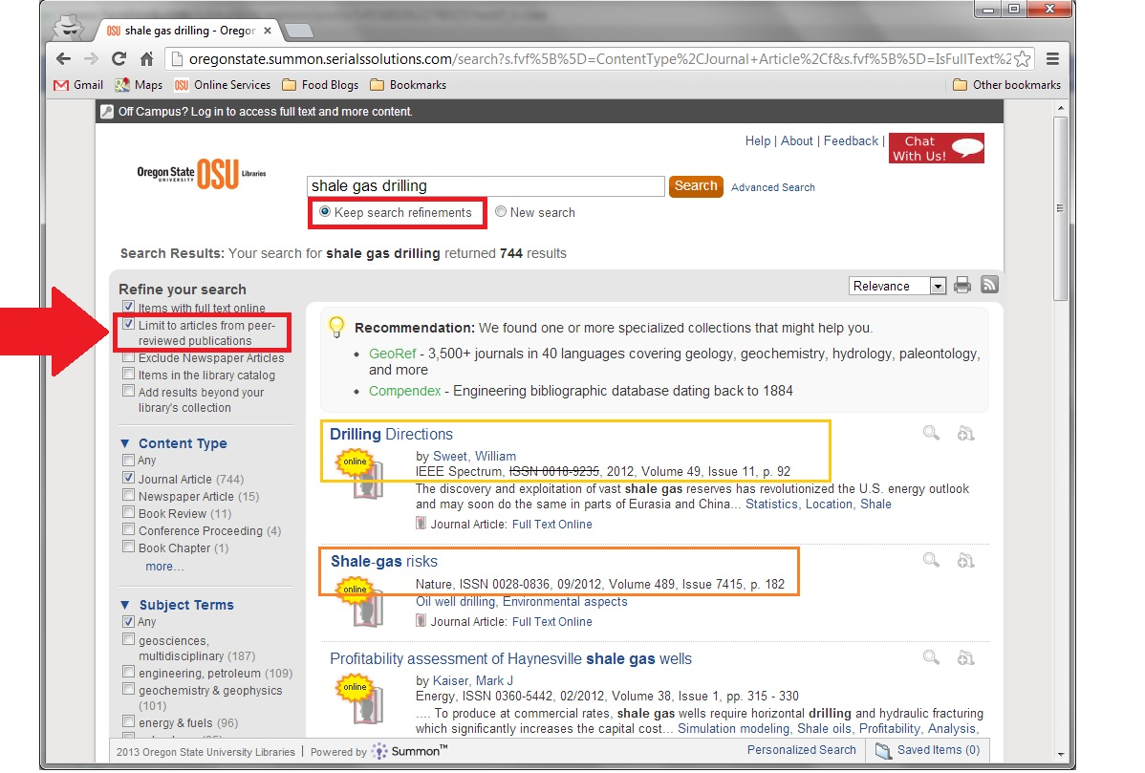
Finding Peer Reviewed Sources
Acceptable Sources:
books or PR journal articles
published from 2000-2015
Good Source
(PR, has all the info you need)
Not Great, but Okay
(no author- real PR articles are longer & have authors listed… but this is acceptable as long as it comes up in the PR search)

Slide 30
Using EBSCO: TA’s preferred method
OSU libraries→ “Find it” drop down menu, click “Databases” or http://osulibrary.oregonstate.edu/research-databases → Find “EBSCOhost”
Once on EBSCO:
Check “select/deselect all” to select all, then click “continue”
Check the boxes for “Scholarly (peer-reviewed) journals” and “Full text”
Adjust the dates to 2000-2015
Type in key words from your topic and search

Slide 31
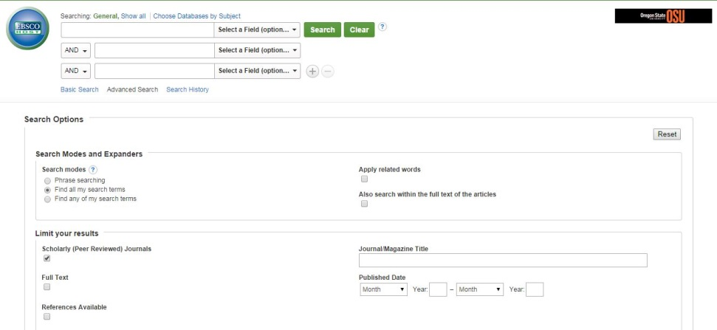
Using EBSCO
Check these two boxes to make sure you yield peer-reviewed results and full text so you can read the articles.
2000-2015

Slide 32
What about government sources? The UN?
US Government publications*** ARE peer-reviewed.
UN publications*** ARE peer-reviewed.
Other agencies: depends. If you want to rely on one, make SURE it’s peer-reviewed.
Publications from other governments: I don’t know. It is your responsibility to make sure their publications are peer-reviewed. If you cannot find a definitive, reputable source saying they are, assume they are NOT.
***Publications: NOT brochures, NOT websites, NOT facts pages...These sources still need to have an abstract and references. They look like other scholarly work; they just happen to be published by the government instead of a journal.

Slide 33
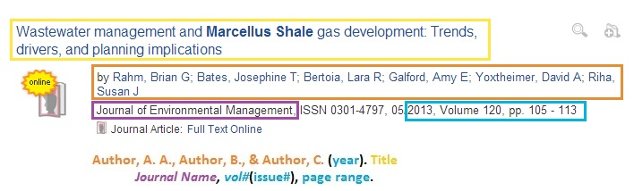
Listing your References
Reference listing:
If 7 or fewer authors, must list all
Rahm, B. G., Bates, J. T., Bertoia, L. R., Galford, A. E., Yoxtheimer, D. A., & Riha, S. J. (2013). Wastewater management and Marcellus Shale gas development: Trends, drivers, and planning implications. Journal of Environmental Management, 120, 105-113.
In text:
More than 5 authors, use et al. every time
Here, I summarized information from the article in my own words or I got the information to come up with the idea for this sentence from a certain article (Rahm et al., 2013:p. 110-111).

Slide 34
Reference List/Literature Cited
Pay attention to:
Capitalization of title
Capitalization of Journal Name
Italicize Journal Name & Vol. #
Keep list of authors in the same order as they appear in the article
Alphabetize the listings in your Works Cited by first author’s last name, NOT by order of appearance

Slide 35
In-Text Citations
A Work by Two Authors:
Research by Wegener and Petty (2004:p. 117) supports...
Research shows that… (Wegener & Petty, 2004:p. 117)
A Work by Three to Five Authors
List all the authors in the signal phrase or in parentheses the first time you cite the source.
(Kernis, Cornell, Sun, Berry, & Harlow, 2003:pp. 33-37)
In subsequent citations, only use the first author's last name followed by "et al." in the signal phrase or in parentheses
(Kernis et al., 2003:p. 39).
In et al., et should not be followed by a period.
Six or More Authors:
Use the first author's name followed by et al. in the signal phrase or in parentheses.
Harris et al. (2001:p. 221) argued...
Researchers argue that…(Harris et al., 2001:pp. 221-223)
For ALL citations: add the page number(s) on which you found the info (needs to match article page interval).
Punctuation goes AFTER the citation (Watson, 2013; p. 452).
Source: Purdue OWL for APA

Slide 36
When Using In-Text Citations
AVOID: Watson (2012; pg. 1) argues that “using lots of quotations can be tedious for the reader, especially when the exact wording of the idea is not particularly important.”
Not plagiarized, but it would flow better if paraphrased.
PLAGIARISM: Using lots of quotations can be tedious for the reader, and thus, we should paraphrase (Watson, 2012; p. 1).
Did not use quotation marks around the quoted part
PLAGIARISM: Especially tedious for most readers is when authors use too many direct quotes, particularly when the ideas do not have to be worded in a specific way.
Used an idea from a source, but did not cite it
BETTER, but still avoid: Watson (2012; pg. 1) argues that direct quotations can be superfluous.
Paraphrased… but in these papers, we don’t want you to waste space talking about the authors.
Instead, simply paraphrase the results that support your position.
BEST: Direct quotations complicate essays unnecessarily (Watson, 2012; p. 1). Paraphrasing helps your ideas flow more smoothly.

Slide 37
Avoid Getting a Zero: IMPORTANT
How to avoid the zero.
There are four ways to guarantee yourself a ZERO SCORE on the paper
Cite at least 4 peer-reviewed sources from 2000 to 2015
Cite every fact or idea you use with an in-text citation and reference listing. Don’t copy-paste ANYTHING or copy exact wording.
Must be 400-450 words in Analysis and 100-150 words in all other sections combined… Make sure the TOTAL doesn’t add up to more than 550 (nor can it be less than 500).
Use headings, and don’t forget any sections.
1. Unacceptable sources.
2. Not properly citing all four of your primary sources in the text of your paper.
3. Not meeting the word counts.
4. Not using the required format, i.e., Interpretation, Analysis, Evaluation, etc.

Slide 38
Learning to be concise: It’s hard.
Before: 70 words
After: 52 words
In the last decade, natural gas extraction in the Marcellus Shale region became economically profitable due to advances in hydrofracturing (also: hydrofracking, fracking) technology. Hydrofracking involves injecting high-pressured water solution into the ground, thus breaking the shale and releasing pockets of gas. Hydrofracking has led to a boom in development. However, because hydrofracking is unproven and potentially harmful to both humans and the environment, policymakers must exercise the precautionary principle.
Recently, natural gas extraction in the Marcellus Shale region became economically profitable due to advances in hydrofracturing, which involves injecting high-pressured water solution into the ground to break shale and release gas. However, because hydrofracking is unproven and potentially harmful to both humans and the environment, policymakers must exercise the precautionary principle.

Slide 39
Word count flexibility
Section titles and citations are OPTIONAL for your word count.
MUST be consistent within the entire paper (cannot count one citation and not another. Cannot count one section title and not another).
Paper title is NOT COUNTED in the word count (not flexible)
Heading is NOT COUNTED in the word count (not flexible)
Section title word counts are NOT COUNTED in the word count (not flexible).
You do not have to indicate to me what you chose
You cannot ‘change your mind’ after you have turned it in

Slide 40
Word count flexibility example
Interpretation (37 words)
Most research indicates that it is human population, resource overconsumption, and technology that threaten the sustainability of the Earth. Given the interconnectedness of these factors, it is impossible to identify human population alone as the biggest threat.
Interpretation (38 words)
Most research indicates that it is human population, resource overconsumption, and technology that threaten the sustainability of the Earth. Given the interconnectedness of these factors, it is impossible to identify human population alone as the biggest threat.
Interpretation (40 words)
Most research indicates that it is human population, resource overconsumption, and technology that threaten the sustainability of the Earth. Given the interconnectedness of these factors, it is impossible to identify human population alone as the biggest threat.

Slide 41
Process
Start by finding literature on your topic (before you even start writing)
Decide on your position (I recommend already having 4+ acceptable sources before even starting to write)
Write your title last.
Content emphasis on analysis section – make sure you form a coherent argument!
Don’t worry about word count until editing.

Slide 42
Other CT logistics
CT papers must be typed! Handwritten papers will not be accepted.
CT papers must be printed double-sided or on reused paper.
You will get 1 bonus point if your paper is printed double-sided or on reused paper, and you will lose 2 points if it is not.
CT papers must have the grading sheet attached.
Or you will lose 15 points.
Grading sheet must be initialed, or you will lose 5 points.
*Bring a final copy to Week 3 recitation (with grading sheet!)

Slide 43
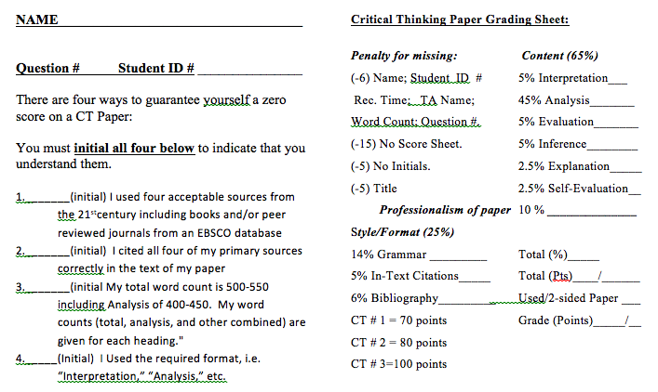
CT grading
*CT 2 AND 3 have different grade sheets. See GEO 300 website.

Slide 44
The Contract
I understand that I will receive an undisputable zero score on my CT paper:
If I have more than 550 total words in my paper
If my analysis section is less than 400 or greater than 450 words
If my other combined sections (besides analysis) have word counts less than 100 or greater than 150
If I do not reference at least four peer-reviewed sources (journal articles or books) published between 2000 and 2015
If I don’t cite all my sources correctly in the body of my paper, or if I plagiarize
If I do not follow the format of the paper (with all the appropriate sections and subheadings)
Furthermore, I understand that:
Newspapers, magazines, and websites are not peer-reviewed sources.
Not every source on EBSCO or OSU libraries is peer-reviewed, and I must take precautions to narrow the search to PR-only sources.
The “ways to get a zero” (word count limits, PR source requirements) are completely rigid and inflexible.
E.g. If I cite 1 of 4 sources from 1999, I have failed to meet the PR source requirement, and I will get a zero on my paper.
Not realizing that I didn’t meet the requirements (a bad source I thought was good, a miscalculated word count, etc.) does not exempt me from the zero score.
Signing up for this class means that I am beholden to the course/assignment rules, and staying in the class implies that the rules apply to me. I can drop the class if I do not like the rules, but the rules will not be changed for me.
My TA wants to help me succeed, and she can provide lots of helpful feedback BEFORE I turn in my paper.
My sad story (“but I won’t be able to graduate!” “but I will lose my scholarship!” ) will make my TA very sad, but she will not be able to [she is not allowed to] change my score out of pity.
Thus, I verify that:
I, and I alone (not my TA or anyone else), am responsible for my score on CT papers.
I will do everything in my power to avoid a zero and submit papers that meet all requirements.
I will get help before the paper is due rather than after.
I won’t beg for a score if I get a zero, but instead will learn from my mistakes and do better next time.
I won’t harass Steve/my TA about these rules, because I have full knowledge of them ahead of time, and I am voluntarily remaining in the class anyways.

Slide 45
If you need help...
Seek it BEFORE the paper is due.
Don’t try to fix what’s already been graded.
If anything is unclear, don’t hesitate to contact your TA. It’s what we’re here to do!
Questions?

