Slide 2
My Corvallis Home on 23rd Street
2001 gray water irrigation system
2005 solar collector water heaters
2006 Rainwater collection system
2009-2011 PV solar system
2013 Heat Pump Water Heater

Slide 3
Graywater Irrigation System
Water collected from Bathroom sink, Tub/Shower, and Clothes Washer. Oregon DEQ adds kitchen sink. Bad idea, I think, too much garbage disposal organic gunk to rot in back yard.
2-55 gallon barrels buried in the ground
“Sump Pump” with float switch
Lines to water raspberries, rhubarb, some shrubs
Cost about $150. Saved that much first year

Slide 4
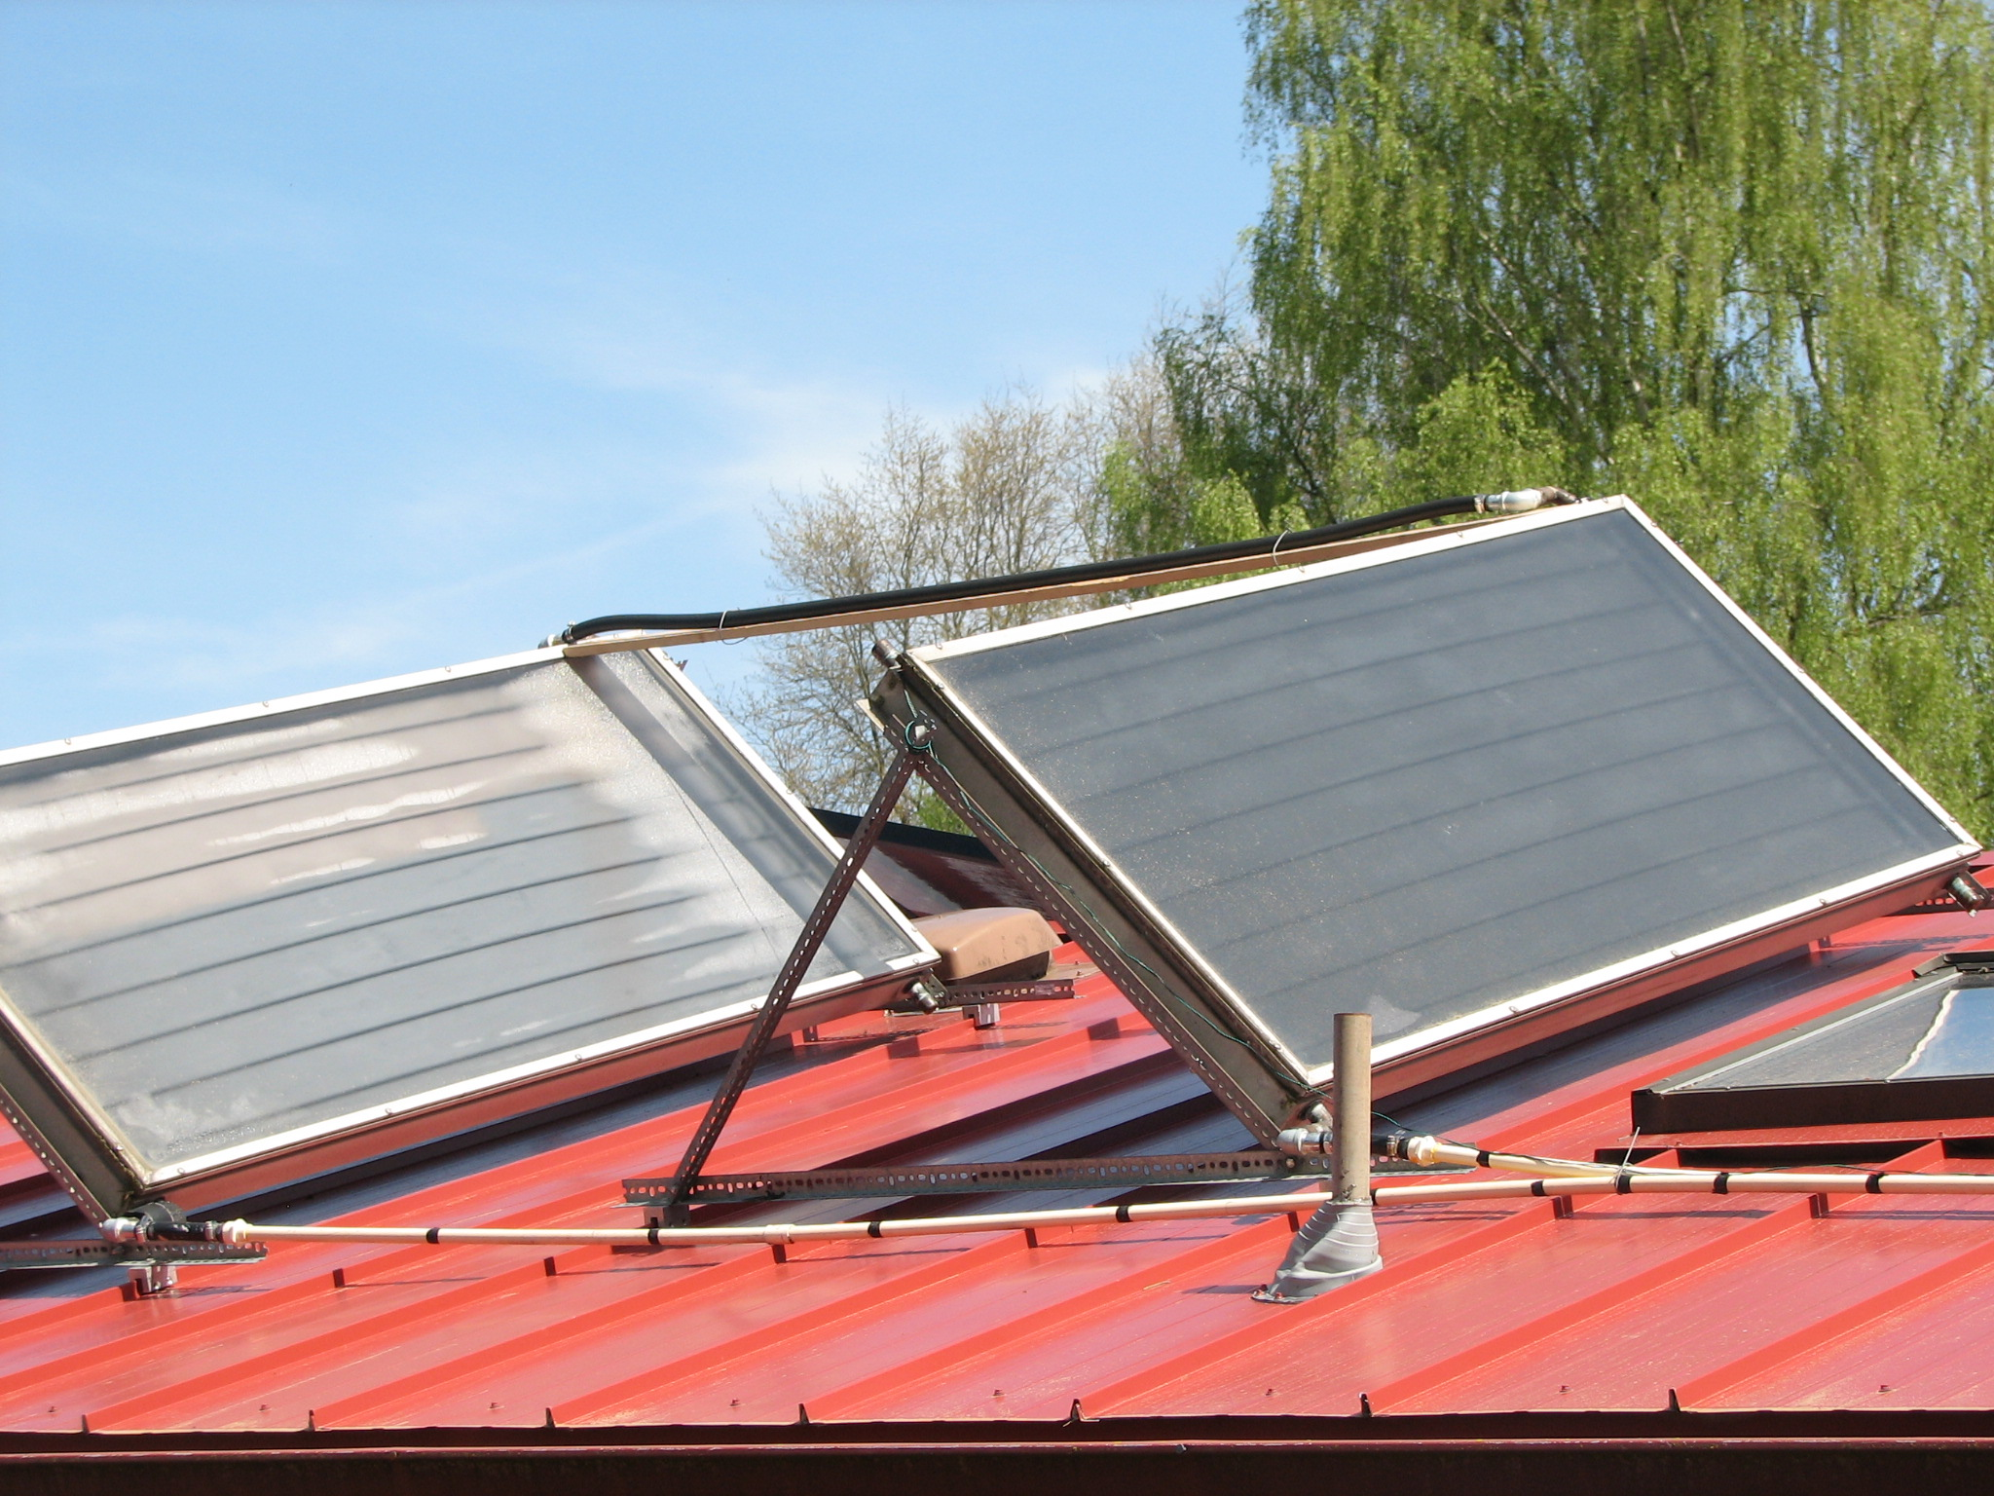
Solar Collectors for Hot Water
Two 3’ X 7’ collectors.
This system cost about $750
for materials (used collectors)
4 hrs of sun = 50 gal of 130⁰ H₂O

Slide 5
Rainwater Collection in Corvallis
Cook’s roof = 2700 square feet of surface (house and garage)
1700 gallons of water collected from 1 inch of rainfall
Corvallis receives about 45 inches rain/year
Total annual rainwater collection possible from Cook’s roof = 76,500 gallons.

Slide 6
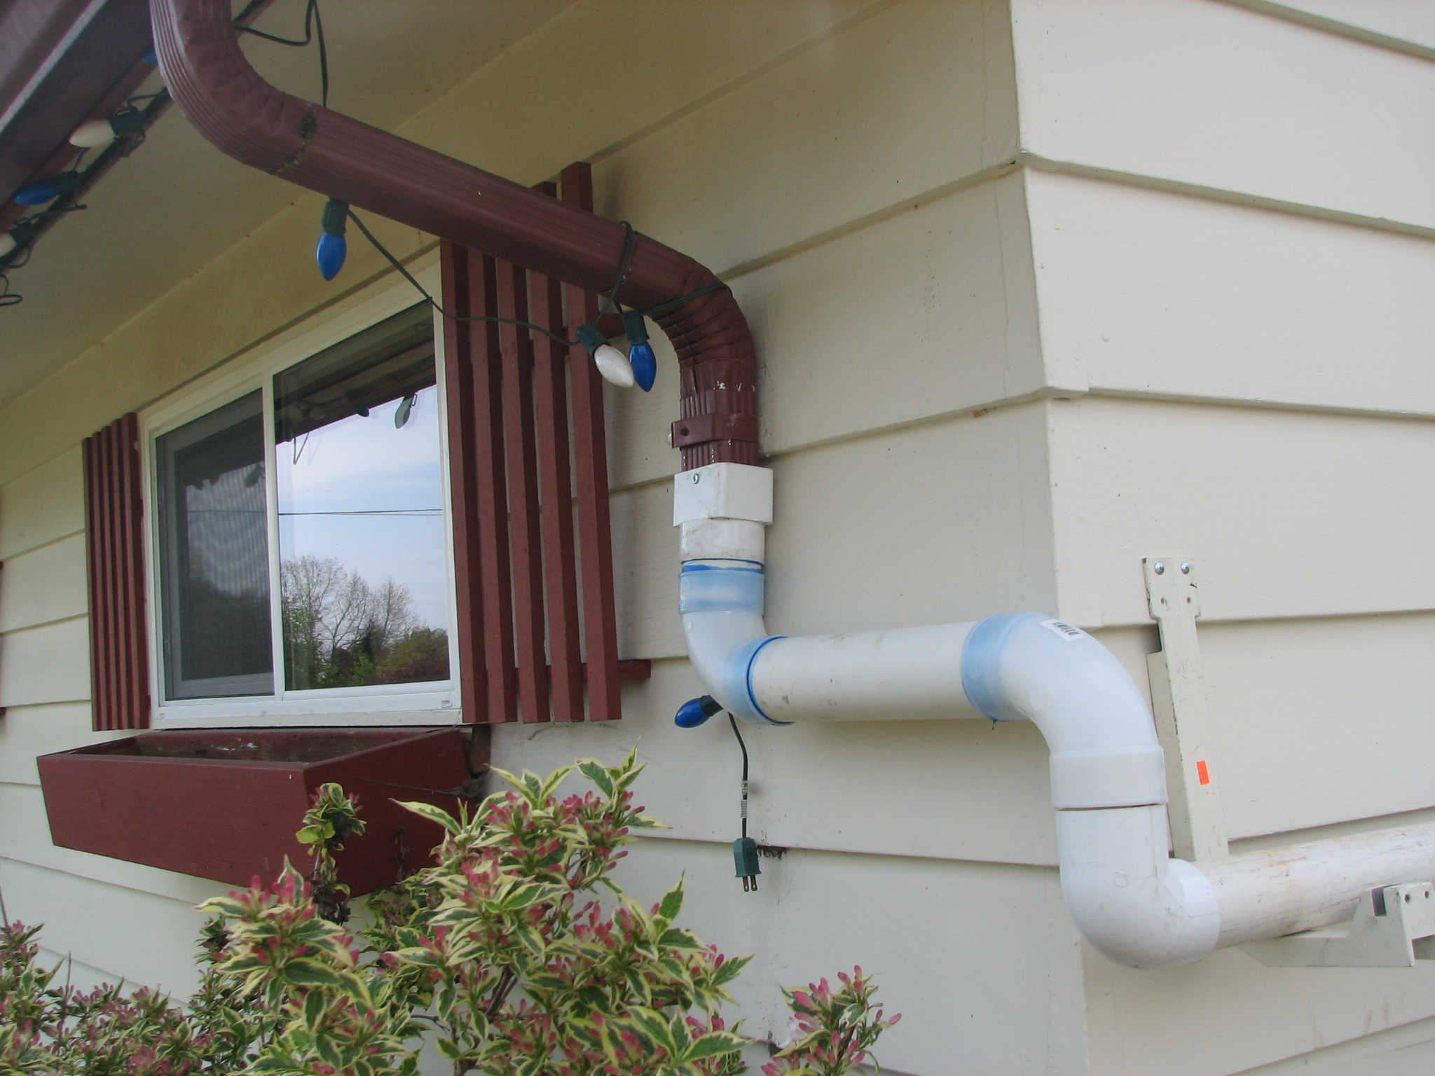
Rainwater Collection

Slide 7
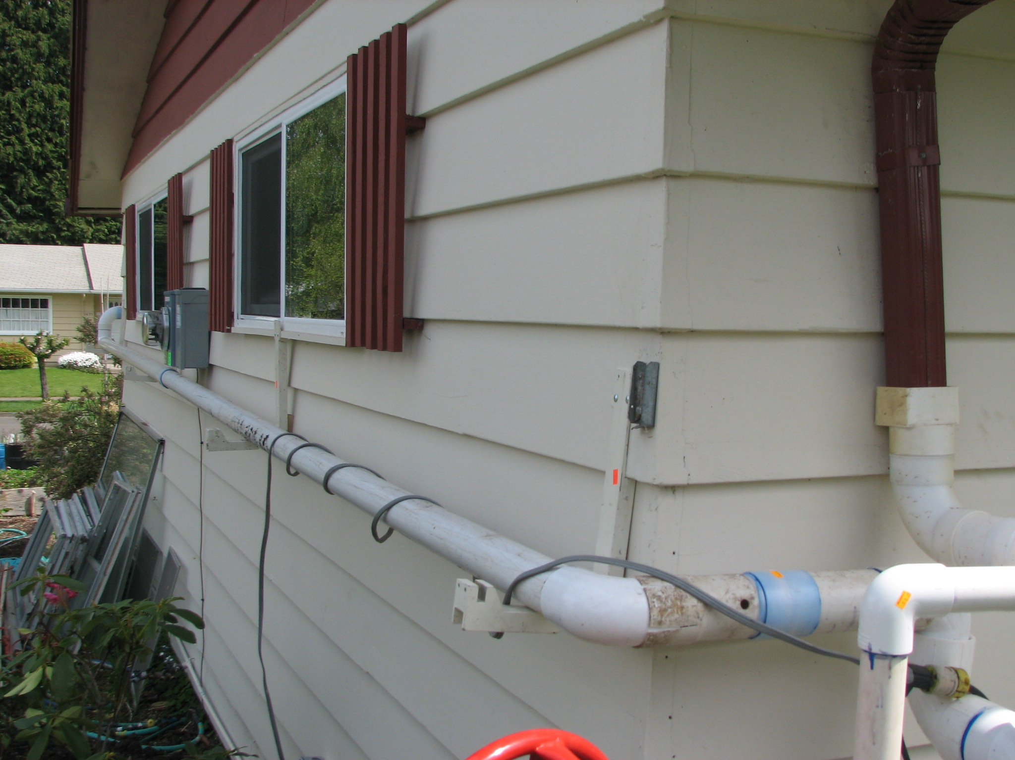
Getting Rainwater
to the sump

Slide 8
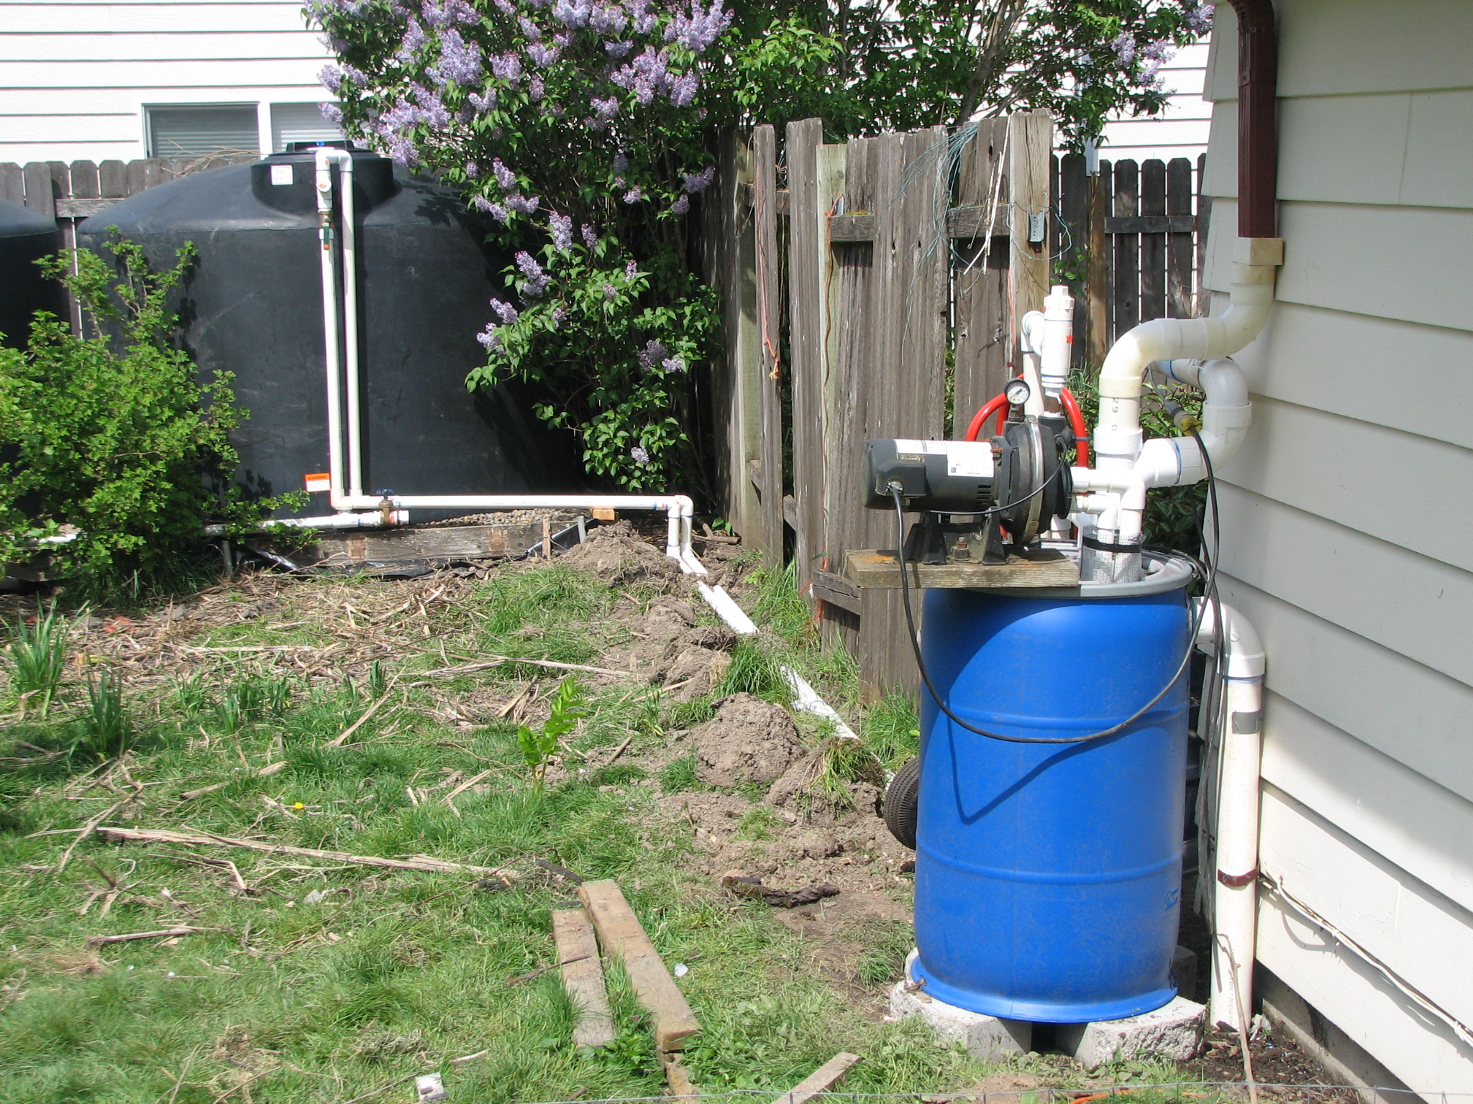
↖Inflow
←from
roof
Float Switch
Controlled pump→
←Overflow
To street
55 gallon “sump”→

Slide 9
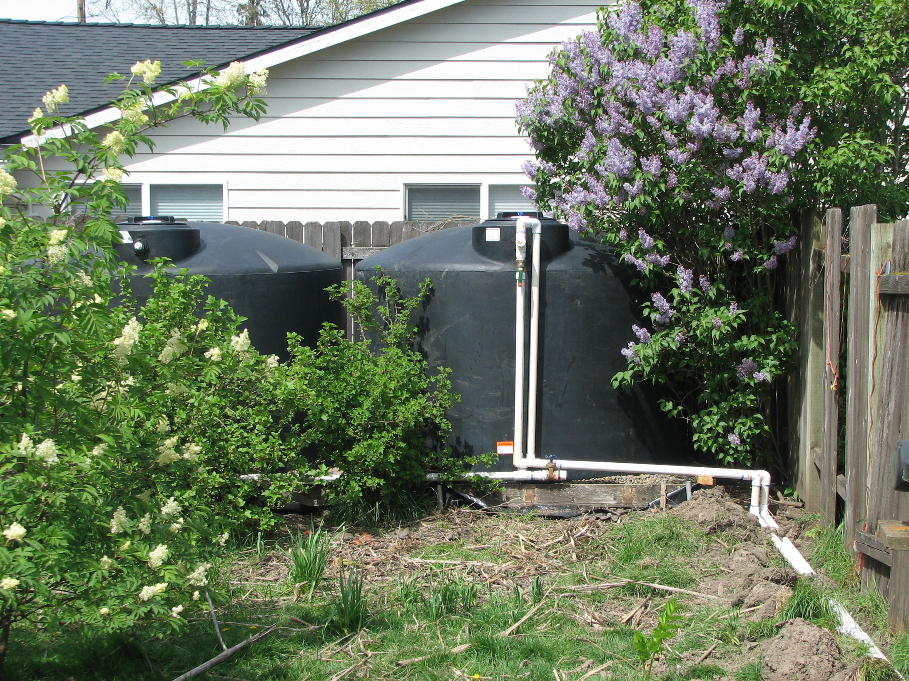
Two 1550 gallon tanks
←Overflow line
Filler line→.
Outflow line ↑

Slide 10
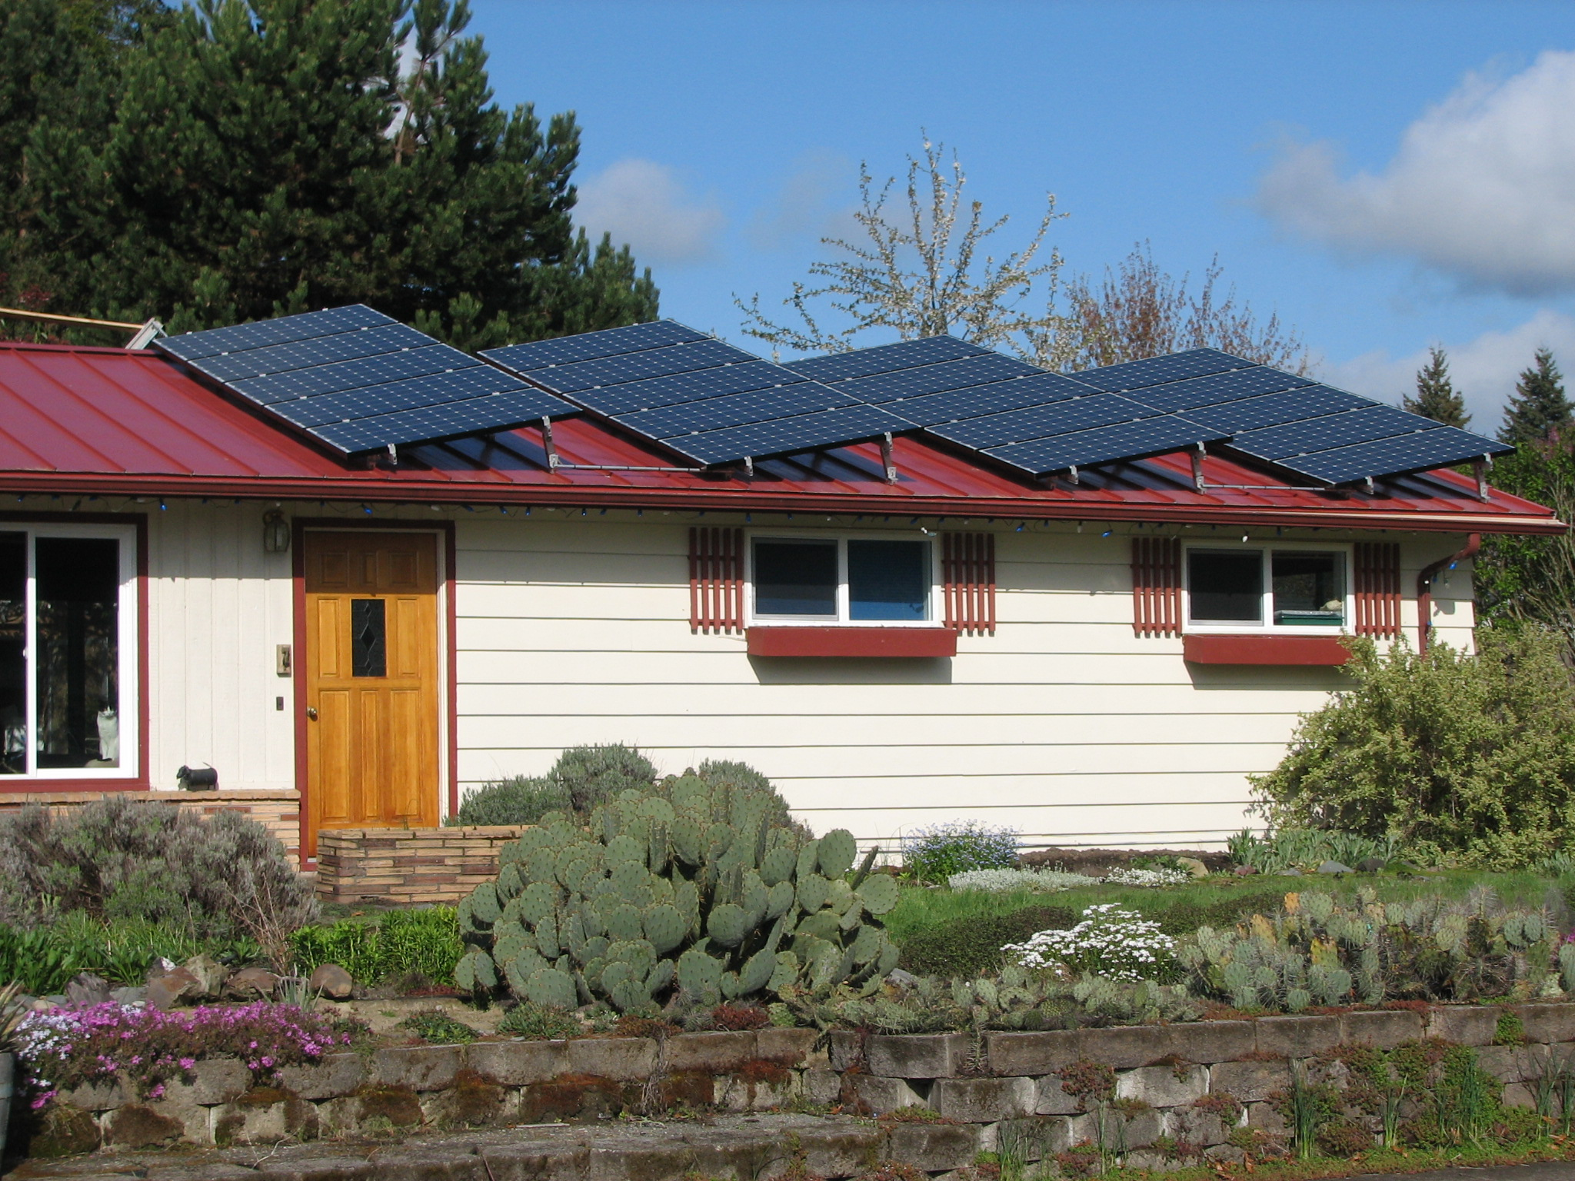
Note Metal Roof. Required
For Rain Water Collection
Solar PV system on 23rd Street, Corvallis
6.6 kw system Cost $51,000 (2009-2011)
Less $15,000 from the Energy Trust of OR
Less $12,000 OR Tax Credit
Less $12,000 Fed. TaxCredit
= $12,000 out of pocket cost.

Slide 11
Home on Oak Creek, Corvallis
6.6 kw system Cost $20,000 in 2016
Less $6,000 State of Oregon Tax Credits
(paid over three years)
Less $6,000 Federal Tax Credits
(30% of system cost)
Out of pocket cost = $8,000

Slide 12
Home on Oak Creek addition 2017
2 kw addition costs $ 8000
less 30% federal tax credit
Out of pocket expense = $5600
Total Oak Creek System cost = $13,600

Slide 13
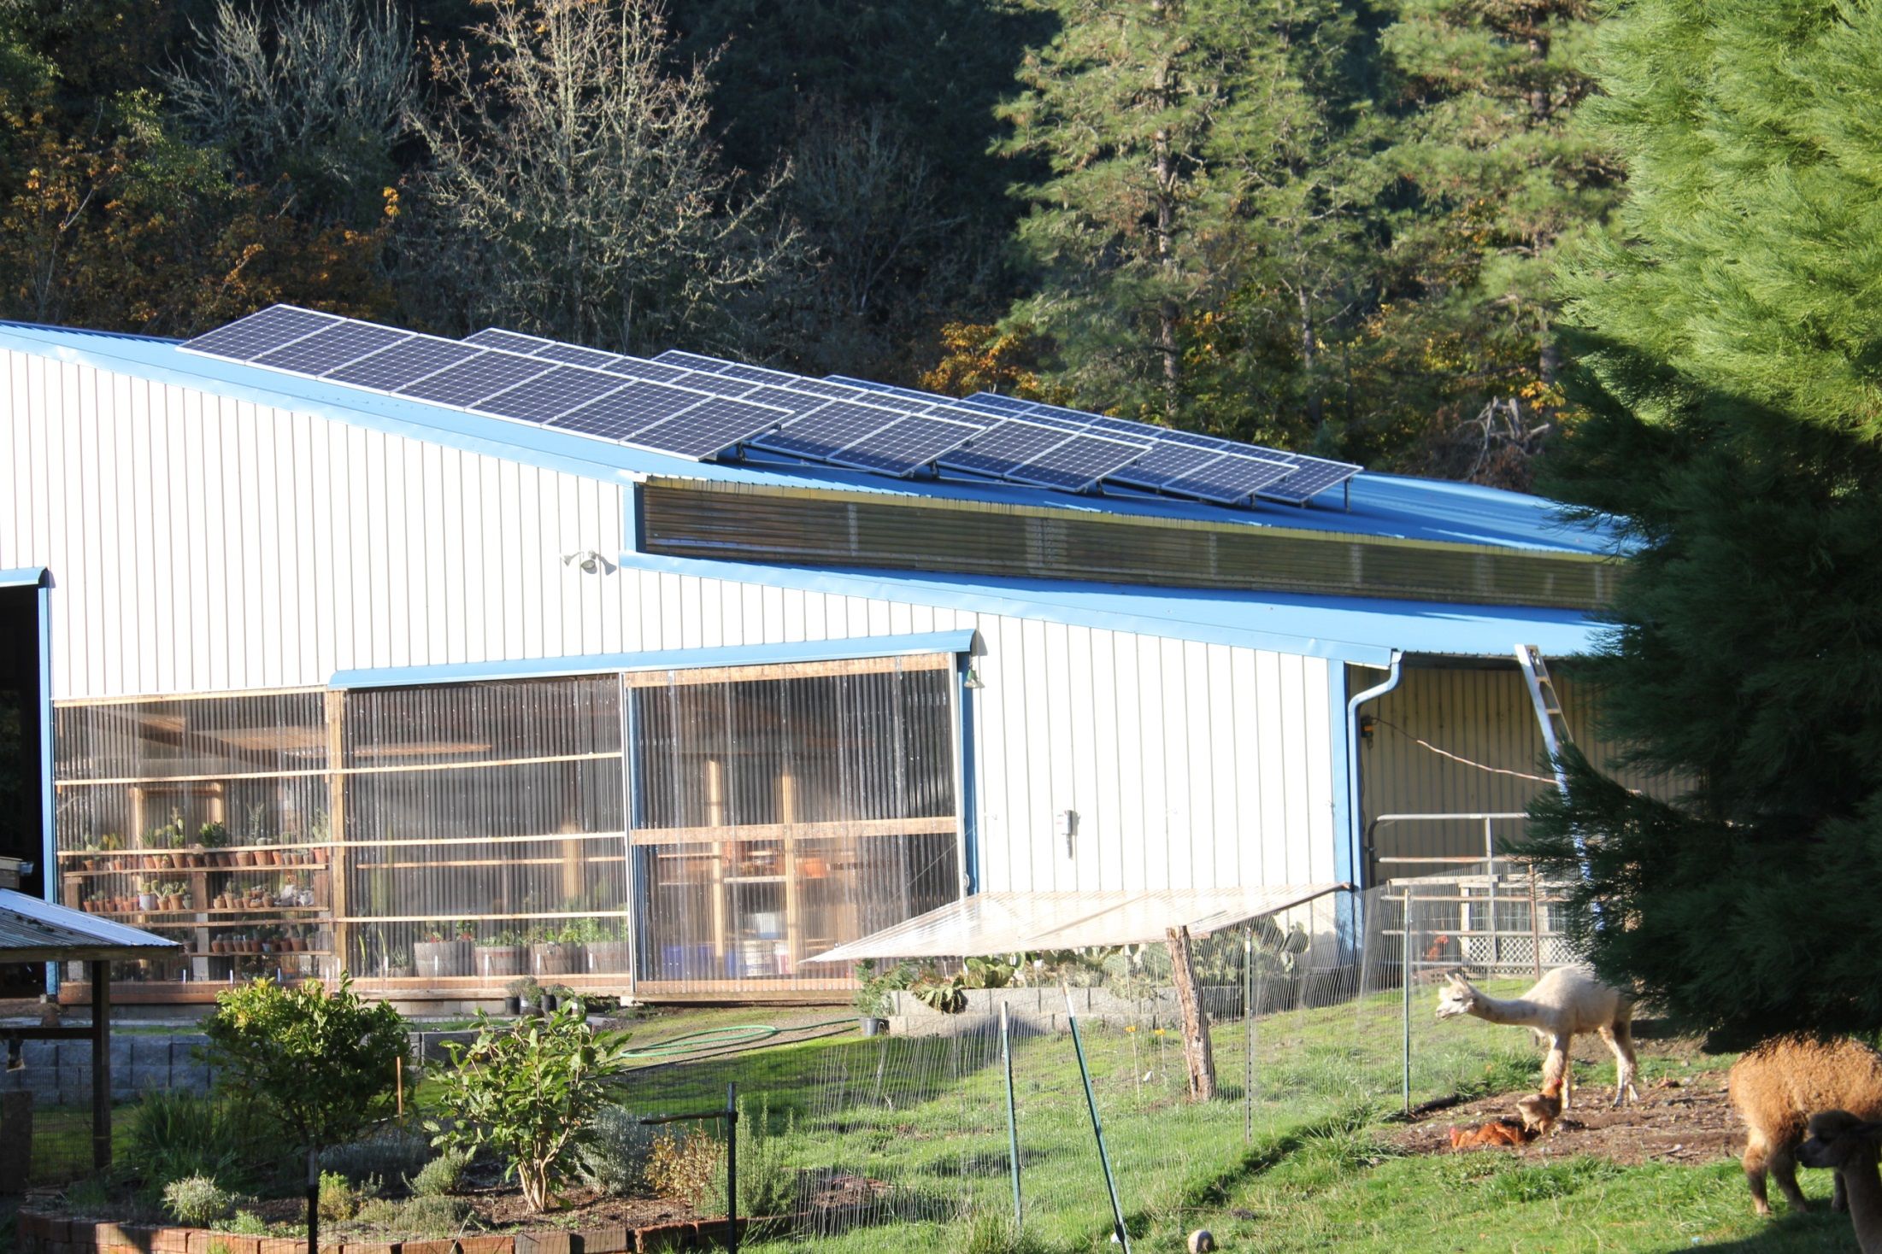
34 panels, total 8.5 kw

Slide 14
34 panels = 8.5 kw possible output

Slide 15
Solar system inverter (DC – AC)

Slide 16
Sunny late October afternoon = 6.148 kw output Current output

Slide 17
Smart Meters
Keeps track of energy in very small increments (an hour or less)
This makes differential pricing possible

Slide 18
Smart Meters
Keeps track of energy in very small increments (an hour or less)
This makes differential pricing possible
Can be read remotely

Slide 19
Smart Meters
Keeps track of energy in very small increments (an hour or less)
This makes differential pricing possible
Can be read remotely
Can measure electricity in both directions

Slide 20
Heat Pump Water Heaters
A heat pump moves heat from one place to another
Refrigerator is a great example
Moves heat from inside the box to the room

Slide 21
Heat Pump Water Heaters
A heat pump moves heat from one place to another
Refrigerator is a great example
Moves heat from inside the box to the room
A heat pump Water Heater
Moves heat from the room to the water in the water heater

Slide 22
GE Geospring Heat Pump Water Heater
Heat Pump Water Heaters will be in nearly all homes in ten years. The improvement in efficiency is amazing. My new 50 gallon Geospring uses 40% the energy of my old 40 gallon high efficiency traditional electric heater.
Cost about $700
$700 tax credit from Oregon State
30% ($210) tax credit from U.S. Government

Slide 23
