Slide 1
Renewables are coming at us
Here is a comparison between the “past” energy vs. the “future” energy

Slide 2
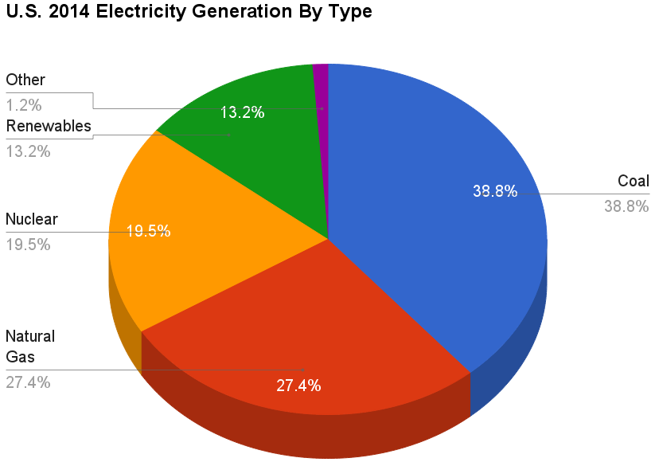

Slide 4
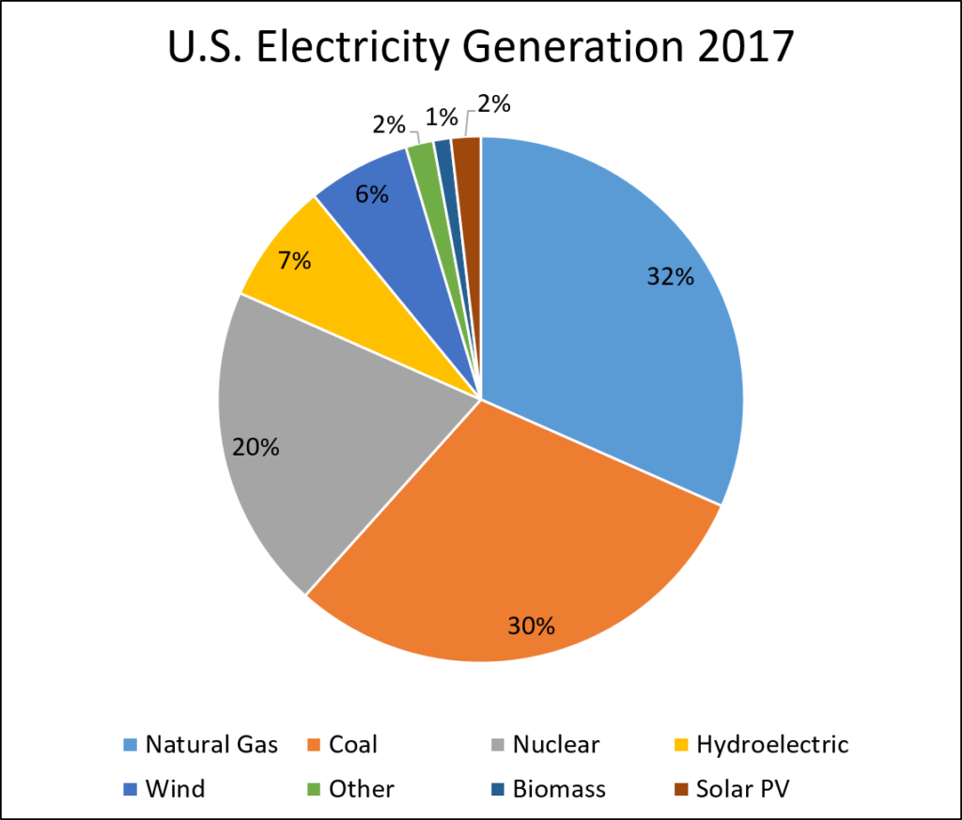

Slide 5
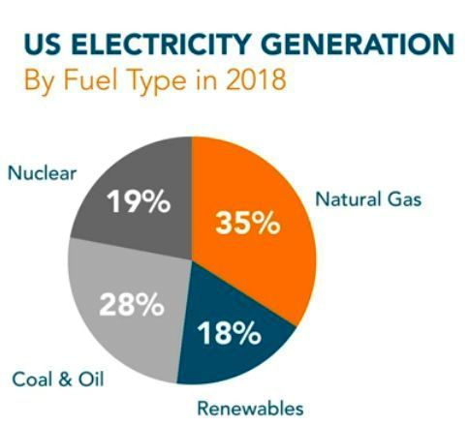

Slide 6
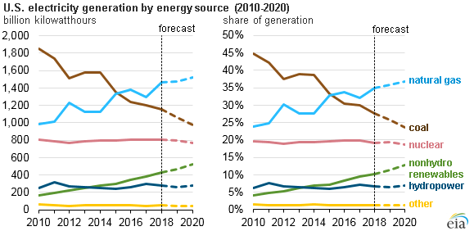

Slide 7
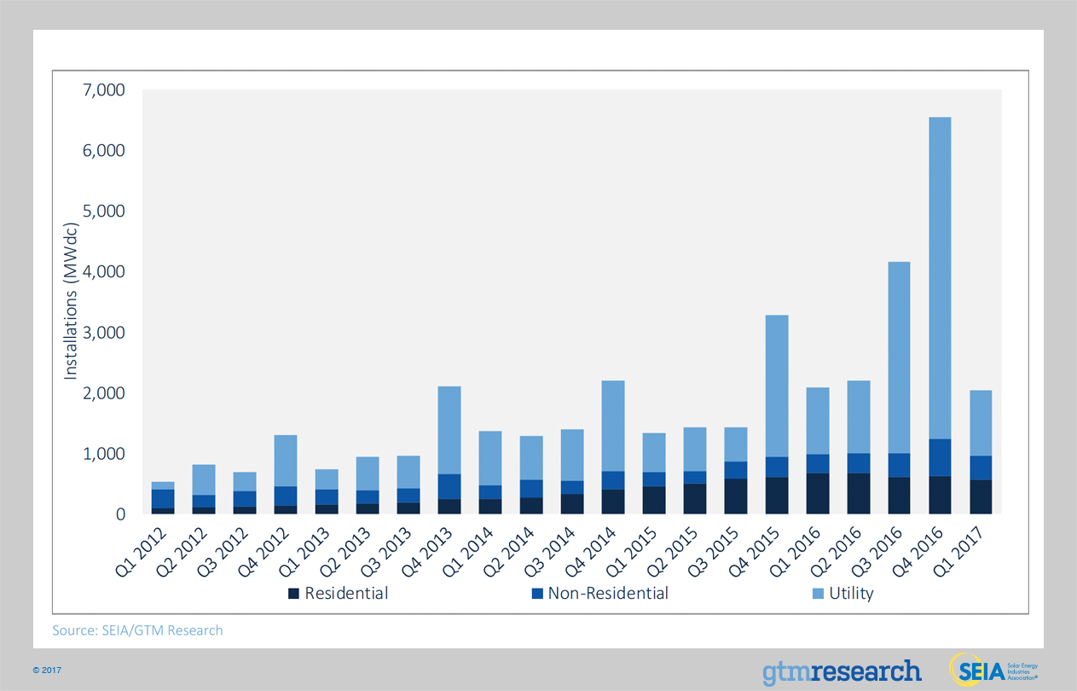

Slide 8
And in Oregon? (Hint: We’re cooler than you are—whoever you are)
2016 Clean Electricity and Coal Transition Act
What it says:
Pacific Power and PGE (50% of energy in Oregon):
*Off coal by 2030
*25% renewables by 2025 (wind, solar, geothermal)
*50% renewables by 2040
*Commits them to buy from small producers and Community Solar installations

Slide 9
And in Oregon? (Hint: We’re cooler than you are—whoever you are)
2016 Clean Electricity and Coal Transition Act
What it (also) says:
*Increase electric vehicle charging infrastructure
*Supports Community Solar facilities
*Incentives for utilities to switch to renewables
*Utilities required to maximize efficiency

Slide 10
Solar Power
It’s coming of age
Interesting factoid: Solar consumes less land per MW of
electricity than either coal or hydro dams

Slide 11
Two basic types: 1) Concentrating Solar Plants (CSP) and 2)Photovoltaic Arrays (PV)
CSP is a thermal plant—solar energy to boil water to make steam to turn a turbine, VOILA! Electricity.
PV converts sun’s rays directly to electricity.

Slide 12
Comparison CSP and PV
CSP is thermal plant—solar energy to boil water to make steam to turn a turbine, VOILA! Electricity.
PV—sun’s rays directly to electricity
CSP advantages:
1) works better in high temp;
2) More efficient/area;
3) Heat salt to store heat (energy)
PV advantages:
1) costs less;
2) less environmental impact;
3) works better at low temp;
4) easily scalable

Slide 13
CSP (Concentrated Solar Power) (These are thermal generating plants—just like coal, nuclear, natural gas, biomass, geothermal)—capture heat to boil water to get steam, steam turns turbine, voila! electricity) Higher temperature = higher output.
There are two types:
Parabolic Troughs and
“Power Towers”

Slide 14
Parabolic Troughs
Linear parabolic mirrors focus light on a tube
Very efficient utilize salt heated to a liquid at 1000 degrees or more
Insulated storage for salt (just like a thermos bottle)
Hot salt boils water, steam turns turbine, turbine turns generator. Voila! 24 hour solar electricity
also
Natural gas boiler integrated into loop as backup

Slide 15
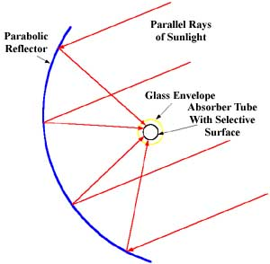
Parabolic Trough

Slide 16
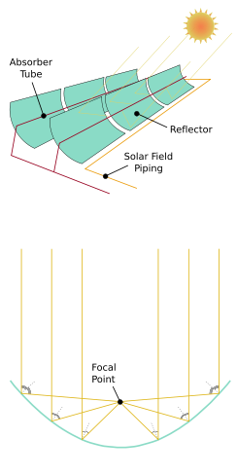
Another way to view a parabolic trough

Slide 17
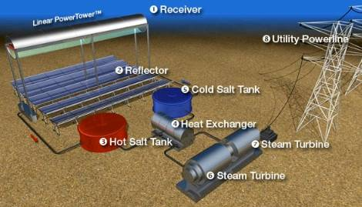
Solar Trough “farms” in the US

Slide 18
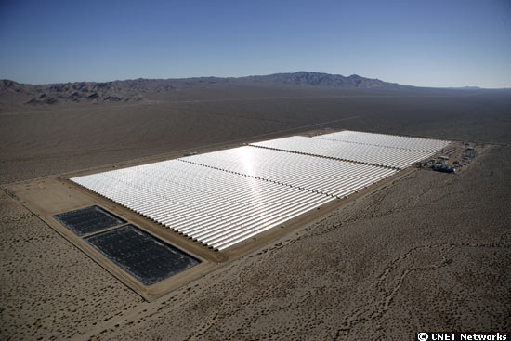
“Solar One” Parabolic Trough in Nevada
64 MW output; 230 homes/Megawatt

Slide 19
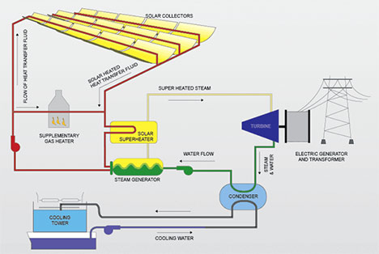
Nevada Solar One Schematic Diagram

Slide 20
Solar Energy Generating Systems (SEGS) Daggett, CA--Mojave Desert
The largest in the world at 359 MW
No thermal storage
Three separate sites within 40 miles of each other.

Slide 21
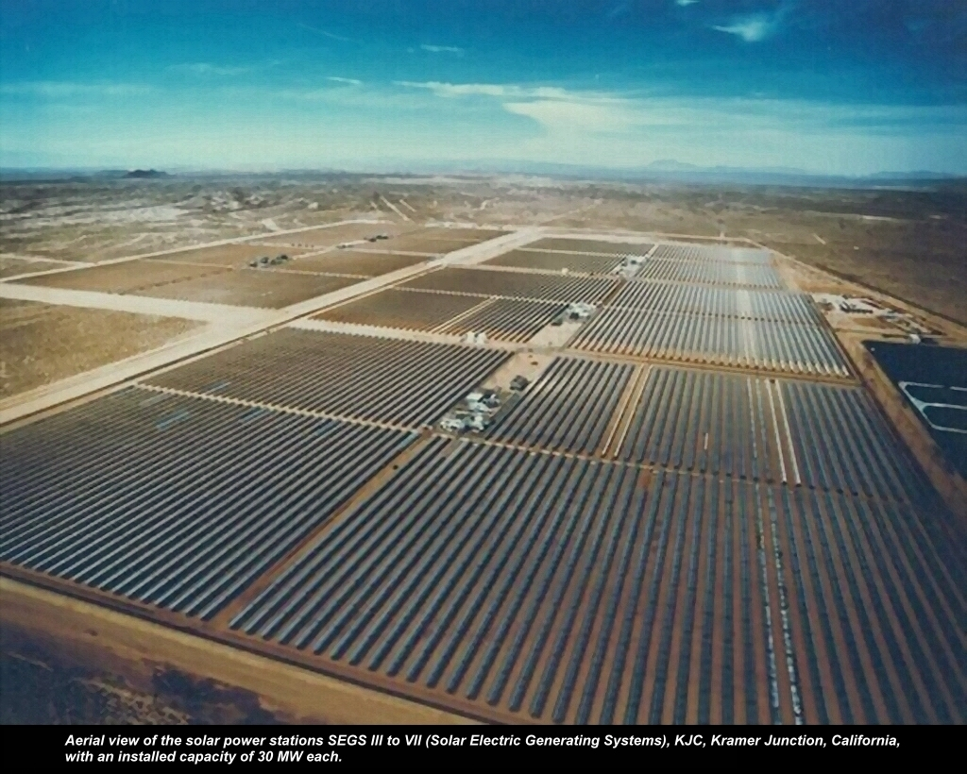

Slide 22
Greentech Media for the latest in . . .well, greentech and from National Renewable Energy Lab—Thermal Storage And the California ISO website shows demand and renewable output.

Slide 23
“Solar One” in Barstow California
“Power Tower” CSP Sites
1981 the original Power Tower thermal plant. Rebuilt as “Solar Two” but dead in 1999. Generated 10MW

Slide 24
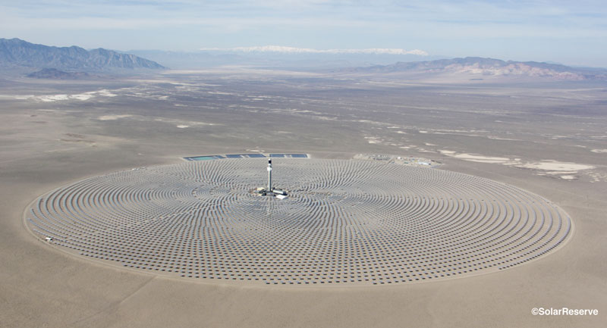
Crescent Dunes Tower Power CSP + Salt Storage; First of its kind near Tonapah, NV
110 megawatt system; 10 hours of salt storage

Slide 25
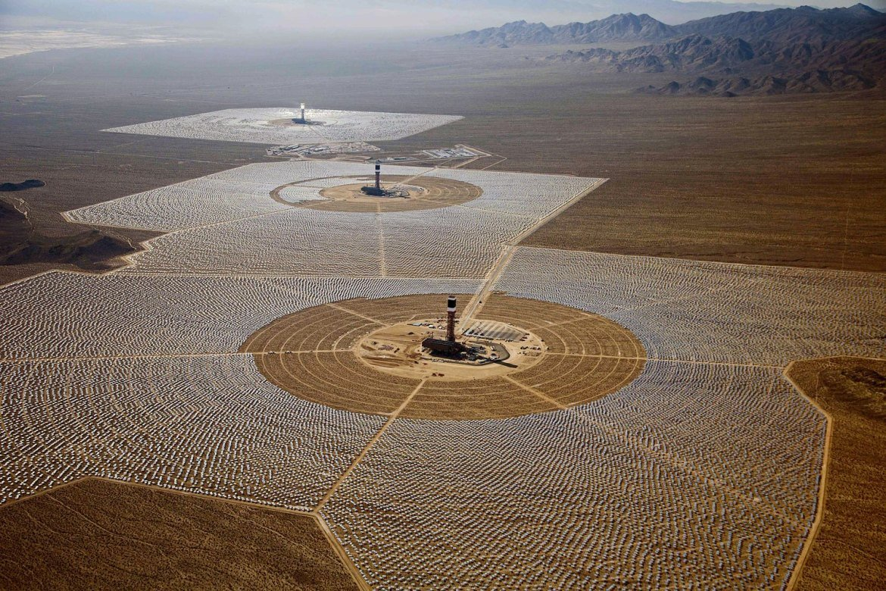
Ivanpah CA Power Towers—Mojave Desert. 4000 acres. Towers 500 feet tall. 170,000 heliostats (mirrors) 390 MW Equals 140,000 homes (360/Megawatt)

Slide 26
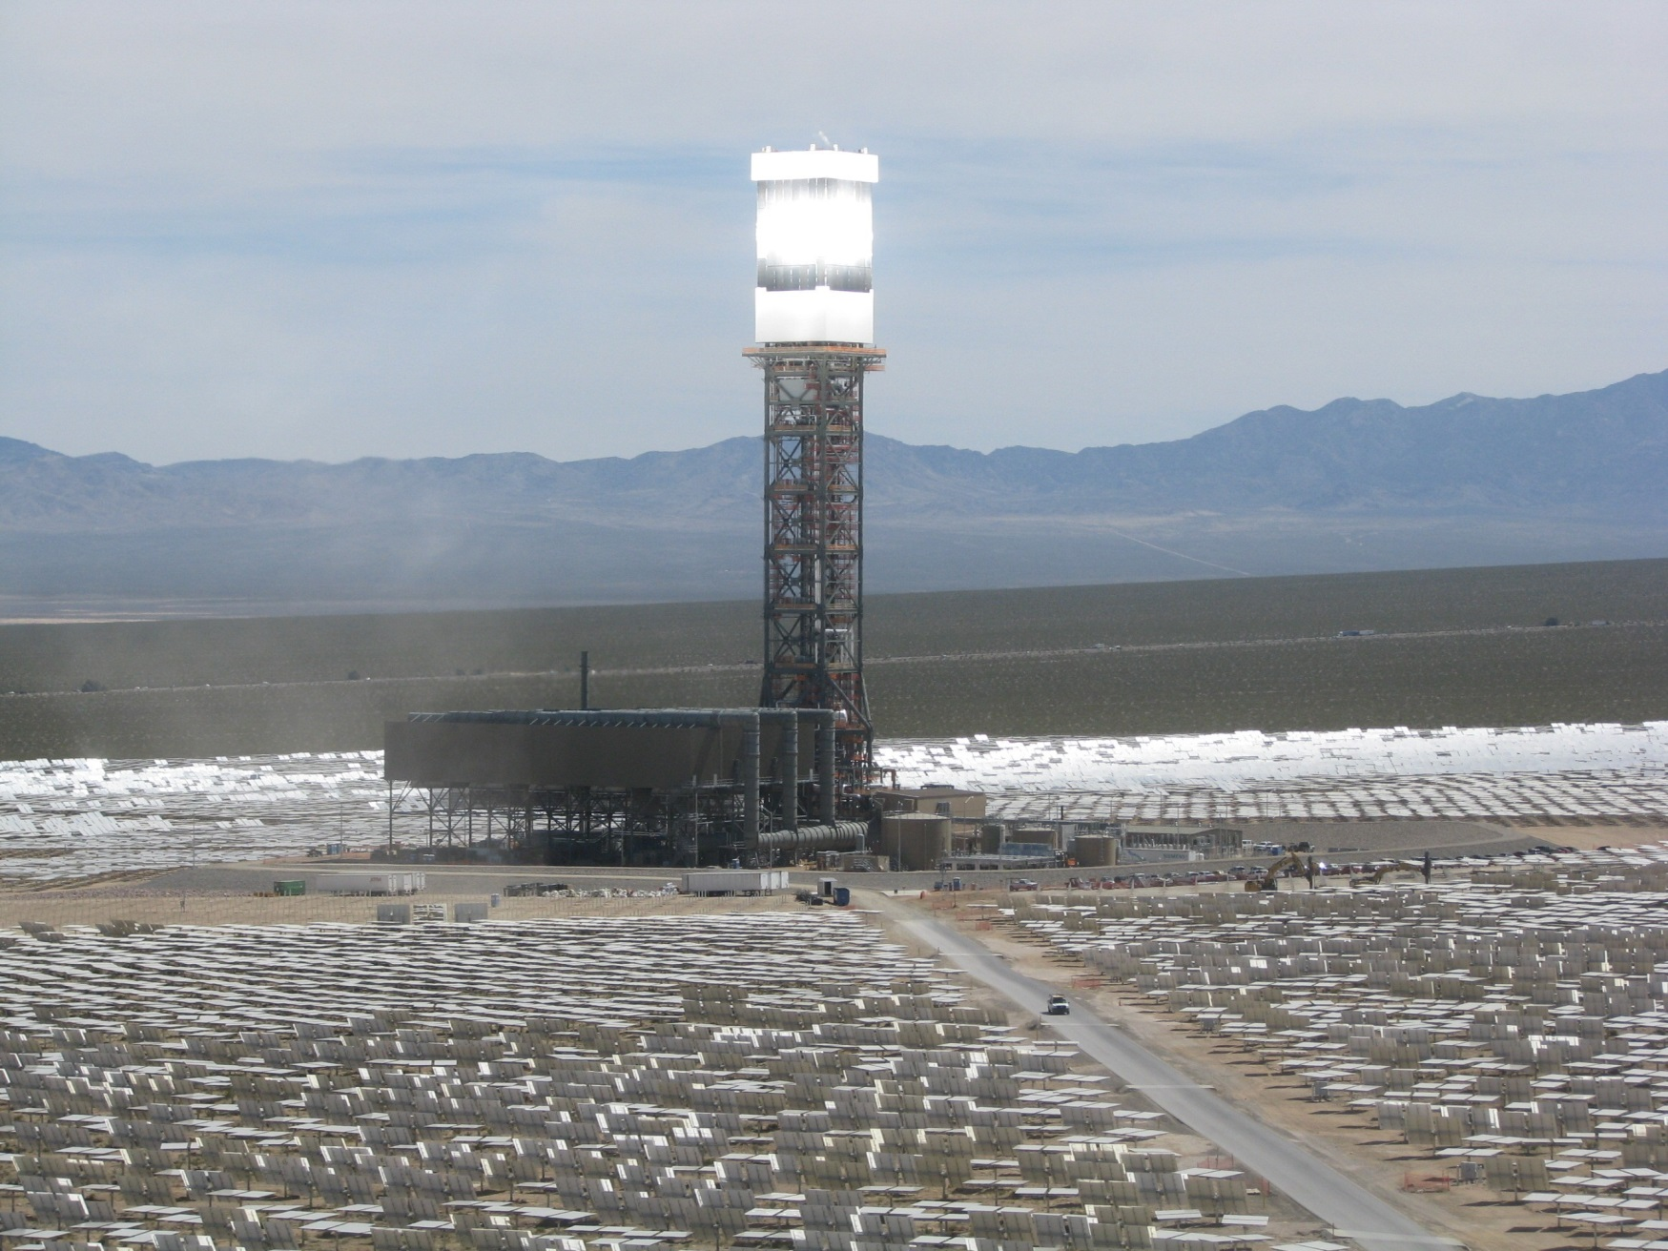
Ivanpah Power Tower

Slide 27
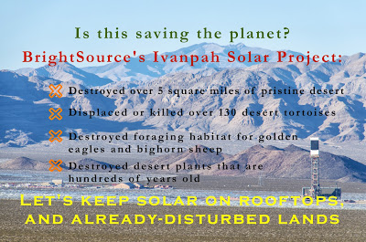
$50 million unsuccessful attempt to relocate endangered desert tortoises. There are desert ecosystems--no free lunches

Slide 28
And then there are “Streamers”
“It appears Ivanpah may act as a ‘mega-trap,’ attracting insects which in turn attract insect-eating birds, which are incapacitated by solar-flux injury, thus attracting predators and creating an entire food chain vulnerable to injury and death,” concluded scientists with the National Fish and Wildlife Forensics Laboratory in a report that investigated 233 bird deaths representing 71 species at three Southern California solar power plants.
“Ivanpah employees called such immolations ’streamers,’” said The Atlantic.
US Fish and Wildlife Service Office of Law Enforcement staff “observed an average of one streamer event every two minutes.”

Slide 29
Photovoltaic (Sunlight directly into electricity) PV is more efficient at cooler temperatures
Price of PV panels has declined 60% in past five years.
Compound Annual Growth Rate from 2000 – 2016 was 41%
CAGR projected 2018-2023 = 20%
“Green Bonds” to finance solar = $180 billion in 2019
2019 PV panels are 23% efficient (up from 17% in 3 years).
New technology on horizon, much, much cheaper panels

Slide 30
And . . . . . My favorite!!!!!!!!!!!
THERE ARE NO MOVING PARTS IN A PV SYSTEM. THESE BABIES JUST SIT THERE MAKING ELECTRICITY FOR 25+ YEARS WITH ALMOST NO MAINTENANCE.

Slide 31
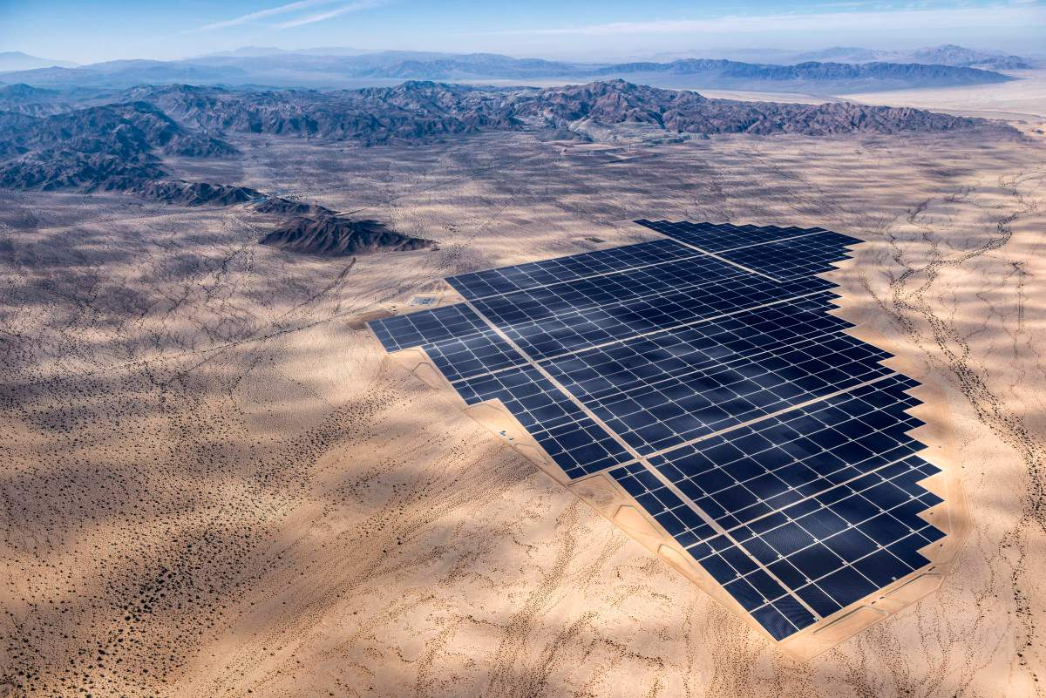
Desert Sunlight Solar Farm
550MW—180,000 homes 330/MW
Mojave Desert, CA 3,800 acres.

Slide 32
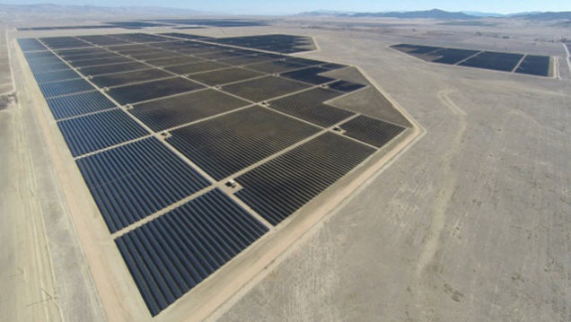
Topaz Solar Farm. 550MW, 180,000 homes
330/MW Mojave Desert, CA 4700 acres

Slide 33
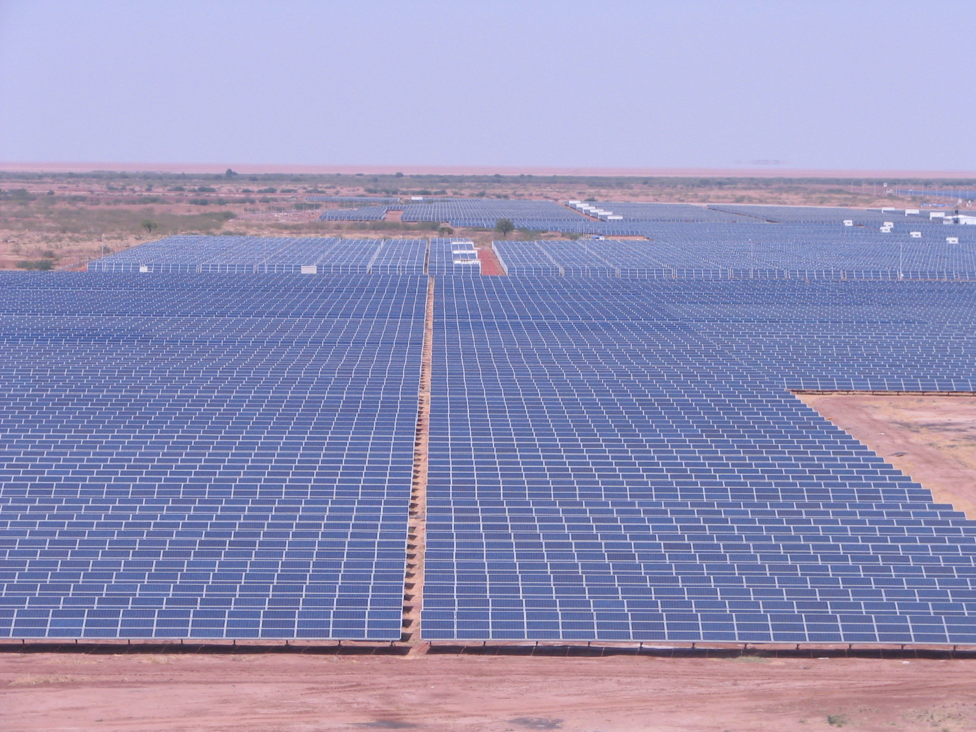
Gujarat India, 600MW currently India intends to be a world leader in PV

Slide 34
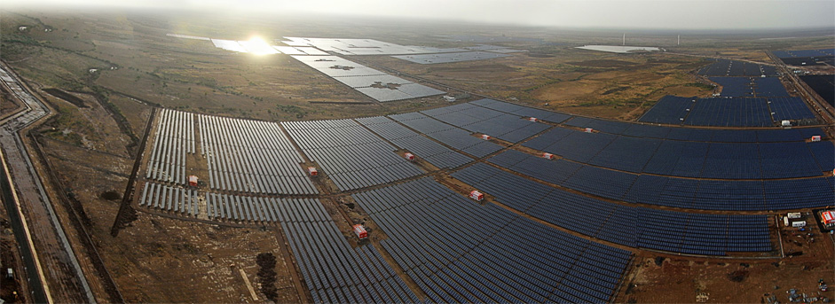
More Gujarat—these guys are serious!

Slide 35
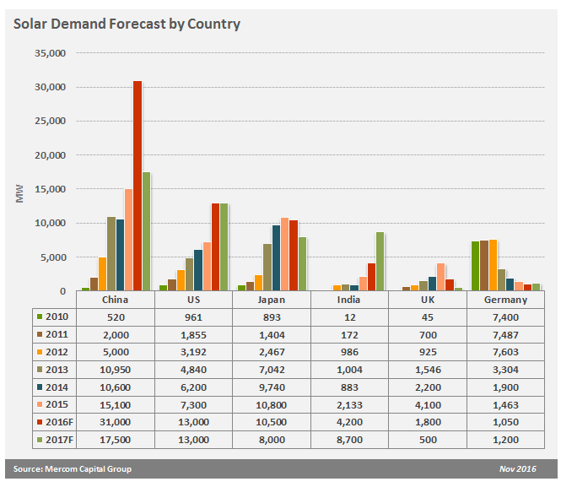
Photovoltaic only

Slide 36
Geothermal-Three types
All Geothermal are thermal plants
Dry Steam/Flash Steam—Steam comes from earth, turns turbine, VOILA! electricity.

Slide 37
Geothermal-Three types
All Geothermal are thermal plants
Dry Steam/Flash Steam—Steam comes from earth, turns turbine, electricity.
Enhanced Geothermal Systems (EGS) Drill multiple holes in hot rock, add water to one, get steam from others, turn turbine, get electricity.

Slide 38
Geothermal-Three types
All Geothermal are thermal plants
Dry Steam/Flash Steam—Steam comes from earth, turns turbine, electricity.
Enhanced Geothermal Systems (EGS) Drill hole in hot rock, add water, get steam, turn turbine, get electricity.
Binary. Hot water from the ground, heat exchanger, heat secondary liquid like Iso-Butane to create “steam” turn turbine, get electricity.

Slide 39
Geothermal Energy These are thermal plants
Dry Steam/Flash Steam. Easiest to exploit but least common. “The Geysers” in California best US example.
About 30 square miles active site.
About 1000 MW continual output—over a million houses!
Three Requirements:
1) Fractured Rock
2) Ground Water
3) Magma near the surface for heat source

Slide 41
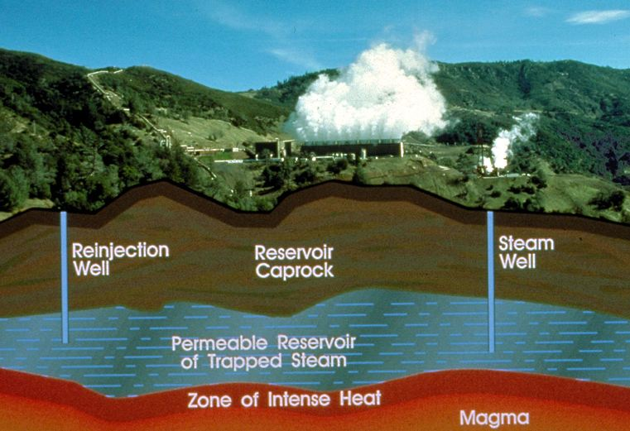
“One of “The Geysers” Plants in northern California

Slide 42
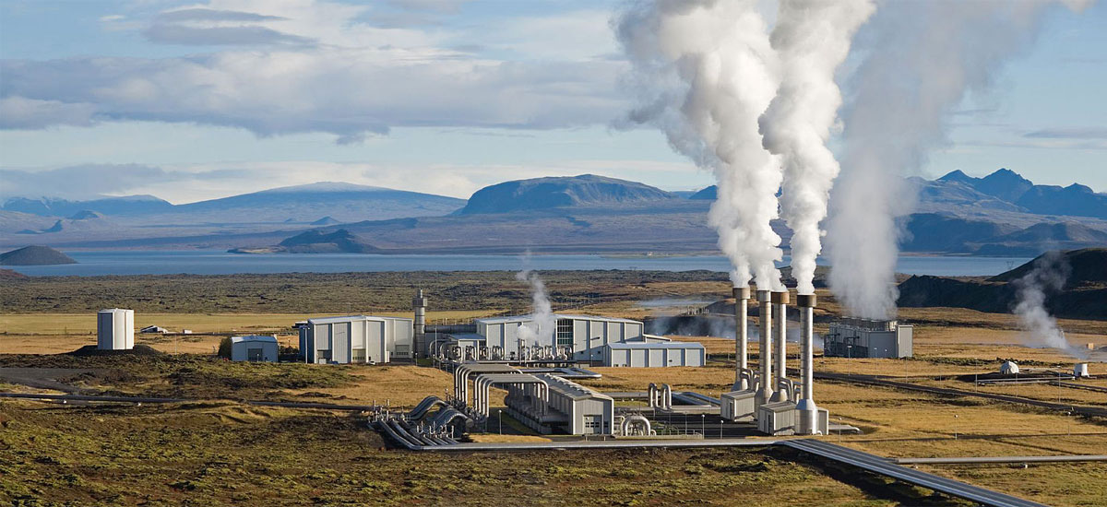
Iceland's Nesjavellir 120 MW geothermal power station. Geothermal plants account for more than 25 percent of the electricity produced in Iceland. Photo: Gretar Ívarsson

Slide 43
Dry Steam and Flash Steam Requires very hot water/steam (The Geysers Model)

Slide 44
Geothermal Energy These are thermal plants
Enhanced Geothermal Systems (EGS) Most difficult to exploit but widespread opportunities. Newberry Volcano Oregon—potential, but no power yet.
Three steps:
1) Drill hole into hot rock—Newberry is 1000 degrees F
2) Drill two more holes, ¼ mile distant from first
3) Pump water down hole # 1, steam back up holes 2 & 3. Turn turbine, VOILA! get electricity.

Slide 45
Enhanced Geothermal System Utilizing Hot, Dry Bedrock

Slide 46
Geothermal Energy These are thermal plants
Binary System Lower potential output, but widespread opportunities. Operating plants across the western US.
Two steps:
1) Hot water at surface, below boiling point
2) Through heat exchanger, heat secondary liquid like Iso-Butane to boiling, flashes to steam, turns turbine, VOILA! Electricity.

Slide 47
Binary System Utilizes a secondary closed loop of low boiling point substance to drive the turbine (Probable EGS model—low water consumption.

Slide 48
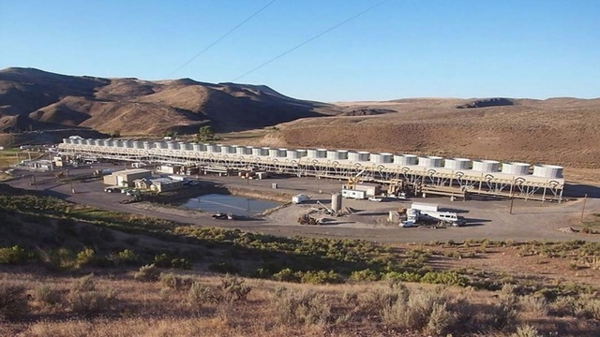
Neal Hot Springs, Oregon Binary Plant 23MW-26000 homes

Slide 49
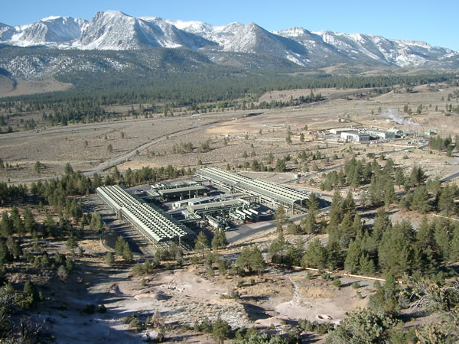
Mammoth Binary Plant, Eastern California 29 MW, 22,000 houses Uses Iso-Butane as secondary fluid

Slide 50
And then there is “Clean Coal”
Projected costs double wind or solar
“Clean Coal Projects not so clean after all*” *Institute for Energy Economics and Financial Analysis http://ieefa.org/clean-coal-projects-not-so-clean-after-all-analysis-finds/
$1 Billion of US Government subsidies
Emissions of NOx still exceed limits
Carbon Capture and Sequestration wildly expensive and very very difficult

Slide 51
Now let’s talk about some “Negawatts” (if making new energy is measured in “Megawatts” why not measure energy saved in “Negawatts”: “Enernet” / “Cleanweb” / “Soft Grid”
Definition: Internet-enabled efficiency
A. Digital Lumens Company utilizes LED lights; motion sensors; ambient light sensors; data; internet technologies. Reduce energy consumption by 90% or more.

Slide 52
“Enernet” or “Cleanweb” or “Soft Grid”
Definition: Internet-enabled efficiency
A. Digital Lumens Company utilizes LED lights; motion sensors; ambient light sensors; data; internet technologies. Reduce energy consumption by 90% or more.
B. Opower Company provides digital consumption alerts via smart phones, iPad apps, smart thermostats to make consumers aware of their energy use but also their neighbor’s use (anonymously). 85 unilities, 27 countries, 18 million homes.

Slide 53
“Enernet” or “Cleanweb” or “Soft Grid”
Definition: Internet-enabled efficiency
A. Digital Lumens Company utilizes LED lights; motion sensors; ambient light sensors; data; internet technologies. Reduce energy consumption by 90% or more.
B. Opower Company provides digital consumption alerts via smart phones, iPad apps, smart thermostats to make consumers aware of their energy use but also their neighbor’s use (anonymously). 85 unilities, 27 countries, 18 million homes.
C. EnerNOC Company works with 14,000 customers in five states. When a utility nears capacity, contacts customers, who then reduce consumption for a fee. Can cut demand 30-35%

Slide 54
“Enernet” or “Cleanweb” or “Soft Grid”
Definition: Internet-enabled efficiency
C. EnerNOC Company works with 14,000 customers in five states. When a utility nears capacity, contacts customers, who then reduce consumption for a fee. Can curtail 30-35%
D. Nest Labs Company sells thermostats that “learn” a house energy needs, and begins to set itself. “At its core it is a smart phone on your wall.” It is internet connected, so can be controlled remotely. It also allows devices in home to communicate with each other via internet—like CO2 detector “talking” with furnace.

Slide 55
Batteries (energy storage devices)
There are many ways to store energy

Slide 56
r
Solid State Batteries - a range of electrochemical storage solutions, including advanced chemistry batteries and capacitors.
Lithium Ion most common
Also capacitors—sort of, actually electrostatic

Slide 57
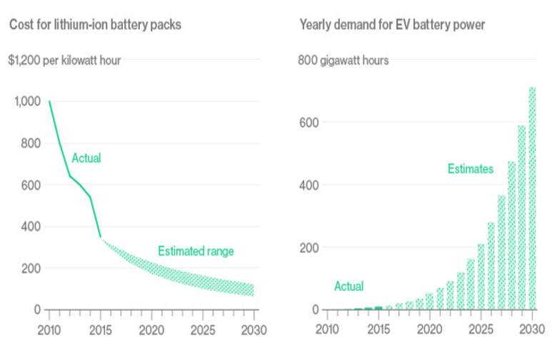
Lithium-ion Cost vs Demand

Slide 58
r
Solid State Batteries - a range of electrochemical storage solutions, including advanced chemistry batteries and capacitors
Flow Batteries - batteries where the energy is stored directly in the electrolyte solution for longer cycle life, and quick response times

Slide 59
r
Solid State Batteries - a range of electrochemical storage solutions, including advanced chemistry batteries and capacitors
Flow Batteries - batteries where the energy is stored directly in the electrolyte solution for longer cycle life, and quick response times
Flywheels - mechanical devices that harness rotational energy to deliver instantaneous electricity
Spin at 20,000 – 50,000 RPM. Used in busses.

Slide 60
r
Solid State Batteries - a range of electrochemical storage solutions, including advanced chemistry batteries and capacitors
Flow Batteries - batteries where the energy is stored directly in the electrolyte solution for longer cycle life, and quick response times
Flywheels - mechanical devices that harness rotational energy to deliver instantaneous electricity
Compressed Air Energy Storage - utilizing compressed air to create a potent energy reserve.
Usually pumped into abandoned salt mines with caprock.

Slide 61
r
Solid State Batteries - a range of electrochemical storage solutions, including advanced chemistry batteries and capacitors
Flow Batteries - batteries where the energy is stored directly in the electrolyte solution for longer cycle life, and quick response times
Flywheels - mechanical devices that harness rotational energy to deliver instantaneous electricity
Compressed Air Energy Storage - utilizing compressed air to create a potent energy reserve Thermal - capturing heat and cold to create energy on demand. Concentrated Solar Power with storage is the best example.

Slide 62
r
Solid State Batteries - a range of electrochemical storage solutions, including advanced chemistry batteries and capacitors
Flow Batteries - batteries where the energy is stored directly in the electrolyte solution for longer cycle life, and quick response times
Flywheels - mechanical devices that harness rotational energy to deliver instantaneous electricity
Compressed Air Energy Storage - utilizing compressed air to create a potent energy reserve Thermal - capturing heat and cold to create energy on demand
Pump-Storage – Two reservoirs at different elevations. Pump up when power demand is low; flow down, turn turbine when demand is high.

Slide 63
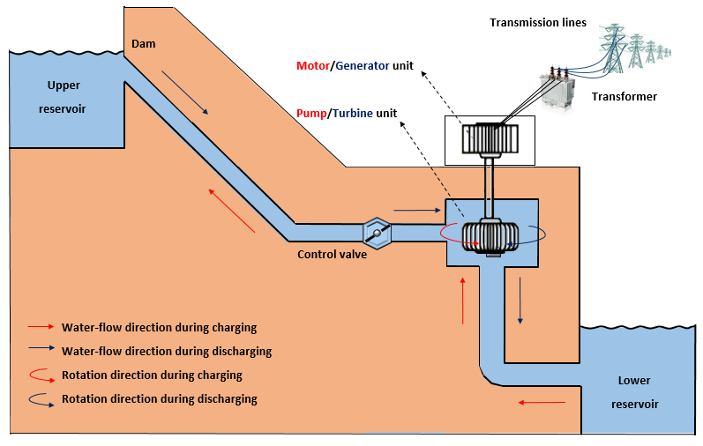
Pump-Storage System

Slide 64
Licensed Pump Storage in the US
Pending Preliminary permits

Slide 65
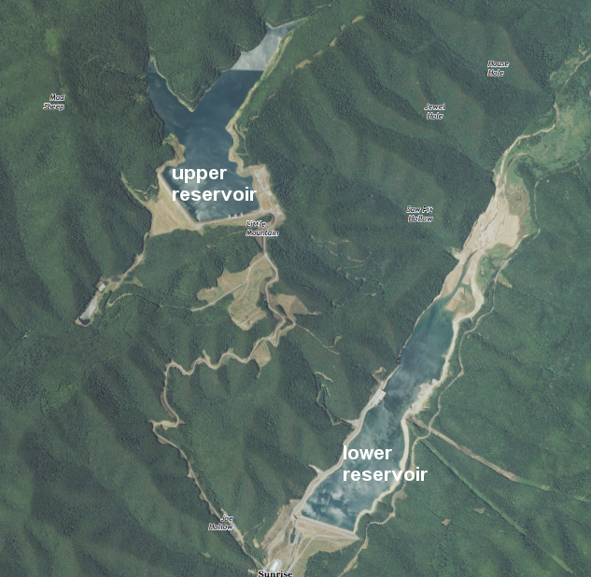
Bath County, Virginia Pump Storage.
3030 MW = 750,000 homes

Slide 66
Lets Go Swimming
“Hydropower” used to mean big dams on streams—exploiting moving river water.
Now it also means exploiting tidal flow with turbines (including tidal barrages).
And exploiting wave action with buoys of various types, some floating some anchored.
And a third category exploits ocean temperature differences: “Ocean Thermal Energy Conversion”
OK, let’s go swimming!

Slide 67
Water Turbines (like wind turbines but tiny in comparison)
Water is 784 times more dense than air = 784 times more energy per unit area of moving water.
Dependable—tide goes in and out on a regular basis. Rivers flow at a dependable rate
Widespread possibilities.
In reality, still in test mode—production costs still very speculative.

Slide 68
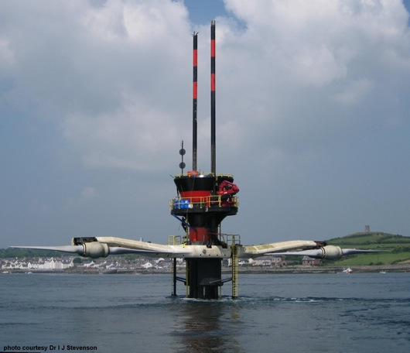
Marine Current Turbine World’s First Commercial Scale Tidal Turbine (Strangford Lough, N. Ireland) 1.2 MW capability (1000 homes)

Slide 69
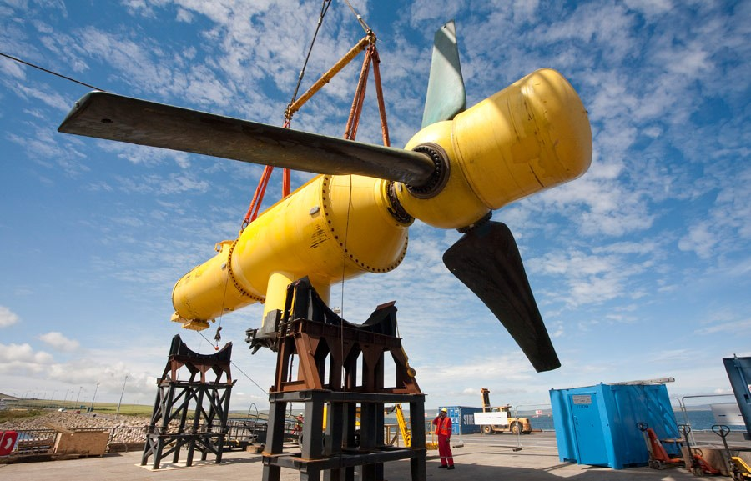
Alstom Tidal Turbine—Orkney Scotland Several actually working worldwide

Slide 70
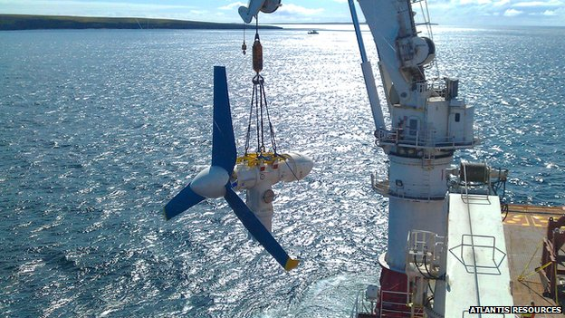
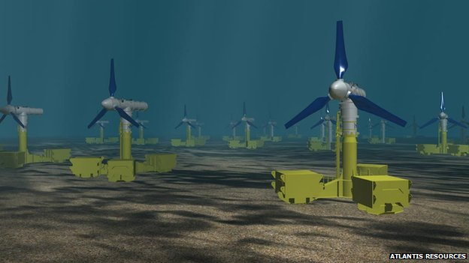
Atlantis Resources MeyGen in Pentland Firth, Scotland
Up to 61 of these by 2020,
enough for 42,000 homes.
Potential for 269
170,000 homes

Slide 71
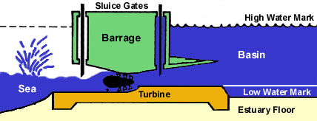
Tidal Barrage System Advantage is that this one can function as a “battery” saving impounded water to generate electricity later

Slide 72
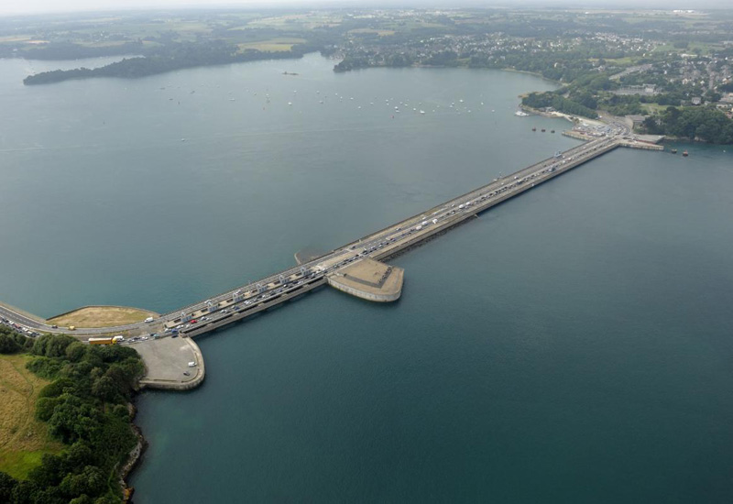
La Rance Tidal Barrage in France-Built 1966 240MW plant 26% efficient = 62 MW output

Slide 73
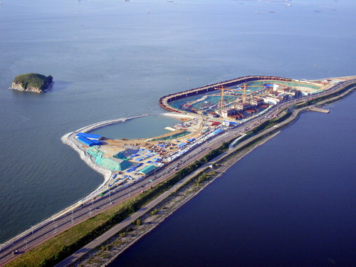
Sihwa Tidal Barrage, Korea, 2011 256 KW installed—I couldn’t find actual output

Slide 74
Exploiting Wave Action
Lots of Experimenting, no commercial examples yet—at least none that I know of, but here are some of the ideas.

Slide 75
Lots of Ideas

Slide 76
Pelamis Wave Energy Converter (Attenuator type—hinged “barrels”) OR Loch Ness Monster! 750 KW per monster. No commercial “farms” yet

Slide 77
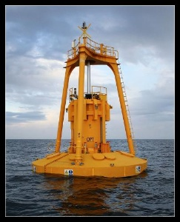
Ocean Power Technology; PB150 Powerbuoy (Point absorber type—bobs up and down)
Potential =150 KW;
output 36%= 54 KW
Another model-PB40 (40kw
output) demos around
the world for Testing.

Slide 78
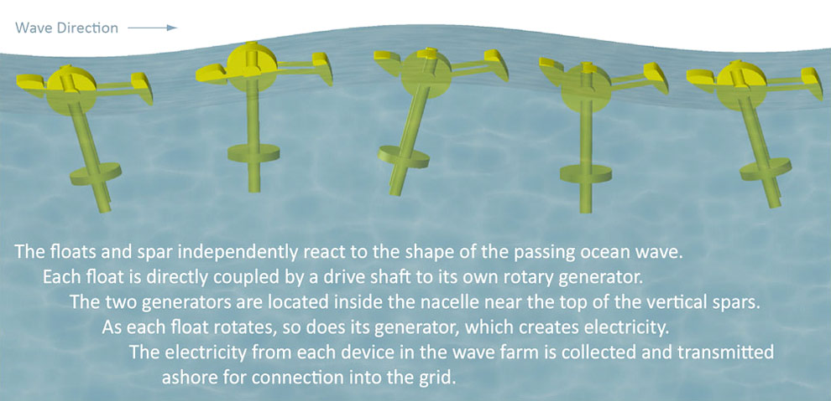
Columbia Power “Stingray” (Point absorber type—bobs and rocks) OSU developed—makes no sense to me!

Slide 79
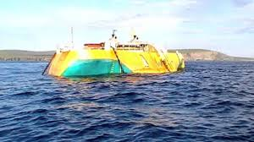
Penguin Wave Energy (Point absorber type— sort of, red gizmo twirls around)

Slide 80
World’s first grid connected wave power station In Australia. Buoys move up and down, which pump seawater ashore to turn turbines.

Slide 81
Aquamarine Power: Oyster Wave Power (surge converter type. Pumps water to shore where it turns a turbine)

Slide 82
Ocean Thermal Energy Conversion (OTEC) (exploits ocean temperature differences)
As Near as I can tell there are no operating systems utilizing the temperature differences in the ocean. In theory and in demos it works, but the costs are so high that nobody has yet invested in a commercial scale site.

Slide 83
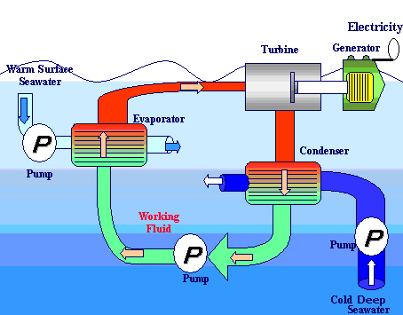
Ocean Thermal Energy Conversion (OTEC) (exploits ocean temperature differences) In theory it is simple; in practice it is wildly expensive

