Slide 1
Guidelines for Group Projects and Papers
GEOG 300 Week 9

Slide 2
What are we doing today?
Recitation points
Guidelines for Paper
Guidelines for Presentation
Group Member Evaluation forms
Group Leader Report
What do you need to turn in?
Group breakout session
Notes:
Today, we are going over guidelines for the paper and the presentation. We will go over where your recitation points will come from (30 sec), what you need to turn in on presentation day (15 mins), and then at the end we will have time to talk to get into groups to plan out what you need to do (15-20 mins).
We are not leaving early, so please use this time to brainstorm and have a plan, or even start the outline of your paper and presentation
Your recitation points today come from group interaction. I’ll walk around to see if you’re participating.

Slide 3
Recitation Points for Week 10
Each person gets credit for attending (10)
When another group is presenting, be sure to actively take notes/ask questions of the groups (10).
Total= 20 pts per recitation, like usual
Do NOT chat, be disruptive, or text during others’ presentation!
Notes:
During week 10, your recitation points will be from attendance and active participation again, whether you are up there presenting or actively listening.
Do NOT be disruptive during a presentation. You should be ready to present before class. Don’t chat during someone else’s presentation as a means of getting ready for your own presentation.

Slide 4
Each group…
Group leader: coordinator
Is the main point of contact for group project
Writes group leader report
Group members: split responsibilities with paper and presentation
Everyone will fill out evaluation forms (upcoming slide)
*If you did not attend the event and did not contact anyone (your group, me) to try to make it up, you will NOT receive credit for the assignment.
Notes:
As a reminder… [read slide]
What if your group had 3 or less? You had the option of doing either a paper or a presentation, but the points for whichever you choose doubles, so make sure it’s good! As for group leader, you should have had only one.

Slide 5
Guidelines for paper
500 ± 25 words
4 sources minimum, cited in text and in bibliography. Only TWO have to be peer-reviewed
Grading
Demographic: Project name, member names, TA, recitation time, date, your name (who wrote it?)
~70% content:
A) Professional project description
B) Inference: What is the broader context of this project?
C) Relevance to GEO 300: How does your project fit into the description of the course?
~30% mechanics: citations, bibliography, grammar, sentence structure
Notes:
Word count ~500.
Sources- at least 4, only 2 have to be peer-reviewed. A lot of these projects are local, so you are welcome to use the organization’s website. For broader impacts, try finding peer-reviewed sources.
Example: You removed invasive species at such and such park. You can talk about the local effects of the invasive species on the native species in Corvallis, but try to find and understand why this issue is important on a broader scale and use peer-reviewed sources for that.
Grading: It’s important I know who is in your group, as well as who contributed to the paper.
(Percentages are about 68 and 32)

Slide 6
Guidelines for presentation
60% Content:
Did you cover the material that applies? (See content part of paper guidelines)
Use of a map
40% Presentation Style:
How well did you get your points across?
Are your visuals actually visible from the back of the room?
Cover the topic thoroughly.
Speaking skills- know what you’re talking about, have good eye contact, don’t read off the slides, etc.
Notes:
For the presentation, the content should match what is in the paper. In addition, please use a map for some sort of spatial illustration.

Slide 7
Be creative!
Goes for paper and presentation
Notes:
Five minutes is not a long time to present, but still keep it interesting.

Slide 8
Time
5 minutes + time for questions!
To make this flow nicely on presentation day, send me your presentation early!
W8: Email by 11:59pm Monday night
F10, 12, 3: Email by 11:59 pm Wednesday night
Notes:
Pace yourself and practice; don’t rush your slides. Because we have several groups going in one day, please send me your PowerPoint in advance so that I can make sure they work and are loaded for the final day.
Expect questions! Your peers are encouraged to ask questions, and I might ask a question or two as well.

Slide 9
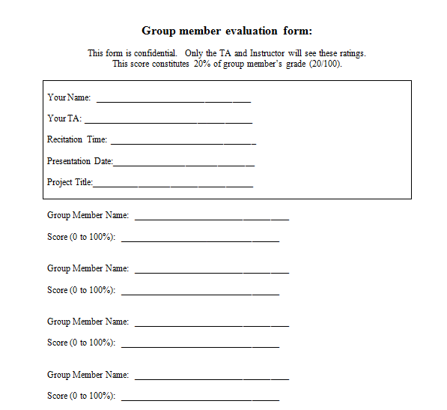
Group member evaluation forms
The complete form is on the GEO 300 website.
Be honest.
Notes:
EACH member will fill one out to evaluate every member’s performance/participation with the entire group project- from getting out in the field to participating in the presentation and paper. It’s important to be honest. The worst part about group projects is that a few people do all of the work, yet everyone gets the same grade. This evaluation form will be the final critical component of your group project grade. While everyone will get the same base grade for the paper and presentation, the remainder of your grade comes from these evaluation forms.
These are found online, so please fill them out before you get to recitation next time.

Slide 10
Group leader report
1 paragraph
Include
Your name, TA name, recitation time, group project name
Describe group dynamics
“We got along well” or “Not everyone did their part,” etc.
Describe your group’s interaction with the “contact person”
Were they prepared? Agreeable? Project well laid out? Any problems?
Did this project fit within the parameters of GEOG 300, as your instructor has taught it?
Notes:
Group leader! We like to know how well the project went in terms of communicating with the contact person, and we would also like to know group dynamics. It’s just a paragraph, so it’s simple.

Slide 11
What to turn in:
1. Score sheet (found on website)-only 1 from group
2. Group leader report (leaders type this)
3. EACH member does a group member evaluation (found on website)
4. Group paper
All of this is to be turned in before you present on your presentation day- it’s how I’m grading all of you at that time!
Notes:
Okay, so on presentation day, you will give me:
A score sheet (unless I have them with me in class)
Group leader report
Every member’s evaluation form
Group paper
This is all due before you begin presenting.

Slide 12
Group breakout session
Right now:
Get responsibilities organized
Ask me any questions
Later:
Facilitate emails/meeting outside of class to help out with paper/presentation
Fun video clip from last term:
https://www.youtube.com/watch?v=6tV89jbMqjw
Notes:
Okay, now that I’ve gone over what’s expected, we will now have the time to get into groups and plan your presentation and paper. Again, we are not leaving even if you plan to meet at another time outside of class. You have this time now to talk, so take advantage of it. Feel free to ask any questions.
[Video clip- optional] Last year when presentations were 15 minutes, we had groups that were really creative with their presentation, and here’s an example. We stopped doing the door hangers because the students didn’t really like it, but this group made the best of it.

