Slide 1
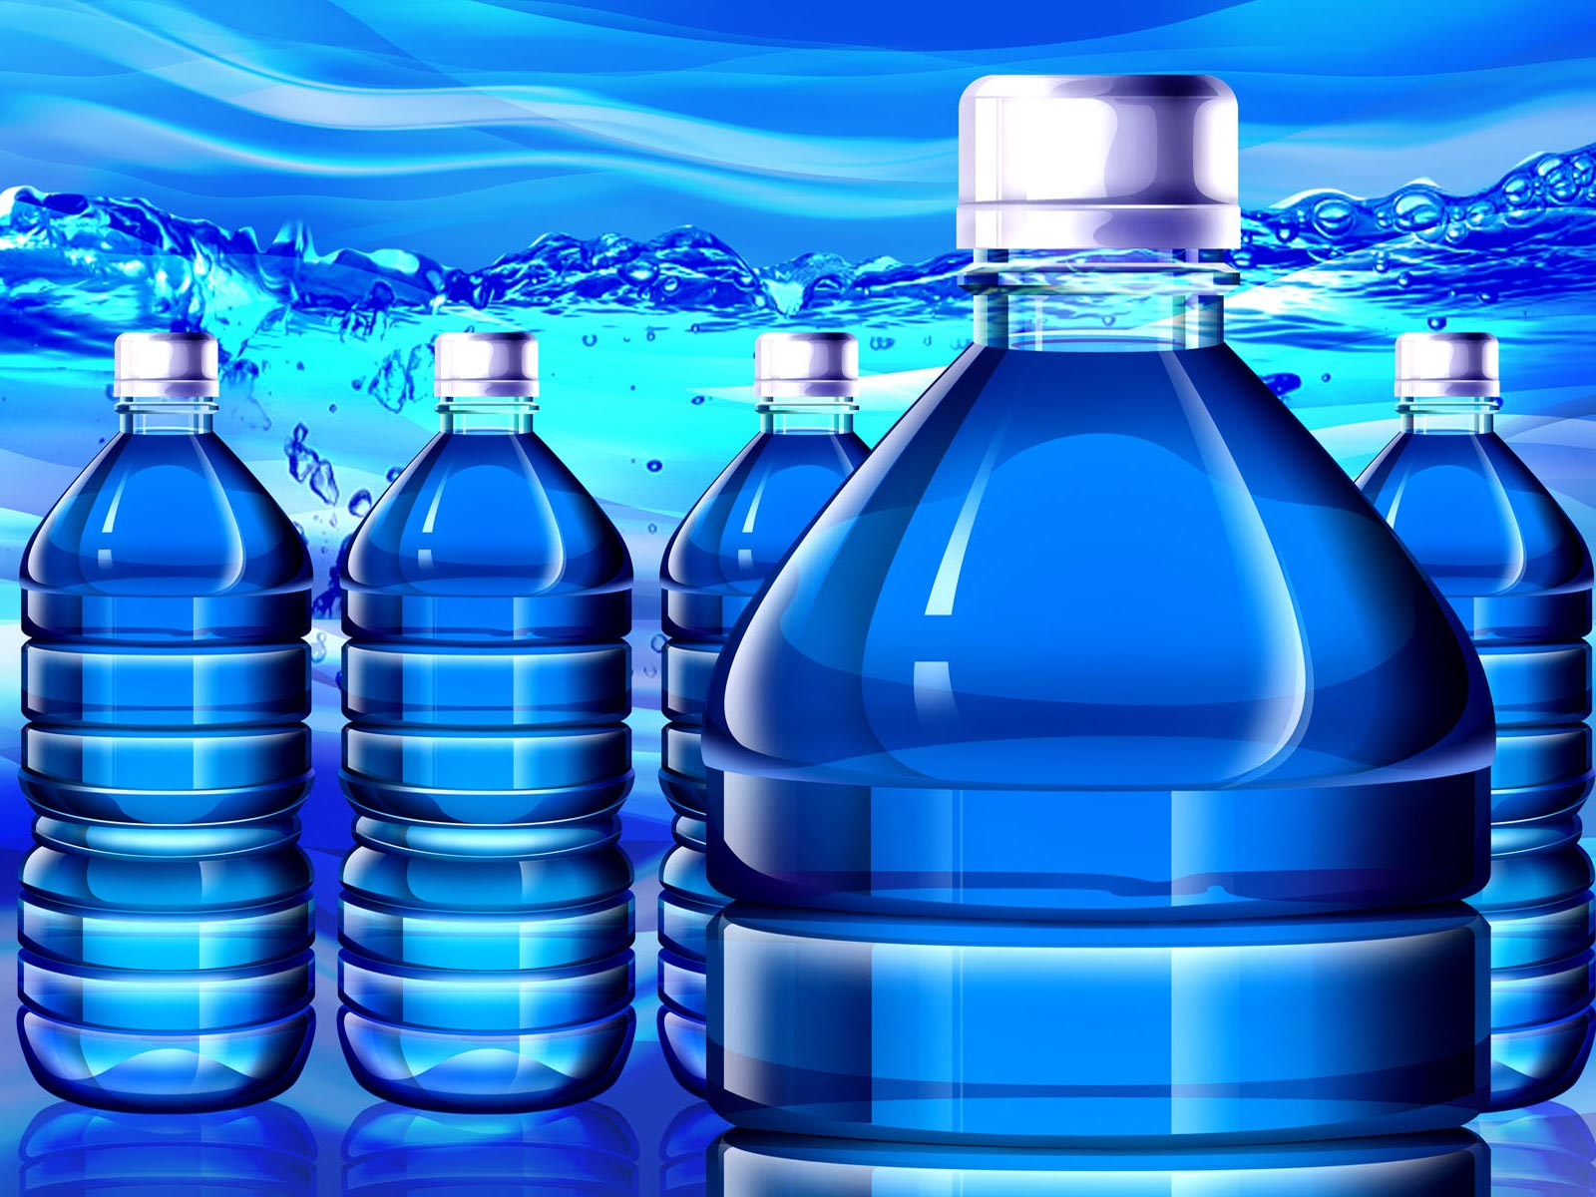
Bottled Water and the Envrionment
Bottled
Water
and the
Environment
Notes:
History, production, impacts; become informed consumer; what’s in water, how it’s produced, where it goes, how its regulated

Slide 3
Donald Trump on Toilets* *From Trevor Noah “The Daily Show”
The toilet that wouldn’t Flush
The dishwasher that wouldn’t wash

Slide 4
Topics Covered:
Bottled Water Benefits
Health Impacts
Environmental Impacts
Economic Impacts
Recent Backlash
Rethink

Slide 5
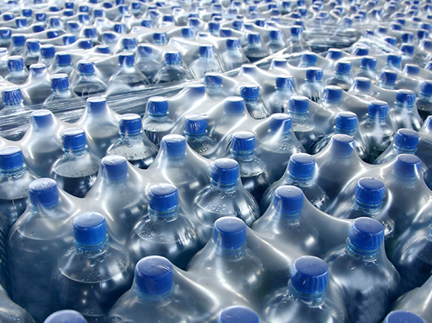
Bottled Water Benefits
http://www.foodandwaterwatch.org/sites/default/files/web_830x437_media-bottledwaterformiles1.jpg

Slide 6
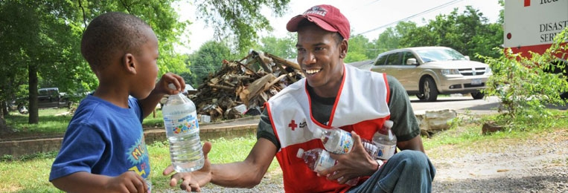
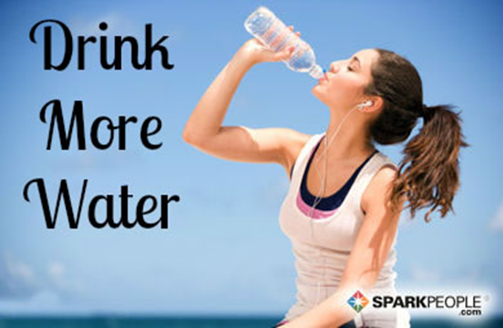
Bottled water benefits
Disaster relief
Contaminated public/private water supply
Healthier than soda!
No access to any other supply
http://www.redcross.org/news/article/Red-Cross-Shelters-and-Provides-Assistance-to-Storm-Victims
Notes:
Easy delivery!
Story about Minnesota

Slide 7
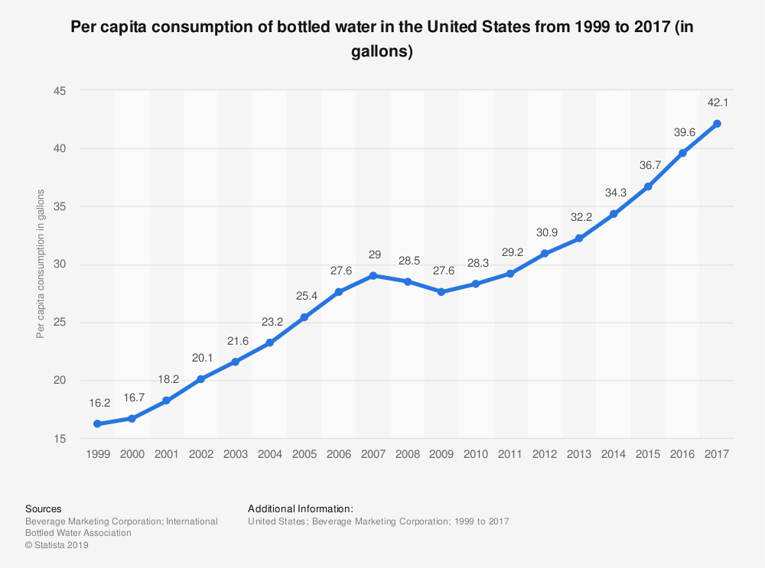

Slide 8
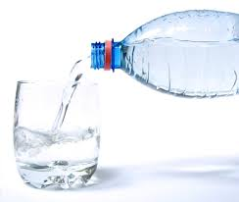
Why do we drink so much bottled water?
Water is bottled and traded globally
1970s - 300 million gallons
2018 - 100 billion gallons (US 13.5 billion gallons)
Companies are good at selling it
How?
Seduce us—Cool, healthy, fit people drink it
Scare us—Tap water is not safe.
Mislead us—Tap Water is inferior in every way
→ MANUFACTURED DEMAND

Slide 9
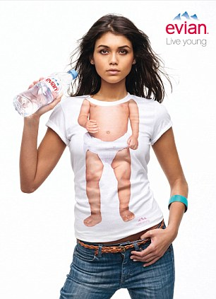
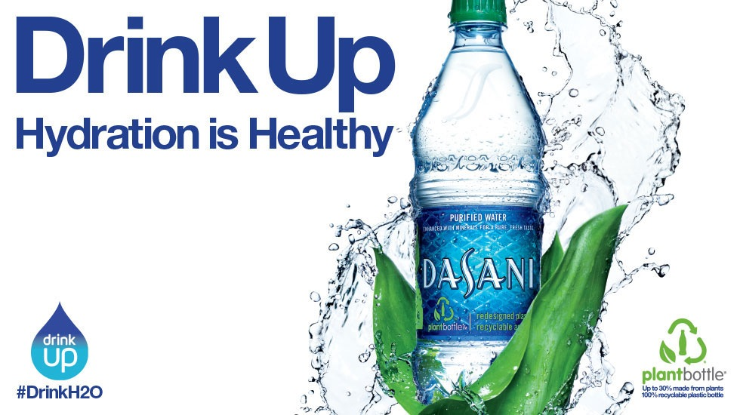
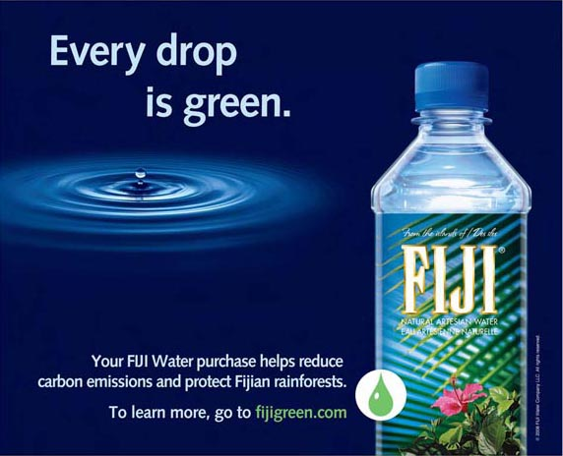
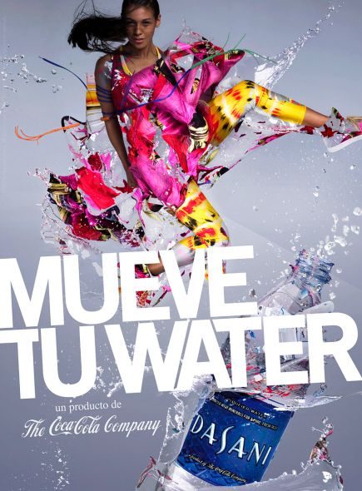
Notes:
All the money that goes into advertisement goes into the cost of the water!

Slide 10
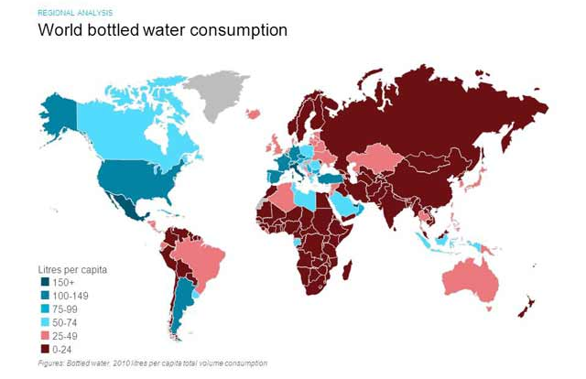
Who drinks bottled water?
3
World Total Volume Consumption of Bottled Water
http://www.euromonitor.com/bottled-water-in-2011-building-on-a-rebound-in-growth/report
Notes:
While a large portion of the world desperately seek clean drinking water, the US and other developed countries spend billions on bottled water when perfectly clean water is readily available.
Flip back and forth bw two maps; look who needs water the most, and look who’s drinking the bottled water

Slide 11
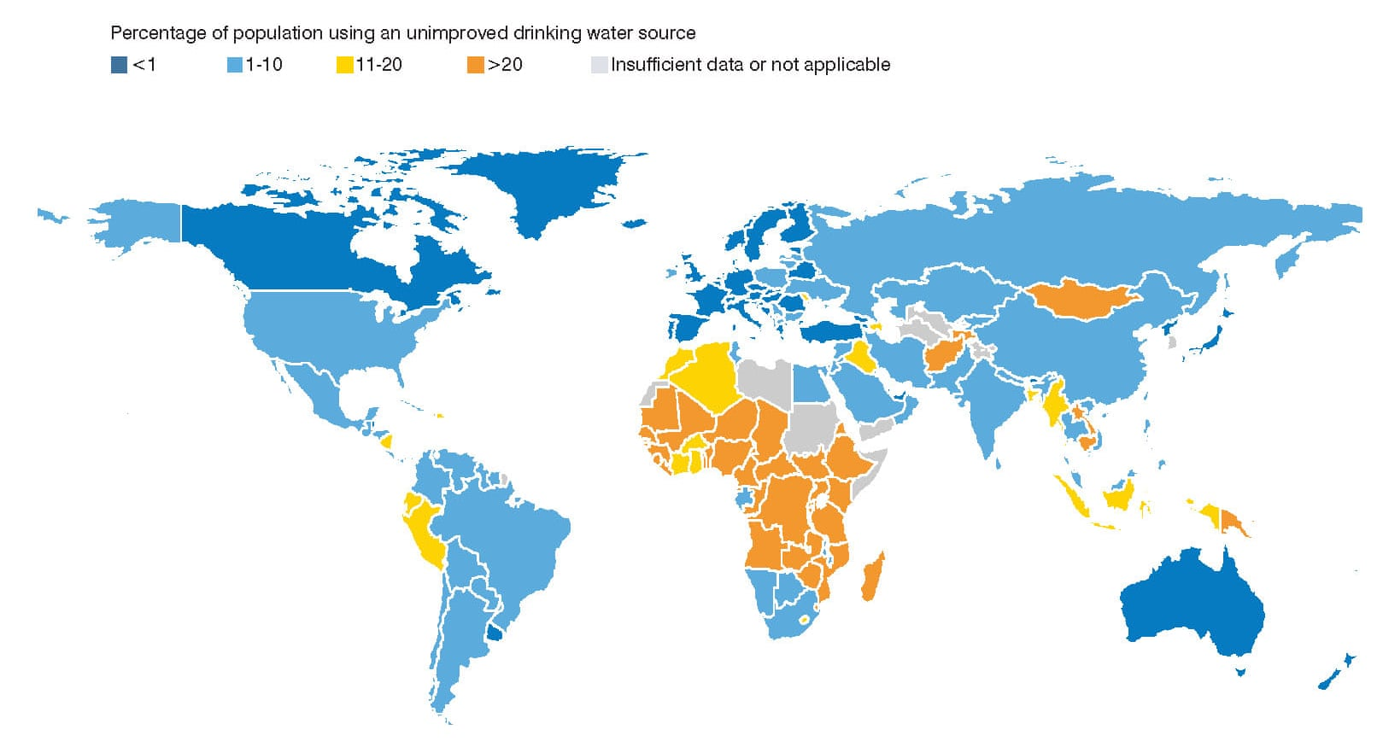

Slide 12
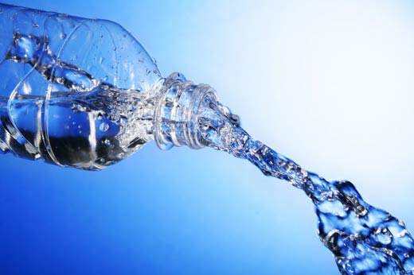
Health IMpacts
http://media.readersdigest.com.au/dynamic

Slide 13
Regulations:
Tap Water: Regulated by the Environmental Protection Agency under the Safe Drinking Water Act
Bottled Water: Regulated as a “food” by the Food and Drug Administration
Detailed quarterly consumer reports (water source, contaminant test violations)
Microbial tests several times per day
Tests for over 100 contaminants as required by the SDWA
No reports to consumers are required
Microbial tests once per week
Tests for only ¼ of the contaminants listed by SDWA
Notes:
Check stats
Different agencies – bottled water regulated as a food, tap water is actually regulated as water by the Safe Drinking Water Act

Slide 14
Corvallis Water & SDWA
FDA only tests
for ¼ of these
contaminants
Notes:
Look up water report wherever you move!
FDA only tests for one quarter of these contaminants. It’s hard to see, but basically you’ve got your bacterial contaminants, household chemicals, agricultural chemicals, as well as inorganic chemicals like arsenic and other poisons.

Slide 15
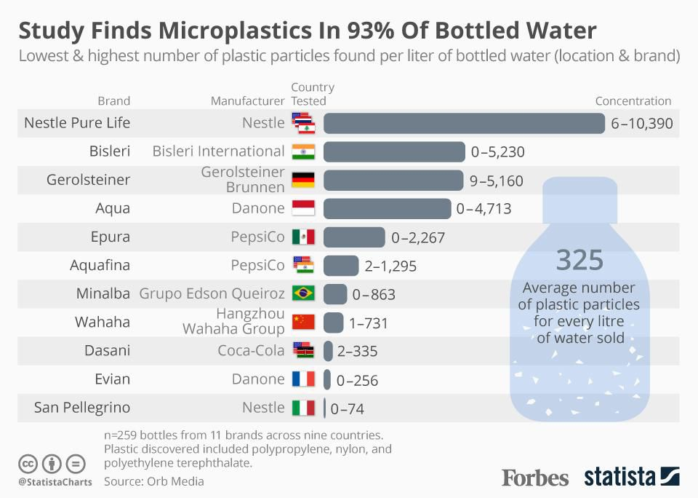

Slide 16
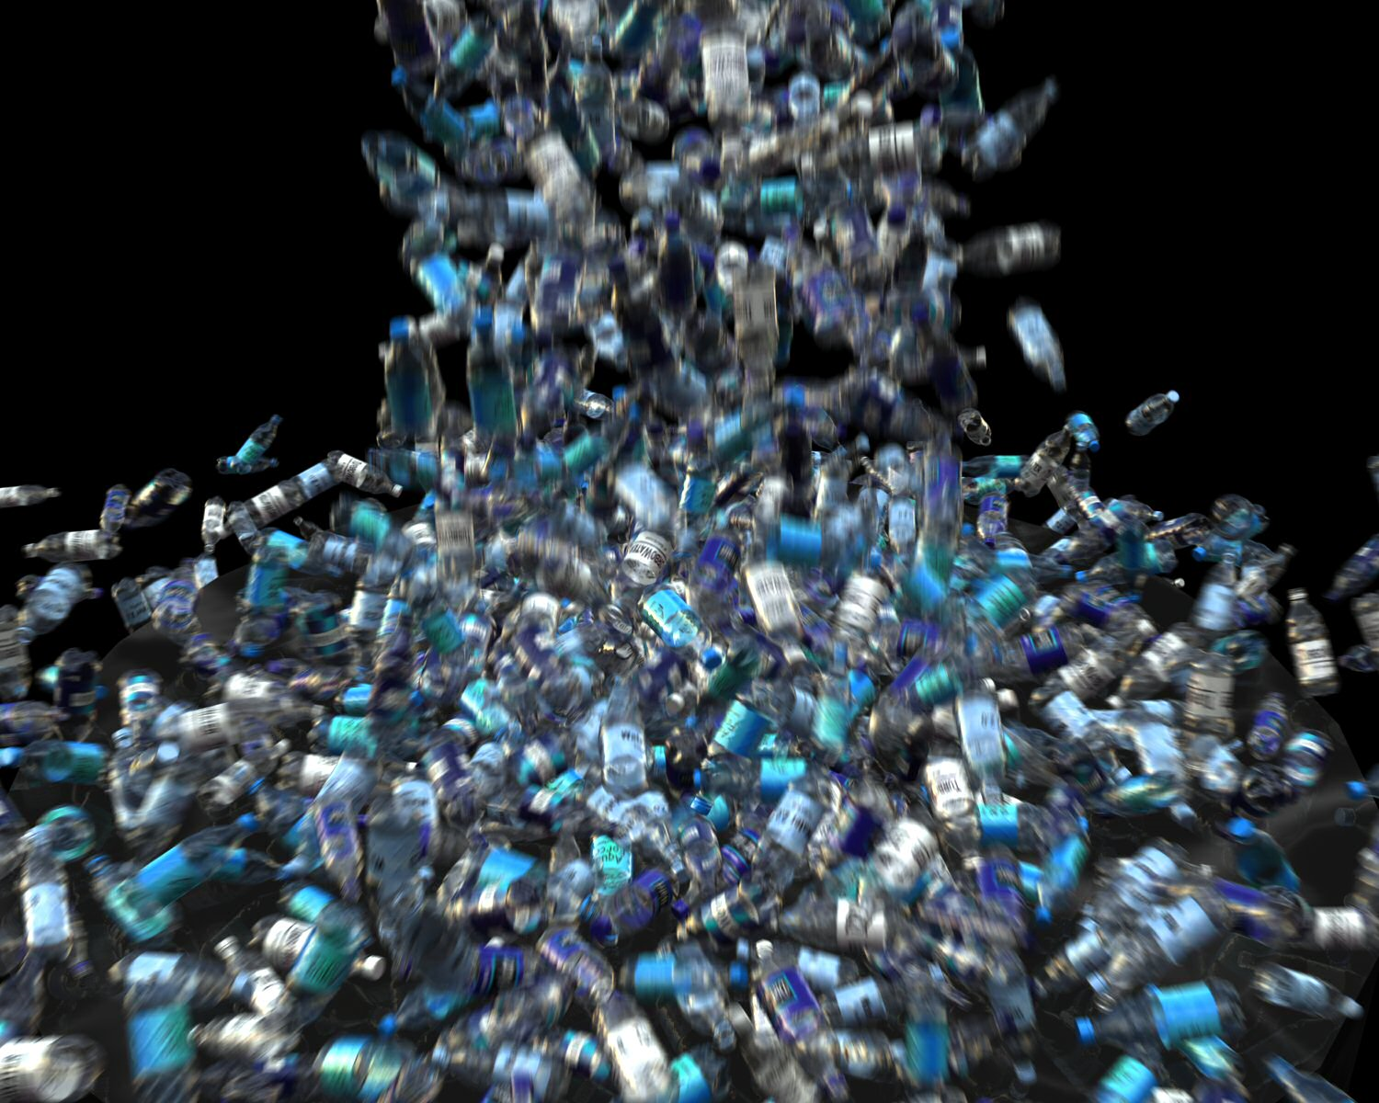
Environmental Impacts

Slide 17
Life Cycle Impacts: Production us =52 Billion 1 liter bottles/yr
This requires:
100 billion gallons of water
and
over 50 million barrels of oil
Just to make the bottles for the US
pacinst.org/publication/bottled-water-and-energy-a-fact-sheet/
Notes:
72 billion gallons of water is equal to over 100,000 olympic swimming pools! (50 m x 25 m x 2m)

Slide 18
Life Cycle Impacts: Transport
A billion bottles of water are transported each week in the US by Boat, Train, and Truck
That’s 18,200 tons Carbon Dioxide each week pumped into the air.

Slide 19
Life Cycle Impacts: Disposal
US plastic bottle recycling rate:
2015 = 32%; 2018 = 29%
Oregon plastic bottle recycle rates:
2012 = 71%
2015 = 64%
2018 = 90% Why? Redemption went from 5 cents to 10 cents.
*https://www.oregon.gov/OLCC/pages/bottle_bill.aspx
**http://www.plasticsrecycling.org/news-and-media/424-november-5-2015-plastic-bottle-recycling-rate-report-release

Slide 20
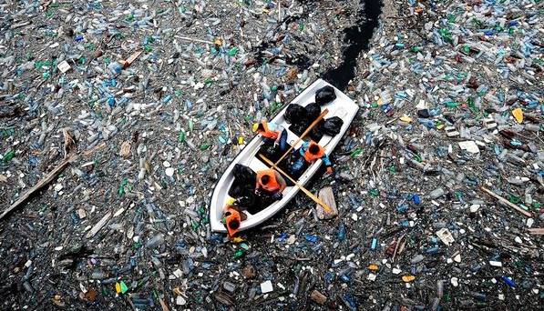
Life Cycle Impacts: Disposal
Plastics do not biodegrade, they photodegrade
Empty bottles eventually fill with water and sink.
The polystyrene bottle caps will float for decades.
www.bloomberg.com/slideshow/2012-10-02/the-life-of-a-plastic-water-bottle.html#slide15
Notes:
Explain biodegrade vs photodegrade.
Anyone ever heard of the Pacific garbage patch???
(LEFT) Volunteers in orange life vests row through a sea of floating debris and plastic bottles while trying to clear a clog at Vacha dam near Krichim, Bulgaria.
"Manufacturers say PET is green because it's 100 percent recyclable," says the Plastic Pollution Coalition's Russo. "But nobody's able to collect 100 percent of the plastic. The problem is that these bottles are meant to be thrown away."

Slide 21
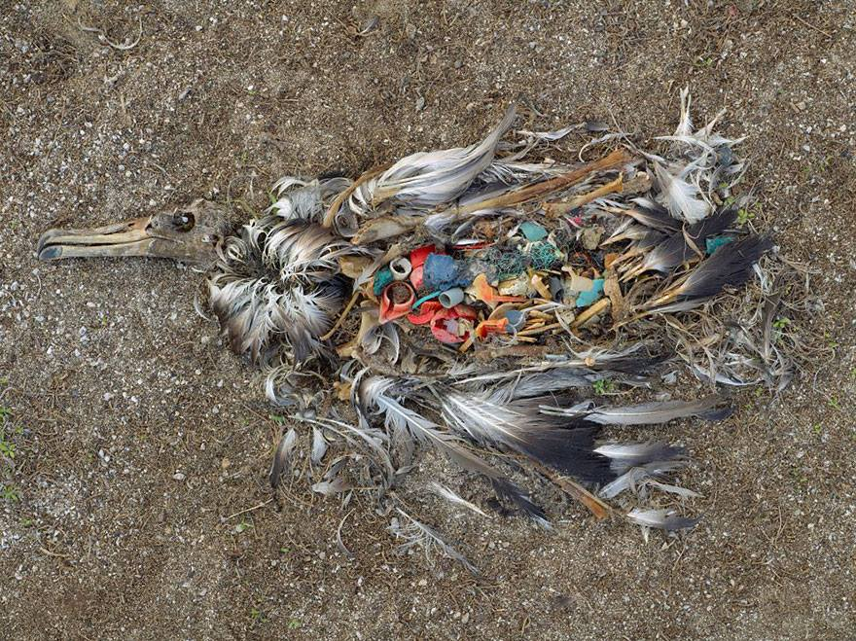
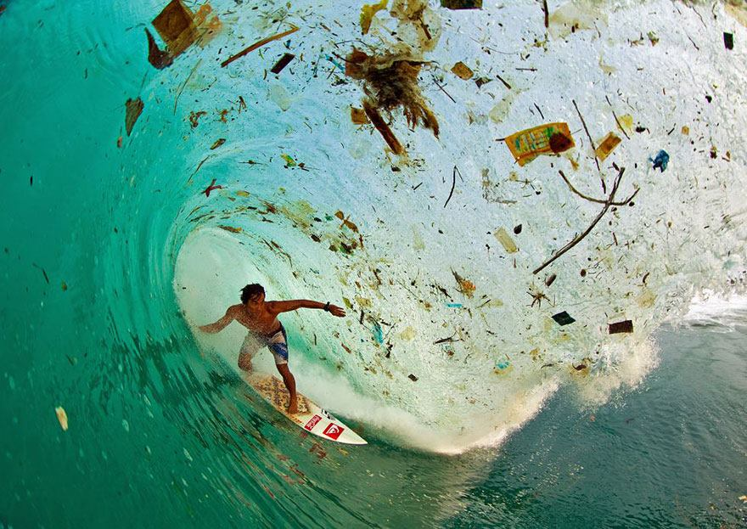
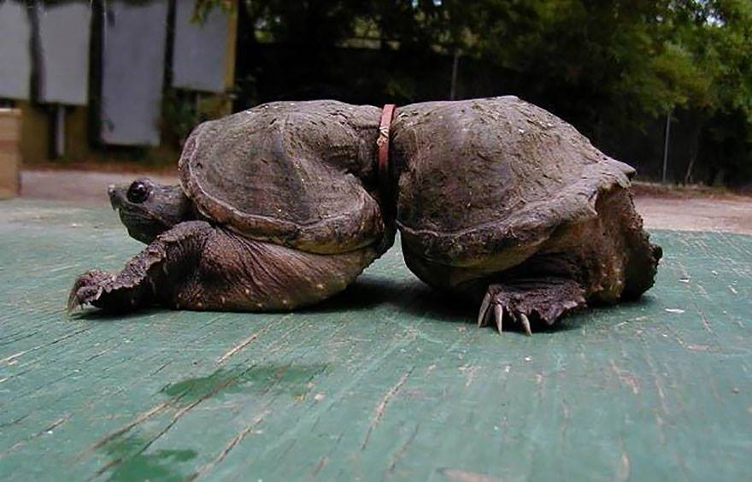
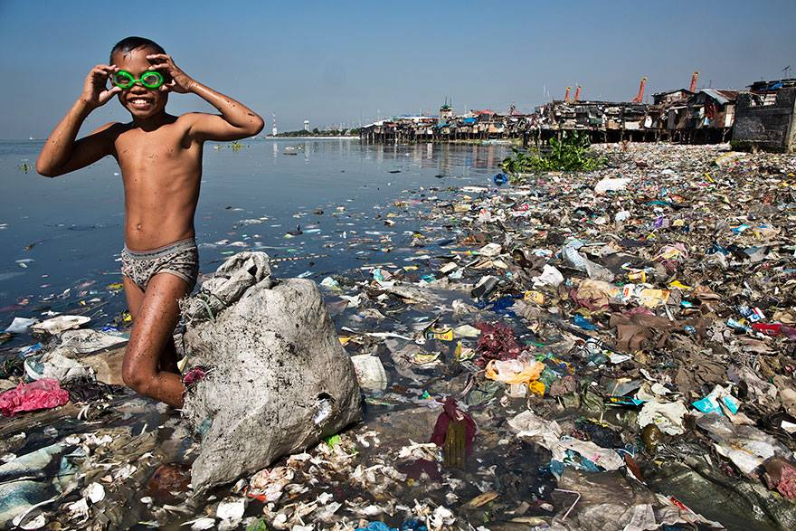
Notes:
Albatross starve to death because their stomachs are full of plastic so they don’t eat.

Slide 22
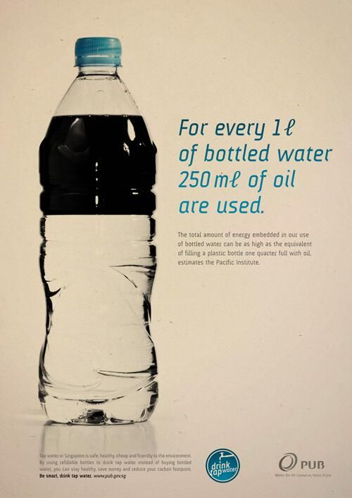
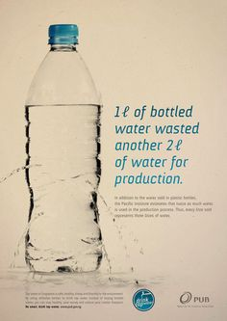
Life Cycle Impacts: Footprint

Slide 23
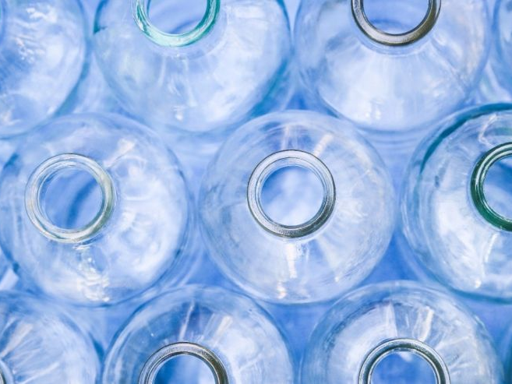
Economic Impacts: For You My Friend!
http://a57.foxnews.com/images.foxnews.com/content/fox-news/health/2016/04/27/4000-sickened-in-spain-how-does-virus-get-into-bottled-water/_jcr_content/par/featured-media/media-0.img.jpg/876/493/1461758692549.jpg?ve=1&tl=1

Slide 24
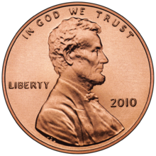
Price differences
Corvallis Tap Water = 3 gallons for a penny—300 gallons for a dollar
Brita Filter Pitcher ($25.00) and filter ($8.00)
The filter alone gets us to $0.10 to $0.12 /gal.
Bottled Waters:
Mt. Shasta = $2.56/gal
Dasani = $3.38/gal
Aquafina = $3.77/gal
Perrier = $5.03/gal
Park City “Ice” Water = $18.00/gal

Slide 25
Who Dominates the Market In Oregon?
Nestle = 29%
Crystal Geyser (currently with Dannon)= 20%
Pepsi = 20%
Coca-Cola = 18%
Others = EartH20 and other smaller bottlers who are our neighbors = 6%
Notes:
Should we leave this?? - Melva

Slide 26
Recent Backlash
https://static1.squarespace.com/static/5101685be4b00028821c175e/51023156e4b0145933797a00/51023156e4b0145933797a01/1359098202512/bottle-pour.jpg

Slide 27
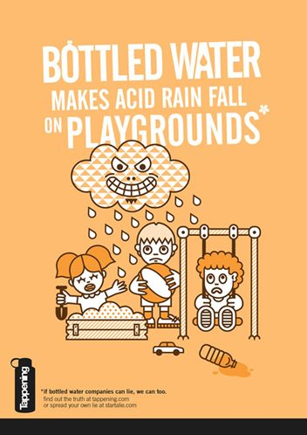
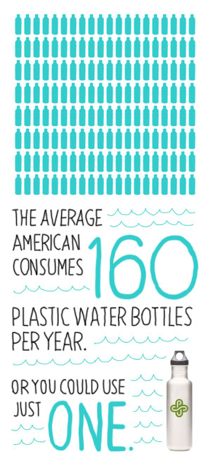
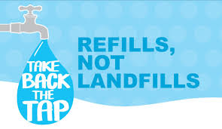
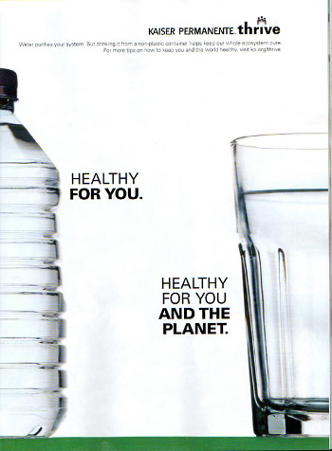
90 U.S. universities have banned the sale of bottled water*
*Everblue News, 2018
http://takebackthetap.org/
Notes:
If bottled water companies can lie, why can’t we?

Slide 28
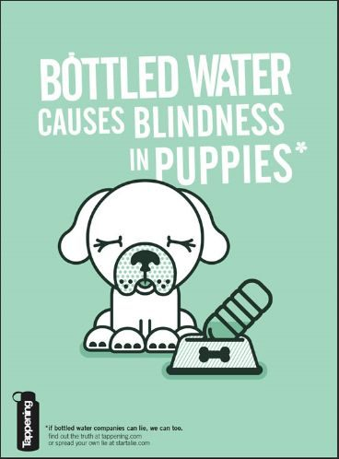

Slide 29
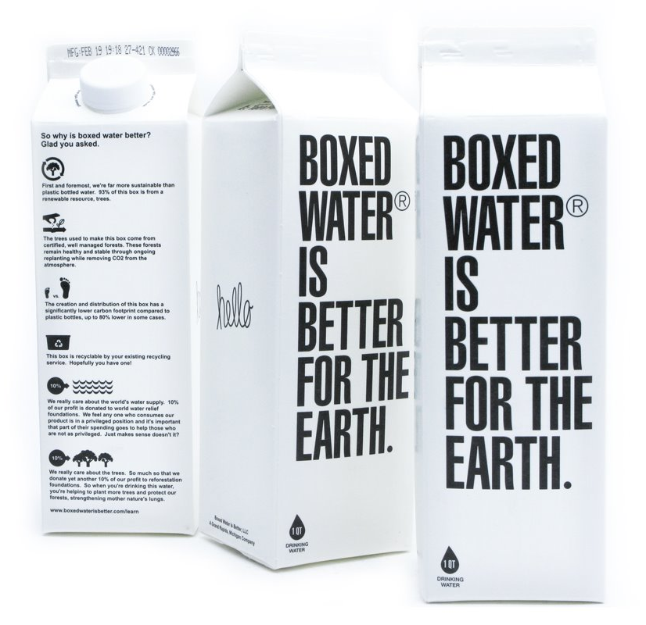
But…there is a New trend. Is this the answer?????

Slide 30
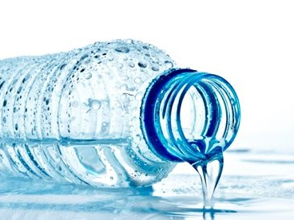
ReThink
https://i.guim.co.uk/img/static/sys-images/Guardian/Pix/pictures/2015/5/29/1432910465076/Bottle-of-water-007.jpg?w=620&q=55&auto=format&usm=12&fit=max&s=c2354322a8e0723472689fddd1e509f8

Slide 31
Rethink Bottled Water
Remember
Tap water is better regulated than bottled water, has a smaller footprint, generates less pollution.
Action
Steve’s suggestion: Buy a bottle of water, refill it fifty times, recycle it.
Rethink
Why not try tap water? Encourage others. Don’t provide bottled water in your home.
Redeem bottles—hey it’s 10 cents a pop!

Slide 32
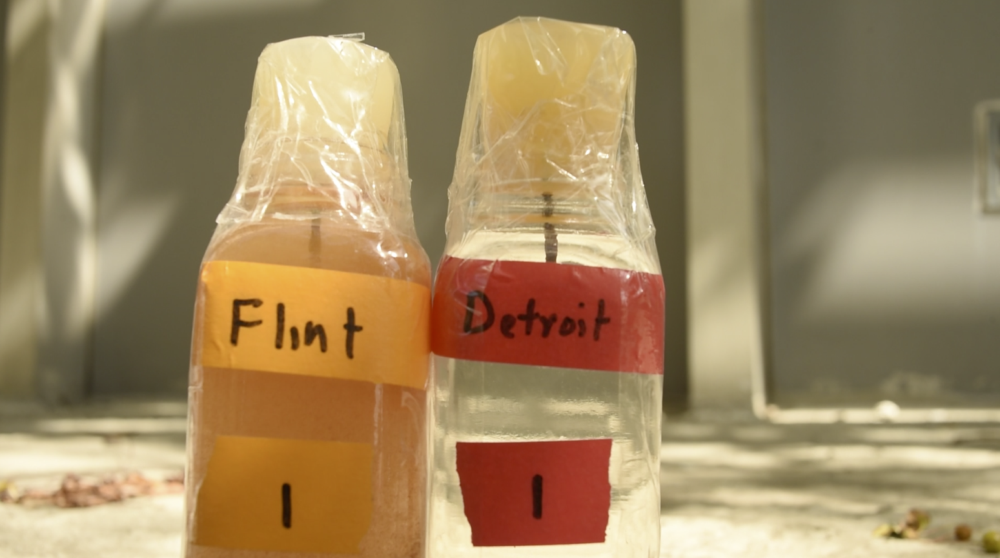
“Arguments for or against bottled water are more than environmental or economic—they have deeper psychological, philosophical, and ideological implications and social subtexts.”
-Peter Gleick, Bottled and Sold

Slide 33
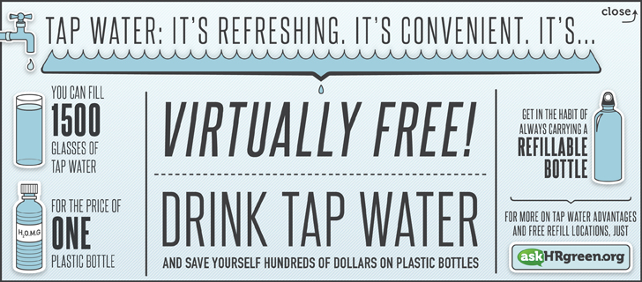
RETHINK WATER Save resources-Save Money!

Slide 34
Notes:
OSU’s initiative to offer filtered water to students with refillable bottles.

Slide 35
“Arguments for or against bottled water are more than environmental or economic—they have deeper psychological, philosophical, and ideological implications and social subtexts.”
-Peter Gleick, Bottled and Sold

