Slide 1
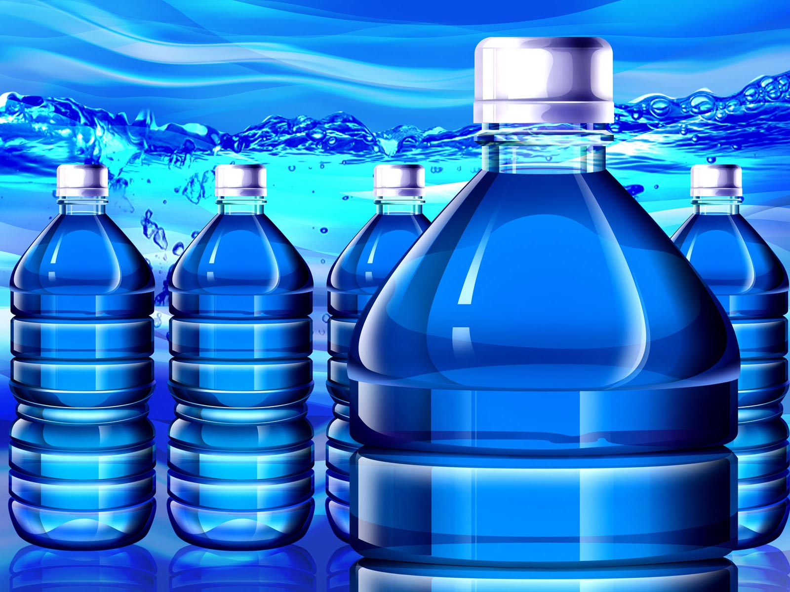
Bottled Water and the Envrionment
Bottled
Water
and the
Environment
Notes:
History, production, impacts; become informed consumer; what’s in water, how it’s produced, where it goes, how its regulated

Slide 2
Topics Covered:
Bottled Water Benefits
Health Impacts
Environmental Impacts
Economic Impacts
Recent Backlash
Rethink

Slide 3
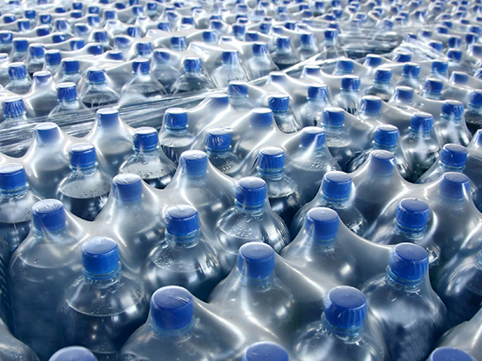
Bottled Water Benefits
http://www.foodandwaterwatch.org/sites/default/files/web_830x437_media-bottledwaterformiles1.jpg

Slide 4
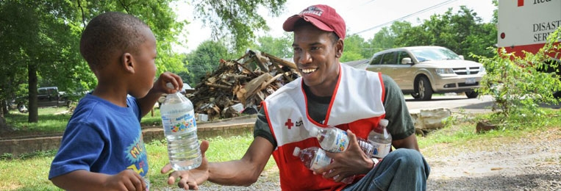
Bottled water benefits
Disaster relief
Contaminated public/private water supply
Healthier than soda!
No access to any other supply
http://www.redcross.org/news/article/Red-Cross-Shelters-and-Provides-Assistance-to-Storm-Victims
Notes:
Easy delivery!
Story about Minnesota

Slide 5
Per capita consumption of bottled water in the us 1999 to 2013
WHY?
What does this tell us about consumption of bottled water in the US??
Per capita consumption (gallons)
http://www.statista.com/statistics/183377/per-capita-consumption-of-bottled-water-in-the-us-since-1999/
Notes:
***Mention that carbonates sales are decreasing as bottled water consumption increases. In the near future, bottled water will surpass other drink sales.
Don’t read below…
After a pronounced slowdown in growth during the 2007-2009 recession years, bottled water sales bounced back in 2010 on a global scale, and are expected to contribute the greater share of overall soft drinks growth in the period to 2015. This report analyses the largest global soft drinks category by volume, identifying regional and category differences, and highlighting the challenges faced and opportunities ahead for bottled water manufacturers in a post-recession economy.
http://www.euromonitor.com/bottled-water-in-2011-building-on-a-rebound-in-growth/report
2015 Per Capita Consumption of Bottled Water in US = 36.2 gallons.

Slide 6
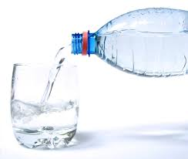
Why do we drink so much bottled water?
Water is bottled and traded globally
1970s - 300 million gallons
2016 - 75 billion gallons (US 12 billion gallons)
Companies are good at selling it
How?
Marketing and advertisement
→ MANUFACTURED DEMAND

Slide 7
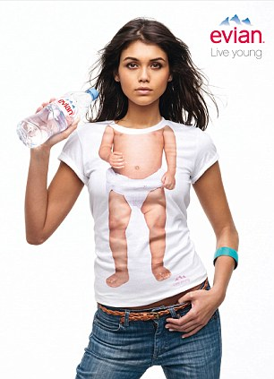
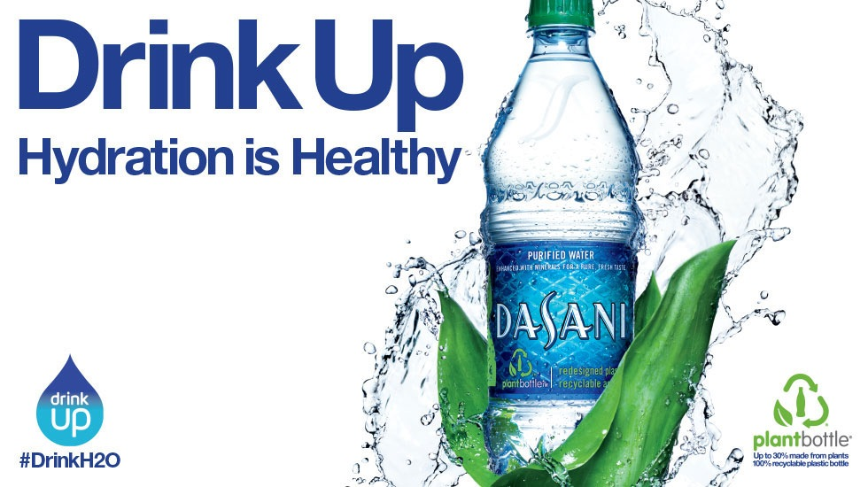
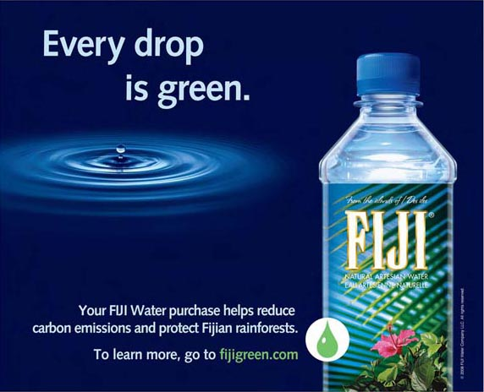
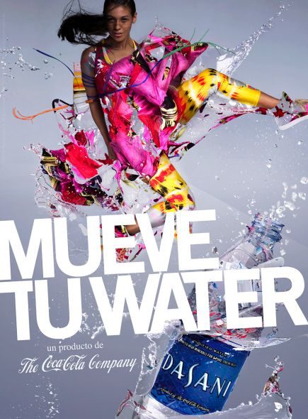
Notes:
All the money that goes into advertisement goes into the cost of the water!

Slide 8
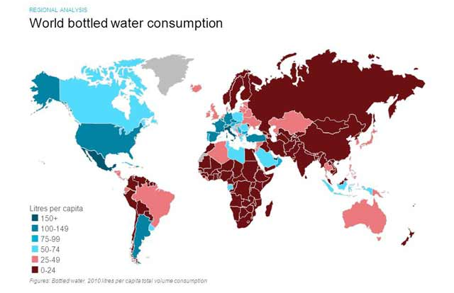
Who drinks bottled water?
3
2010 World Total Volume Consumption of Bottled Water
http://www.euromonitor.com/bottled-water-in-2011-building-on-a-rebound-in-growth/report
Notes:
While a large portion of the world desperately seek clean drinking water, the US and other developed countries spend billions on bottled water when perfectly clean water is readily available.
Flip back and forth bw two maps; look who needs water the most, and look who’s drinking the bottled water

Slide 9
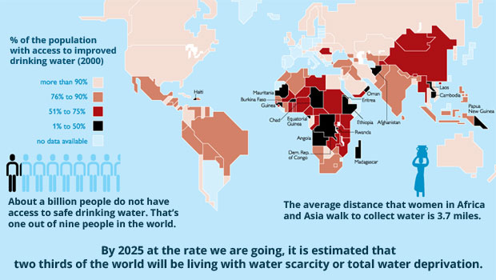
Not everyone has access to clean water
http://blueplanetnetwork.org/water/
Notes:
Darker the image, the less available water is

Slide 10
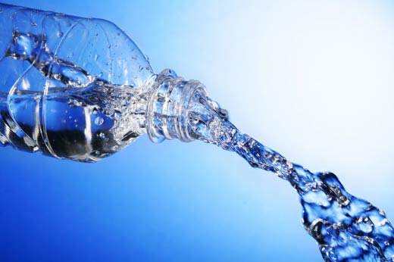
Health IMpacts
http://media.readersdigest.com.au/dynamic

Slide 11
Regulations:
Tap Water: Regulated by the Environmental Protection Agency under the Safe Drinking Water Act
Bottled Water: Regulated as a “food” by the Food and Drug Administration
Detailed quarterly consumer reports (water source, contaminant test violations)
Microbial tests several times per day
Tests for over 100 contaminants as required by the SDWA
No reports to consumers are required
Microbial tests once per week
Tests for only ¼ of the contaminants listed by SDWA
Notes:
Check stats
Different agencies – bottled water regulated as a food, tap water is actually regulated as water by the Safe Drinking Water Act

Slide 12
Corvallis Water & SDWA
FDA only tests
for ¼ of these
contaminants
Notes:
Look up water report wherever you move!
FDA only tests for one quarter of these contaminants. It’s hard to see, but basically you’ve got your bacterial contaminants, household chemicals, agricultural chemicals, as well as inorganic chemicals like arsenic and other poisons.

Slide 13
2011 Bottled Water survey
Out of a survey of 173 unique bottled water products:
18% fail to list the source
32% disclose nothing about the treatment or purity of the water
Only two water brands listed source, treatment, and purity
Close to half of all bottled water is sourced from municipal tap water
Notes:
Activity: boxed water? Spend about 5 mins
Survey done in 2011
http://www.ewg.org/research/ewg-bottled-water-scorecard-2011
*Water Watch 2010 and BMC 2010
**Gleick 2009
EWG Bottled Water Scorecard
It takes approximately 2000 times more energy to produce an equivalent amount of tap water**

Slide 14
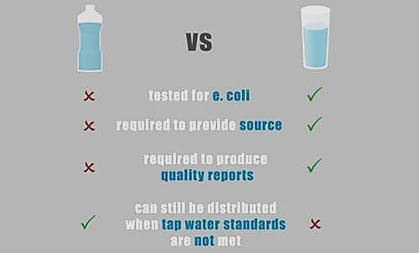
In conclusion…

Slide 15
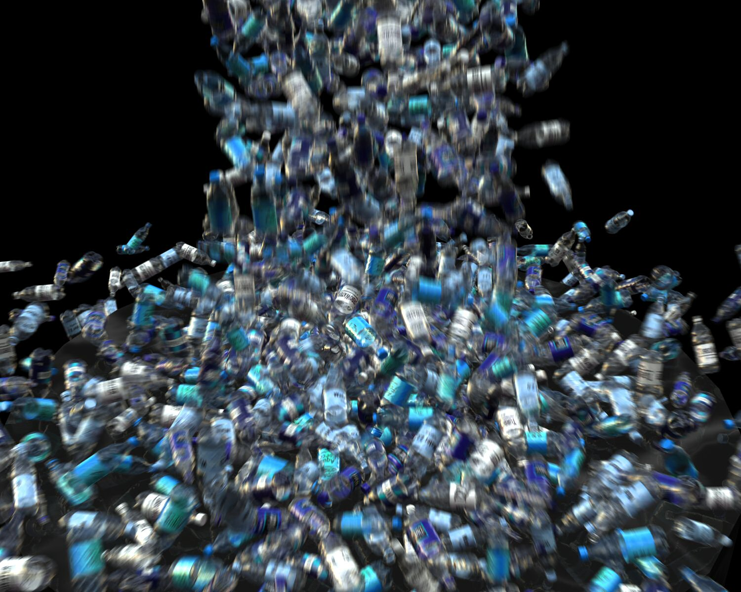
Environmental Impacts

Slide 16
Life Cycle Impacts: Production
72 billion gallons of water and
900 million gallons of oil are required to manufacture empty PET bottles each year
(this is the equivalent of one day’s oil consumption in the US)
*Emily Gursima, AP, 2003
**http://www.bloomberg.com/slideshow/2012-10-02/the-life-of-a-plastic-water-bottle.html#slide15
Notes:
72 billion gallons of water is equal to over 100,000 olympic swimming pools! (50 m x 25 m x 2m)

Slide 17
Life Cycle Impacts: Transport
A billion bottles of water are transported each week in the US by Boat, Train, and Truck
That’s 18,200 tons Carbon Dioxide each week pumped into the air.

Slide 18
Life Cycle Impacts: Disposal
US plastic bottle recycling rate:
2015 = 32%
Oregon plastic bottle recycle rates:
2012 = 71%
2015 = 64%
Consequently, the Oregon redemption rate goes to 10 cents on April 1, 2017.
*https://www.oregon.gov/OLCC/pages/bottle_bill.aspx
**http://www.plasticsrecycling.org/news-and-media/424-november-5-2015-plastic-bottle-recycling-rate-report-release

Slide 19
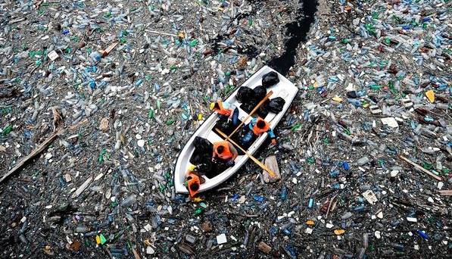
Life Cycle Impacts: Disposal
Plastics do not biodegrade, they photodegrade
Empty bottles eventually fill with water and sink.
The polystyrene bottle caps will float for decades.
www.bloomberg.com/slideshow/2012-10-02/the-life-of-a-plastic-water-bottle.html#slide15
Notes:
Explain biodegrade vs photodegrade.
Anyone ever heard of the Pacific garbage patch???
(LEFT) Volunteers in orange life vests row through a sea of floating debris and plastic bottles while trying to clear a clog at Vacha dam near Krichim, Bulgaria.
"Manufacturers say PET is green because it's 100 percent recyclable," says the Plastic Pollution Coalition's Russo. "But nobody's able to collect 100 percent of the plastic. The problem is that these bottles are meant to be thrown away."

Slide 20
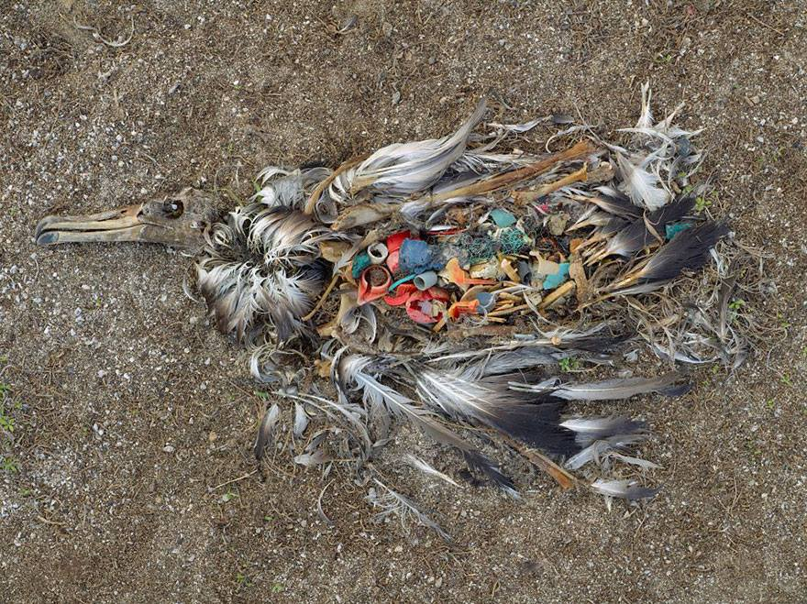
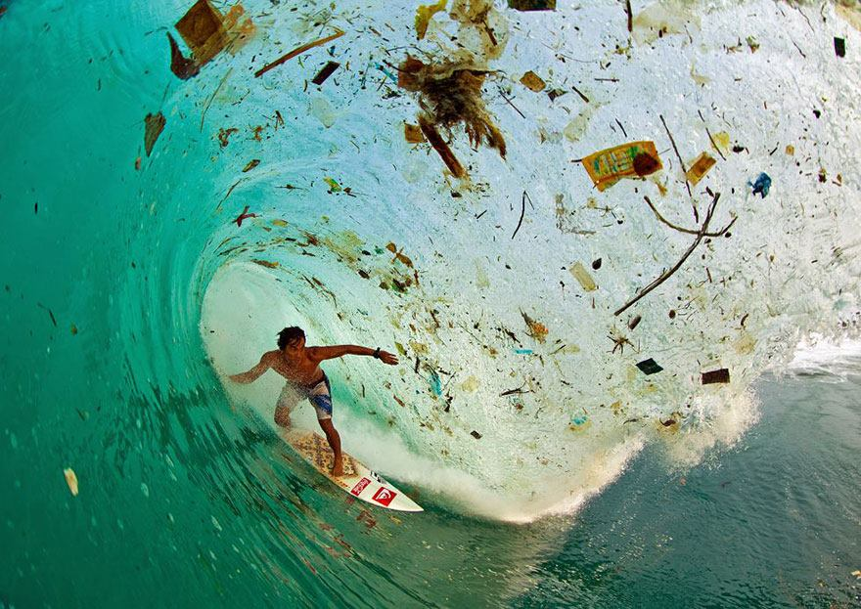
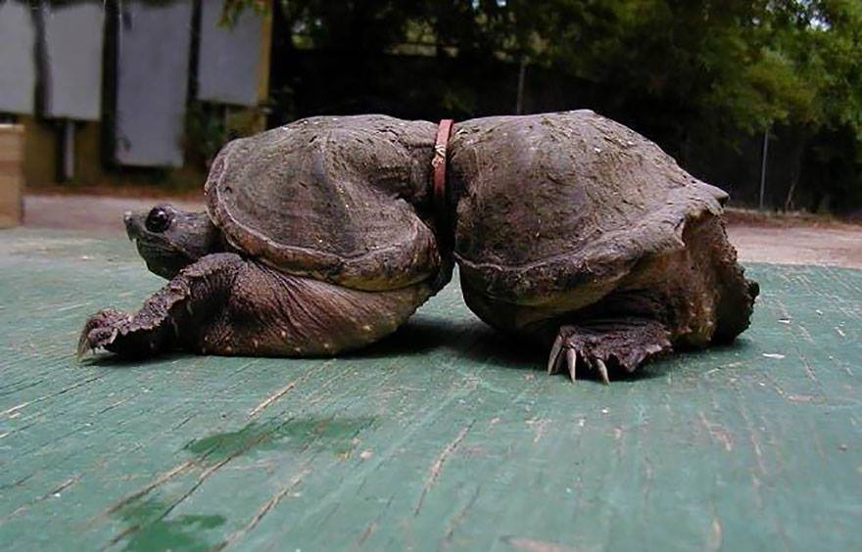
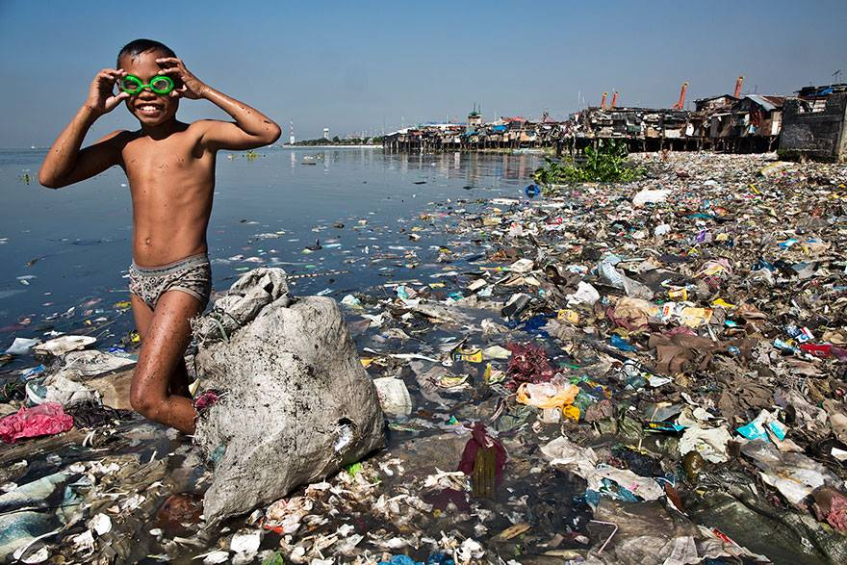
Notes:
Albatross starve to death because their stomachs are full of plastic so they don’t eat.

Slide 21
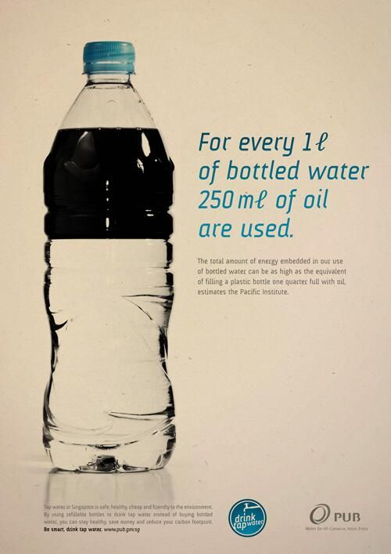
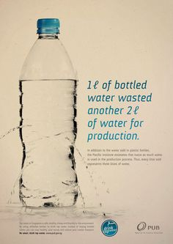
Life Cycle Impacts: Footprint

Slide 22
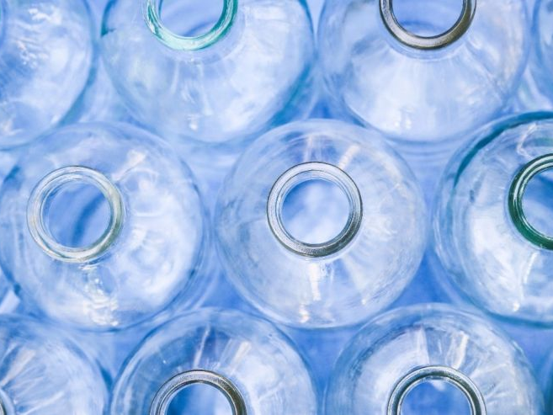
Economic Impacts
http://a57.foxnews.com/images.foxnews.com/content/fox-news/health/2016/04/27/4000-sickened-in-spain-how-does-virus-get-into-bottled-water/_jcr_content/par/featured-media/media-0.img.jpg/876/493/1461758692549.jpg?ve=1&tl=1

Slide 23
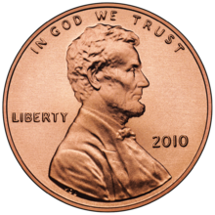
Price differences
Corvallis Tap Water = 3 gallons for a penny—300 gallons for a dollar
Brita Filter Pitcher ($25.00) and filter ($8.00)
The filter alone gets us to $0.10 to $0.12 /gal.
Bottled Waters:
Mt. Shasta = $2.56/gal
Dasani = $3.38/gal
Aquafina = $3.77/gal
Perrier = $5.03/gal
Park City “Ice” Water = $18.00/gal

Slide 24
Who Dominates the Market In Oregon?
Nestle = 29%
Crystal Geyser (currently with Dannon)= 20%
Pepsi = 20%
Coca-Cola = 18%
Others = EartH20 and other smaller bottlers who are our neighbors = 6%
Notes:
Should we leave this?? - Melva

Slide 25
Nestlé's War in Cascade Locks, OR
Nestlé wants access to the gushing water from Oxbow Springs controlled by Oregon Department of Fish and Wildlife. The company proposes a plant to bottle 100 million gallons per year.
Cascade Locks desperately wants to get control of the water from ODFW so it can sell it to Nestle to generate revenue.
http://www.oregonlive.com/environment/index.ssf/2015/01/bottled_water_wars_nestles_lat.html
Notes:
For info on this, go to:
http://www.oregonlive.com/environment/index.ssf/2015/01/bottled_water_wars_nestles_lat.html

Slide 26
Nestlé's War in Cascade Locks, OR
ODFW currently draws water from Oxbow Spring for a nearby salmon hatchery
In May 2016, Food & Water Watch and Local Water Alliance got Measure 14-55 on Hood River County ballot, banning Nestle from withdrawing water. Measure passed.
October 2016, Judge ruled that ODFW can transfer water to Cascade Locks. But the issue of Hood River County vote prohibiting selling water out of the county is outstanding.

Slide 27
Recent Backlash
https://static1.squarespace.com/static/5101685be4b00028821c175e/51023156e4b0145933797a00/51023156e4b0145933797a01/1359098202512/bottle-pour.jpg

Slide 28
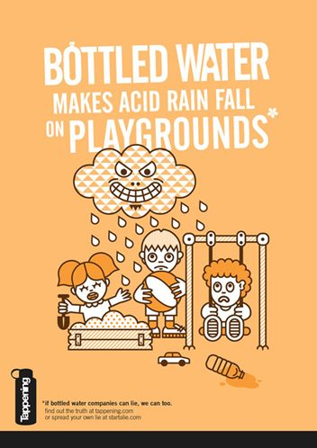
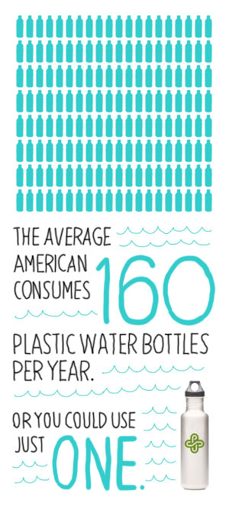
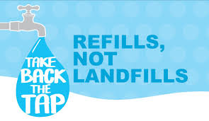
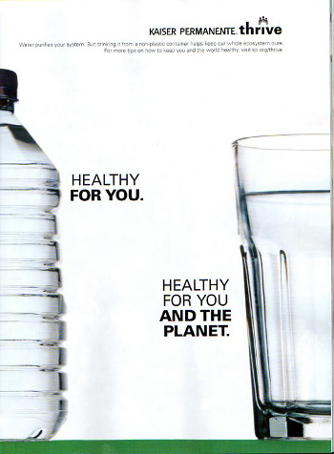
An estimated 70 U.S. universities have banned the sale of bottled water on campus- not OSU
*google fusion tables
http://takebackthetap.org/
Notes:
If bottled water companies can lie, why can’t we?

Slide 30
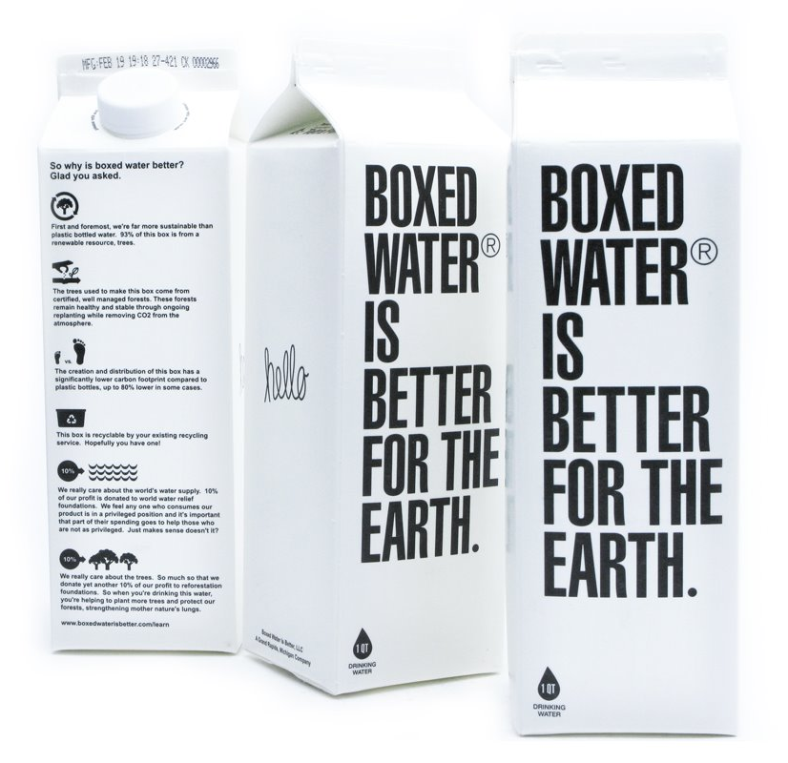
But…there is a New trend. Is this the answer?????

Slide 31
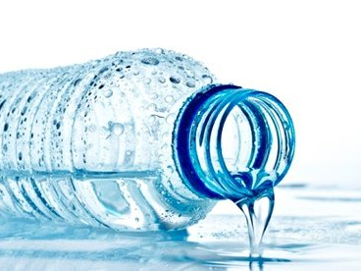
ReThink
https://i.guim.co.uk/img/static/sys-images/Guardian/Pix/pictures/2015/5/29/1432910465076/Bottle-of-water-007.jpg?w=620&q=55&auto=format&usm=12&fit=max&s=c2354322a8e0723472689fddd1e509f8

Slide 32
Rethink Bottled Water
Remember
Tap water is better regulated than bottled water, has a smaller footprint, generates less pollution.
Action
Buy a bottle of water, refill it fifty times, recycle it.
Rethink
Why not try tap water? Encourage others. Don’t provide bottled water in your home.
Recycle yours and other’s bottles.

Slide 33
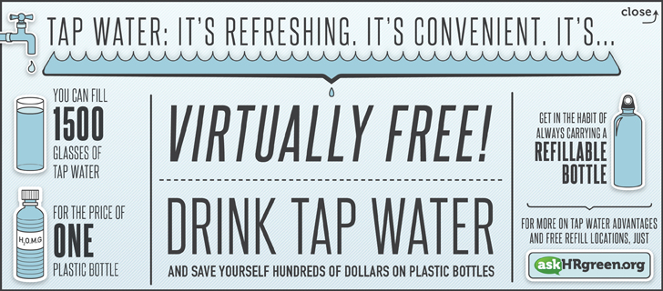
RETHINK WATER Save resources-Save Money!

Slide 34
Notes:
OSU’s initiative to offer filtered water to students with refillable bottles.

Slide 35
“Tapped”
Documentary Movie Trailer

Slide 36
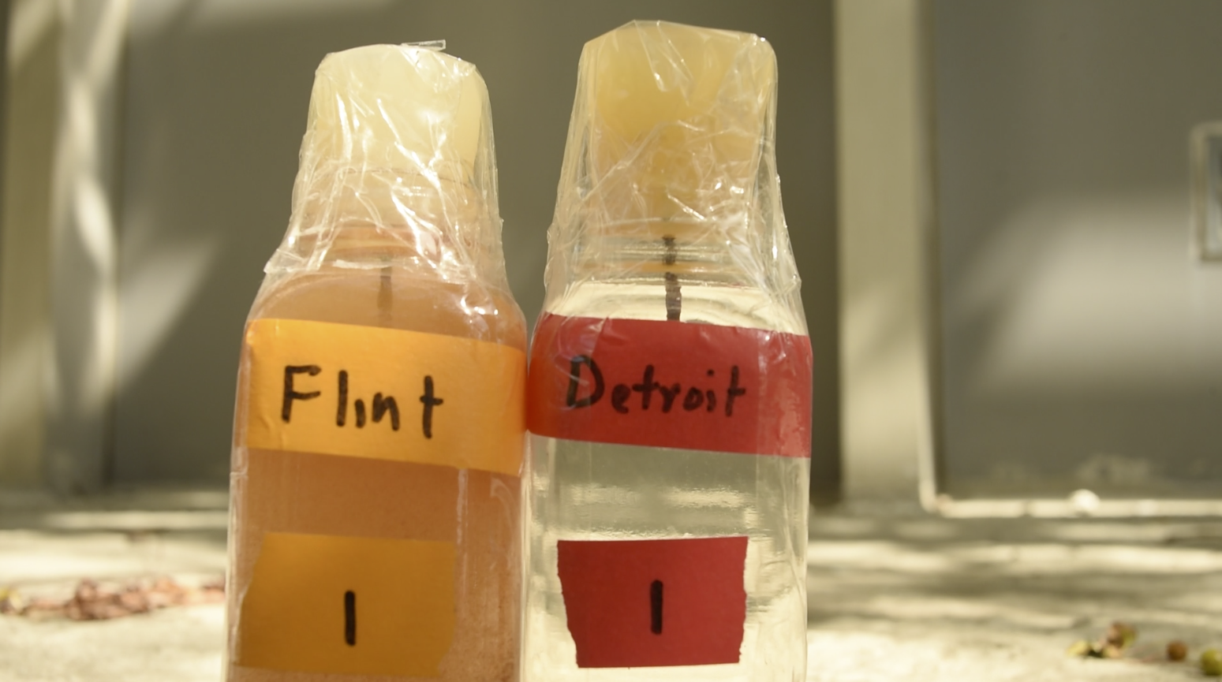
“Arguments for or against bottled water are more than environmental or economic—they have deeper psychological, philosophical, and ideological implications and social subtexts.”
-Peter Gleick, Bottled and Sold

